Slide 1
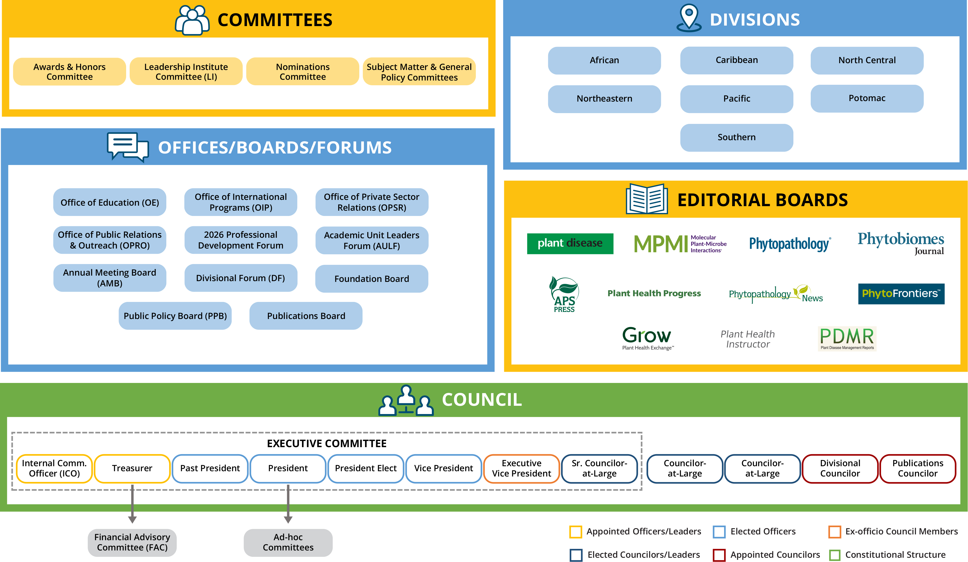
Notes:
KATY: Let’s talk about how you fit in. This organizational chart conveys the breadth and structure of APS. Given its size it is complicated. This chart is posted in the governance section on the APS website.
https://www.apsnet.org/members/leadership/apsleadership/Documents/APS_Org_Chart_2020.pdf
Subject matter and general policy committees ‘report’ directly to Council through their liaisons, the Councilors at Large. Your Councilor at Large is your key contact for questions support and access to the Council. They will reach out to you several times per year and will join your meetings as they are able.

