Slide 1
AgriLife Center TV Wall Tips
Let the Creativity Roll
With 28 screens, two computers, a DVD player, and satellite service, the TV Wall can do just about anything you can dream up. Want to recognize award winners in a huge way? Want to create a larger-than-life slideshow? How about watching the BIG game on the BIG screen? Or maybe you've always dreamed of a 20’ holiday fireplace... it can do it all.
TV Wall Features
28 Screens
46” LCD Flat Panel Displays
1920 x 1080 Resolution
Blu-Ray DVD Player
Satellite TV Service
State-of-the-Art Sound System
Handicap-Accessible Stage
Removable Podium and Microphone
PC Laptop and Wireless Clicker
AV Tech to Operate System
Texas A&M AgriLife
556 John Kimbrough Boulevard
College Station, TX 77843-2140
Phone: 979.458.4910
agrilife.org/agrilifecenter
Our TV Wall is extremely unique, both in capabilities and size. So here are a few helpful hints to get you started on creating an amazing presentation.
Here are a few things you’ll need to know:
1. It’s 16x9! If you’re building your presentation in PowerPoint, go to Design > Page Setup and set it to 16x9.
2. It’s PC. Our system is equipped with two PC computers, so if you are using a Mac, be sure to test your presentation on the screen at least a day before your event. In our experience, most presentations created on a Mac computer need fonts and sizing to be adjusted.
3. It’s a grid. With 28 screens, our TV Wall does have a lot of mullions (black bars). So be sure your presentation isn’t too text heavy and use a large font size. For easy placement, use our PowerPoint template (last page) so you’ll know where the mullions are.
4. Be Cautious. When you change the size of an existing PowerPoint, the text will be fine, but the photos will be stretched or squished. On a PC, you should be able to right click the photo and “reset” the image. Once it’s reset, grab a corner and be sure to hold down the “shift” key as you resize it. The shift key keeps the photo in proportion so you can’t accidentally stretch or squish the image
5. It’s all about the beta test. At least a day before your event, email your presentation to brittany.allen@ag.tamu.edu or bring a USB to the AgriLife Center. If you’d prefer to use your own laptop, please let us know at least a day ahead of time.
And remember, we’re always here to help!

Slide 2
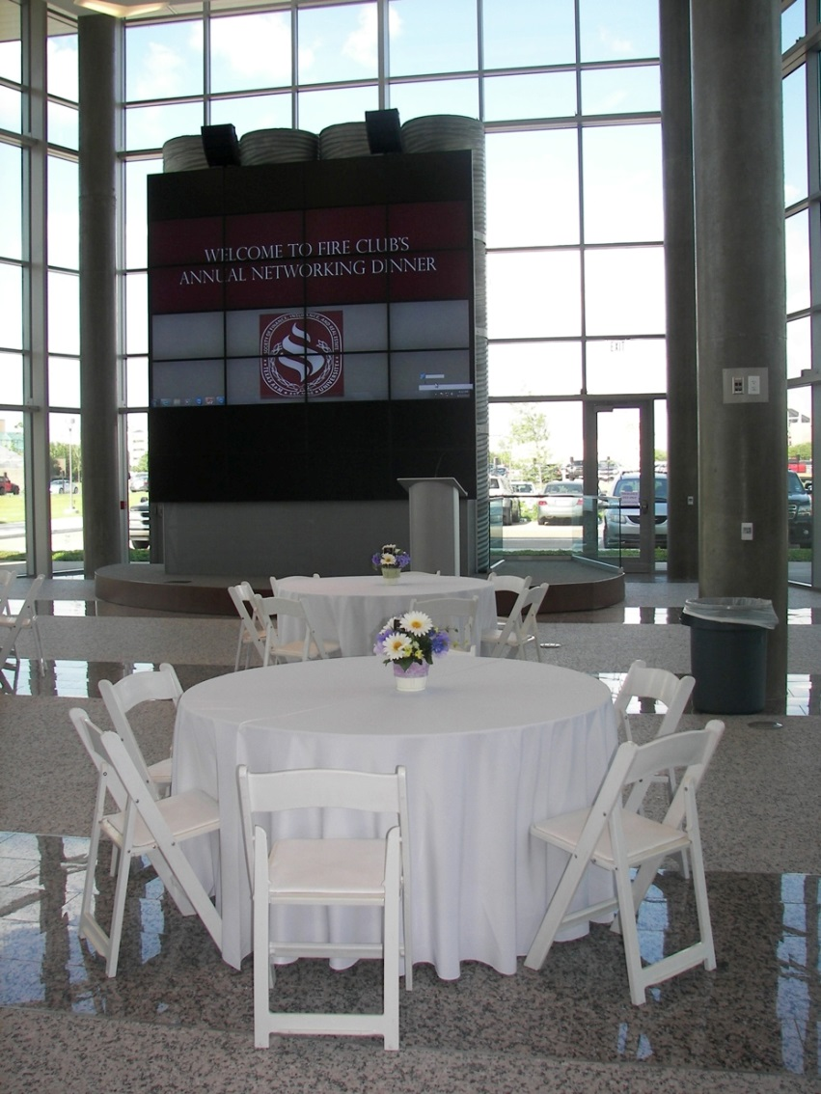

Slide 3
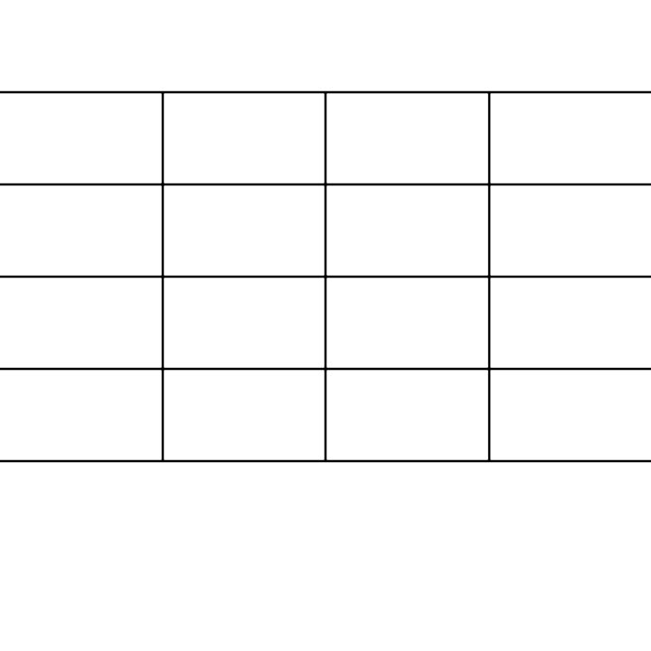
Sample Grid
4x4
This grid represents where the mullions are on the TV wall. Use it to help with placement of photos and text.

