Slide 1
NPDRS Generic Template Project
Phase 3
Neil McRoberts
Carla Thomas
Judy Brown

Slide 2
Phase 2 Outcomes
Plant Disease Feature Article published on process, the 37 characters, and the four resulting plan groups
  Air-borne
  Soil-borne
  Actively vectored
  Passively vectored

Slide 3
Phase 3 Activities
Gold Standard Lead Authors rated the 6 new NPDRS plans that were written since the generic project began.
These rankings were combined with the 14 rankings of gold standards in Phase 2.
The results were compared with the results of the 14 rankings in phase 2 to see if additional plans improved or degraded the 4 groups of plans.

Slide 4
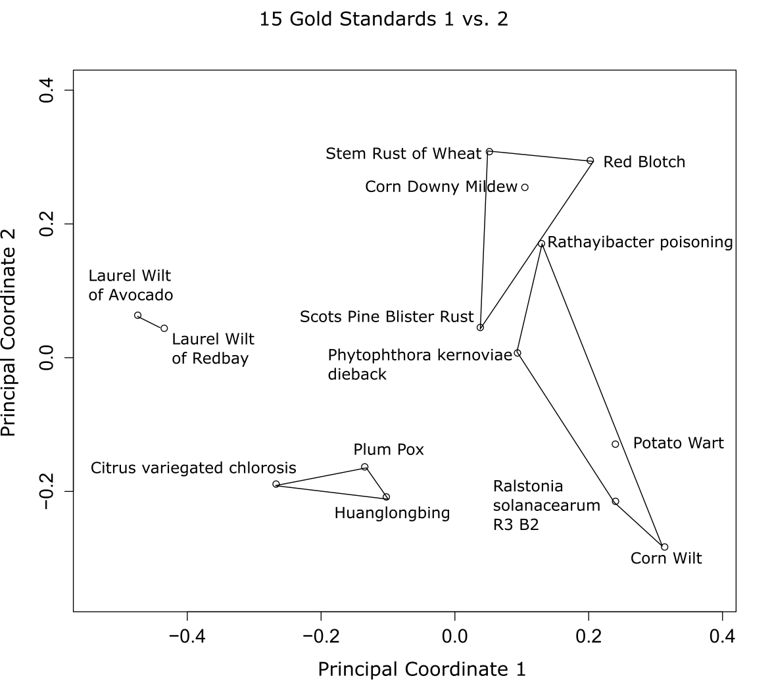

Slide 5
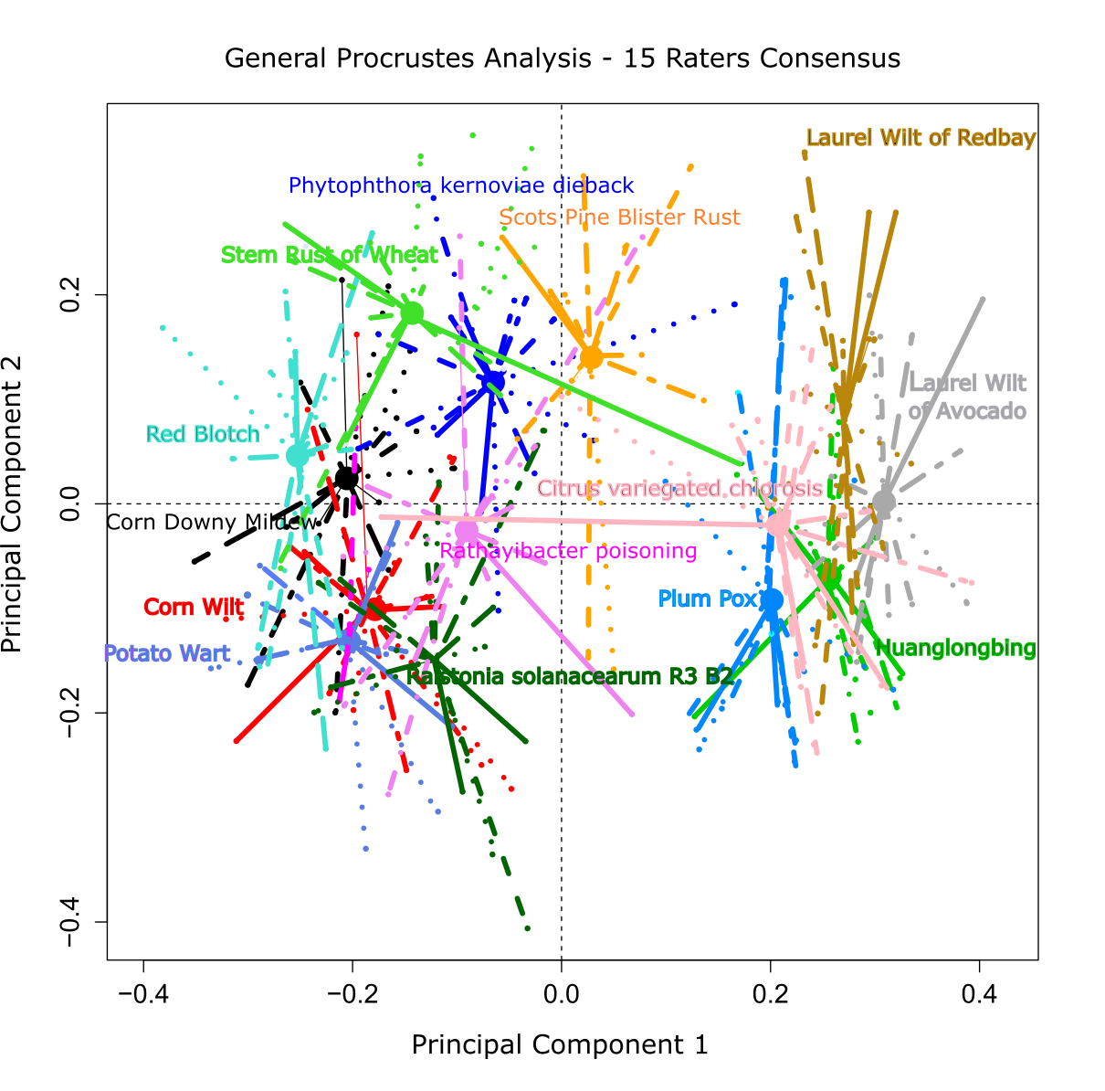

Slide 6
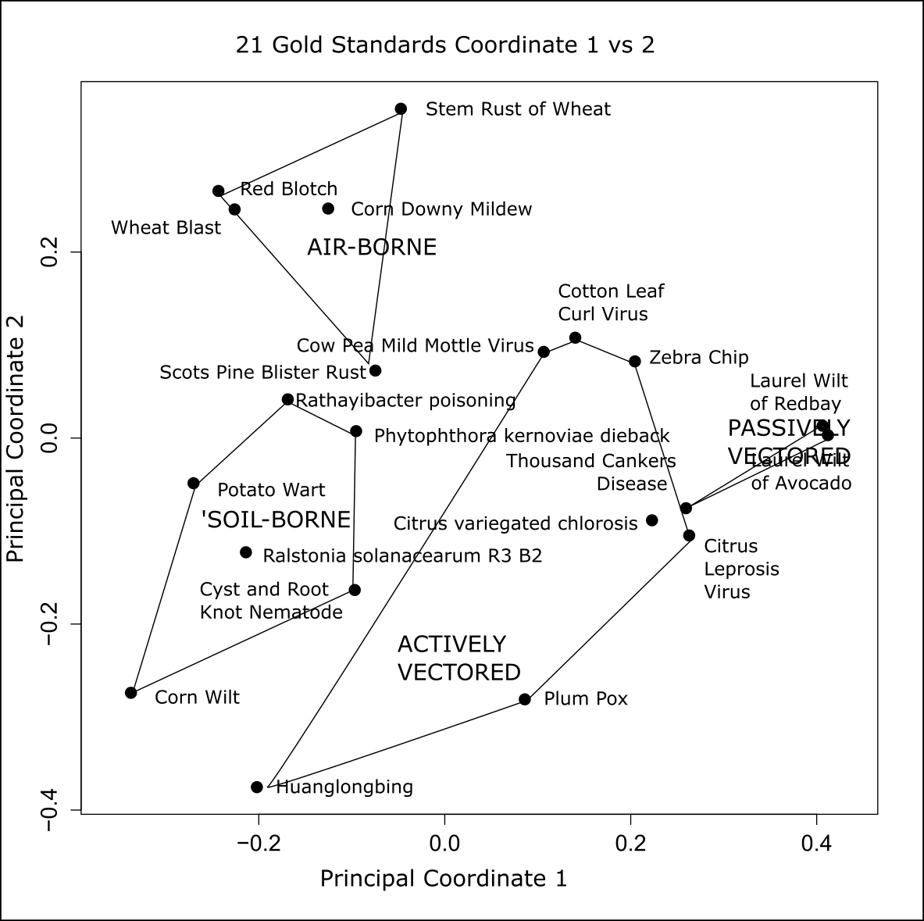

Slide 7
Project History
Phase 1 - create a set of parameters that are key to differentiating categories of NPDRS plans
  A team of five plant pathologist met and identified 37 Characteristics that separated the existing 14 plans into 4 different groups.
  Four of the team then rated each plan topic for the 37 characters for each of the 14 existing plans. A sixth plant pathologist ran a principal coordinates analysis of ratings. 4 groups emerged.
Phase 2 – 14 additional plant pathologists rated each plan for the 37 characters for each of the 14 existing plans. The lead author (gold standard) for each plan was asked to rate their plan for the 37 characters.
  The four groups remained and the clusters were statistically more significant when 14 additional ratings were added. The gold standard ratings analysis maintained the same 4 groups.
  A Plant Disease Feature Article was published on these findings.
Phase 3 – Six new plans were created in the interim. Lead authors rated their own plan for the 37 characters. An analysis of all 21 gold standard ratings was conducted.
Manuscript in preparation describing statistical approach as Special Report for Plant Disease.

