Slide 1
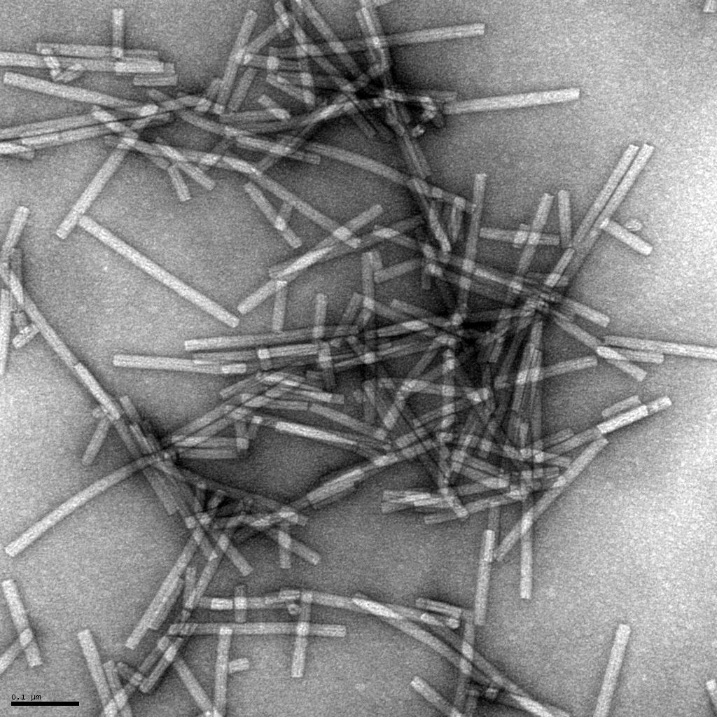


CGMMV Recovery Plan and Research
Tera Pitman, MS
Bryce Falk, PhD

Slide 2
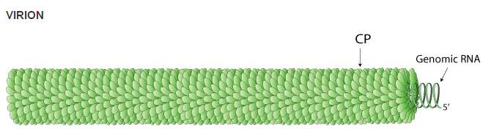
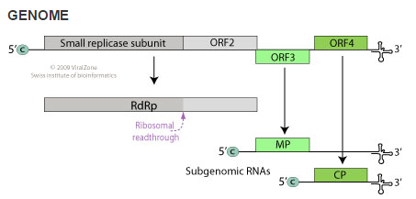
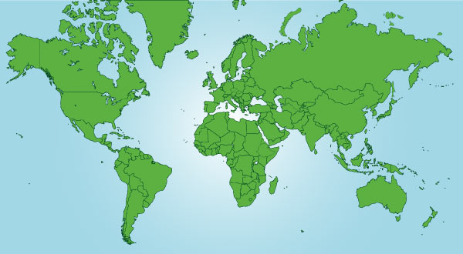
Cucumber Green Mottle Mosaic Virus
6422 nucleotide genome
Group IV +ssRNA virus
Top image from viralzone,expasy.org, produced by the Swiss Institute of Bioinformatics.
Bottom image from NCBI.NIH.gov accession NC_001801.1, National Center for Biotechnology Information.

Slide 3
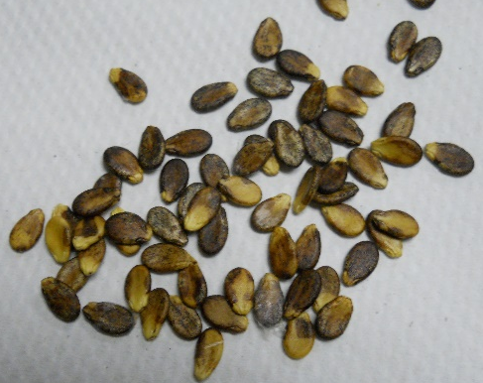
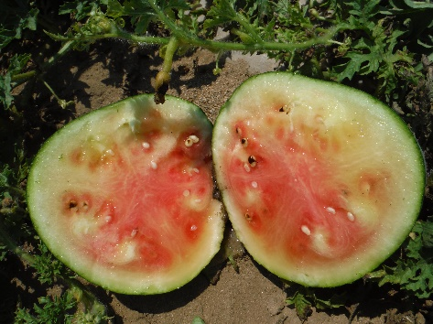
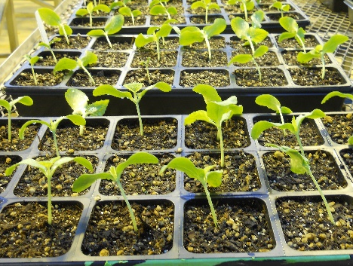
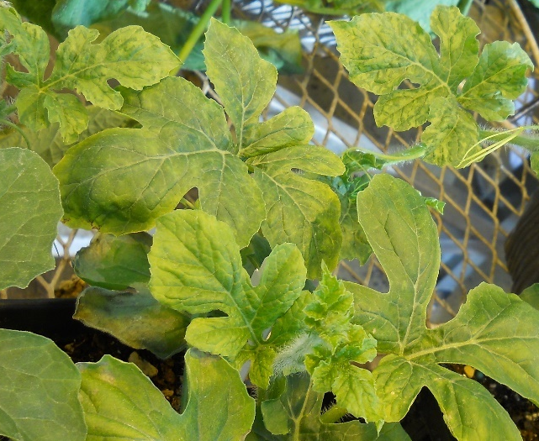
Disease Cycle
Contaminated seeds
1%-5% infected seedlings
Infected fruit
Secondary spread by mechanical transmission, infection rates up to 100%

Slide 4
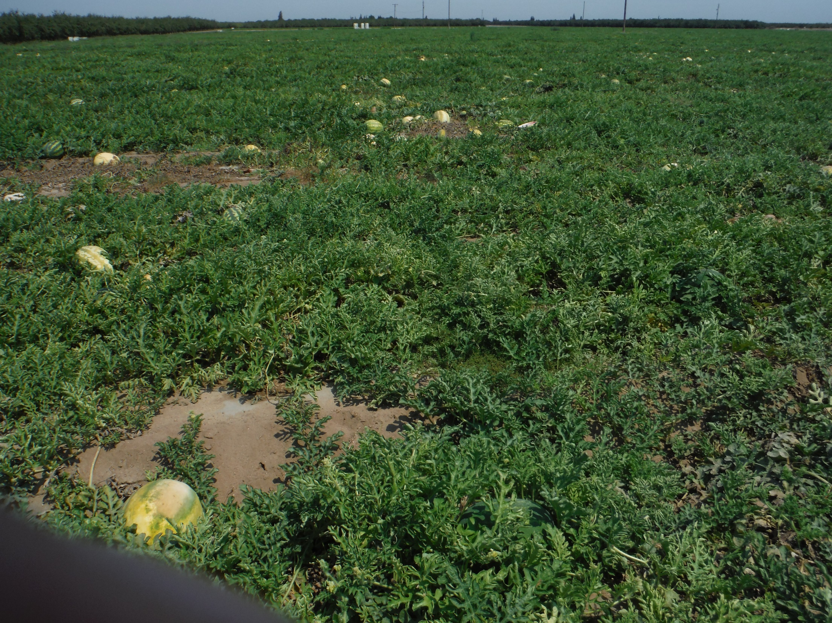
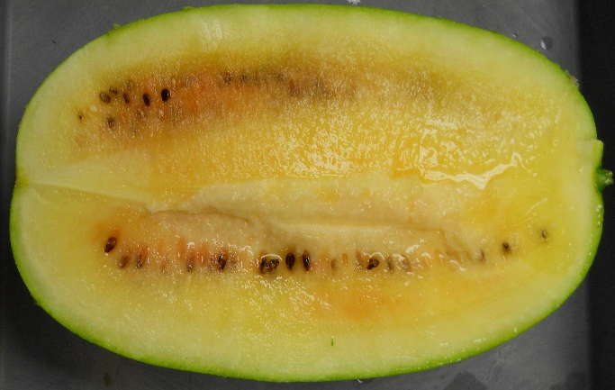
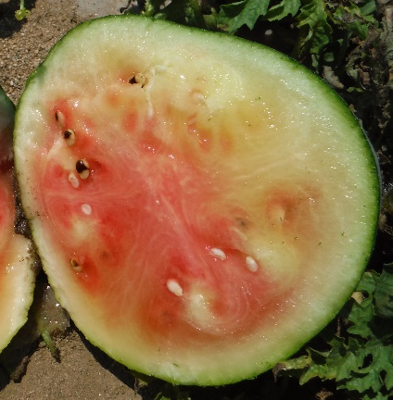
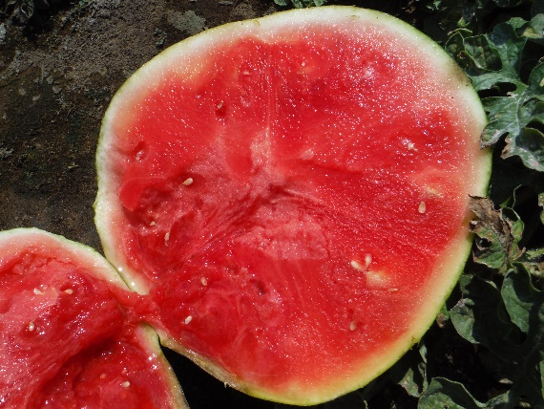
San Joaquin County, 2014

Slide 5
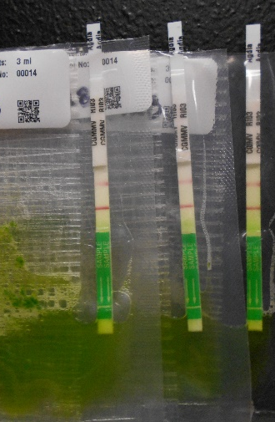
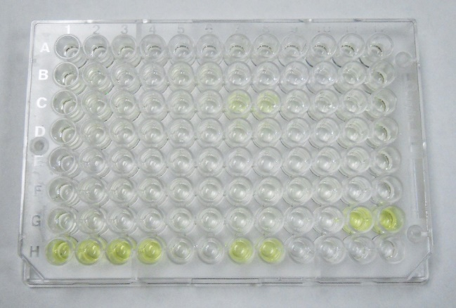
Testing methods
DAS-ELISA
RT-PCR
RT-qPCR
Immunostrips

Slide 6
Seed Testing
Dilution: # contaminated seeds/# total seeds; healthy and contaminated seeds were watermelon

Slide 7
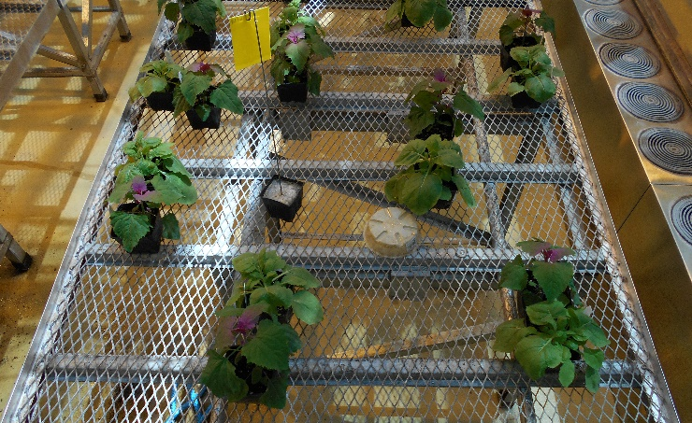
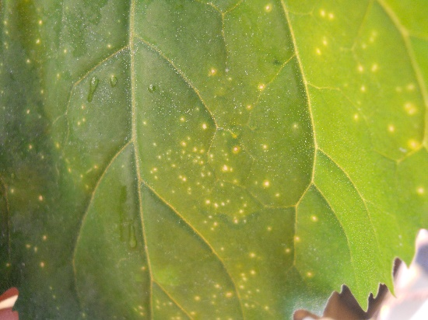
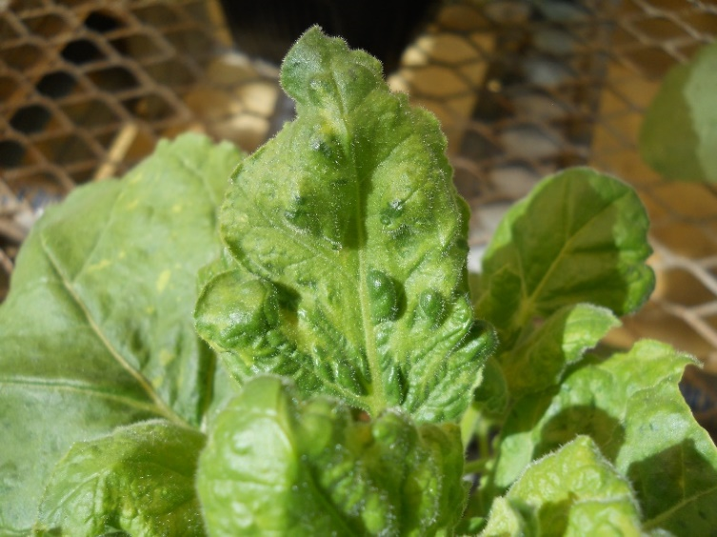
Bioassay
To confirm infectious virus
Rub inoculate both Nicotiana benthamiana (Nb) and Chenopodium album ssp. amaranticolor (Caa)
  Reducing inoculation buffer
  carborundum
Symptoms take up to 10 days to develop
For Nb systemic infection, test upper newest leaves with RT-PCR or ELISA
Caa local lesions, excise local lesions and test with RT-PCR or ELISA

Slide 8
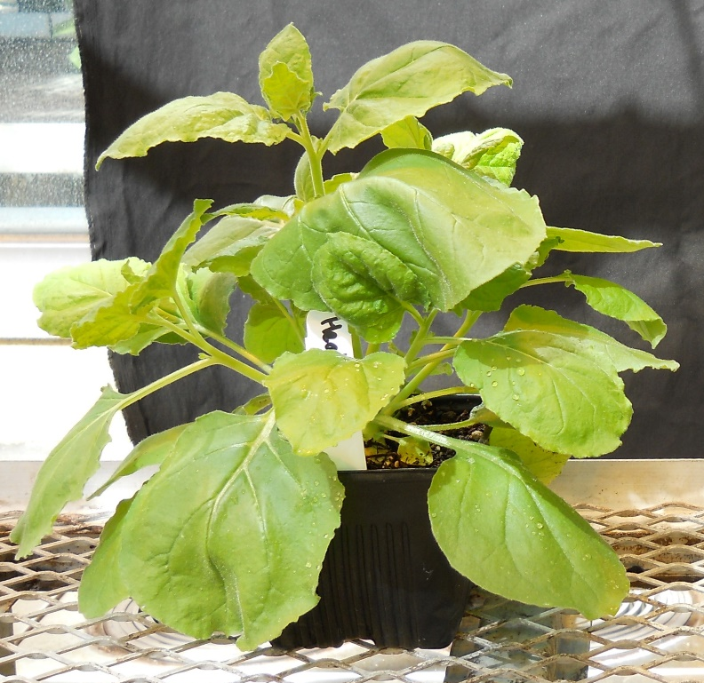
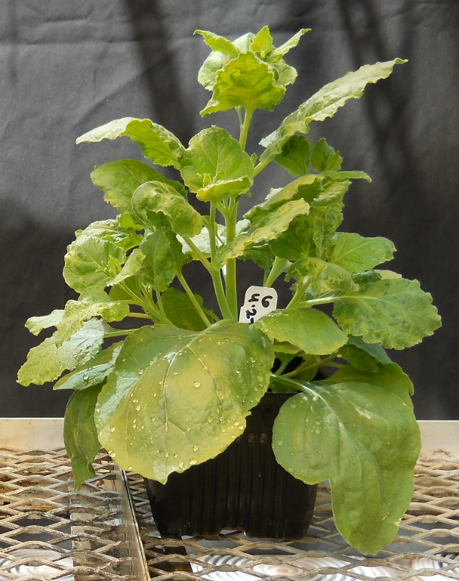
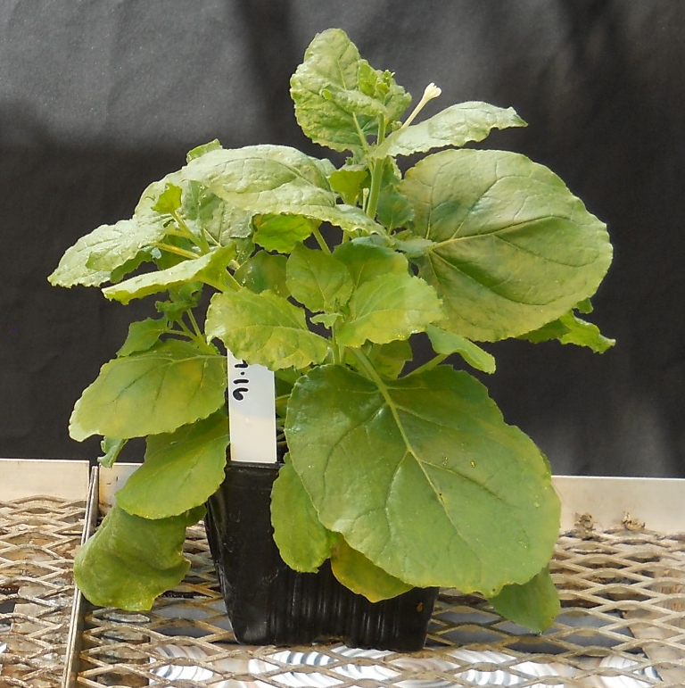
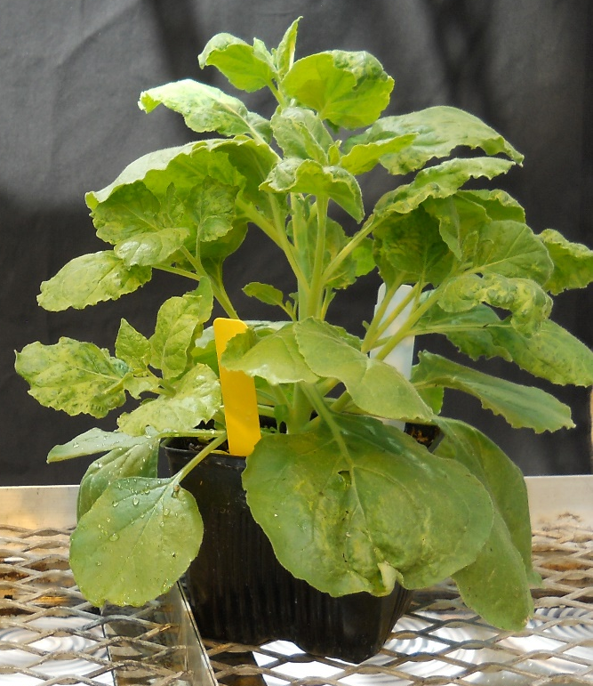
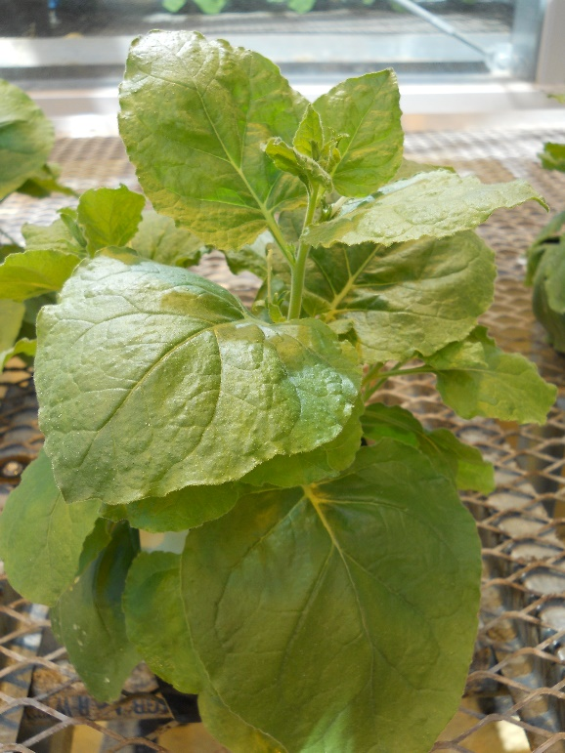
Healthy
CGMMV
CGMMV
CGMMV
CGMMV
Nb 20 days post inoculation. Symptom expression begins as early as 5 dpi, if Nb are at 4th true leaf when inoculated. Not all isolates cause strong symptoms in Nb despite systemic infection.

Slide 9
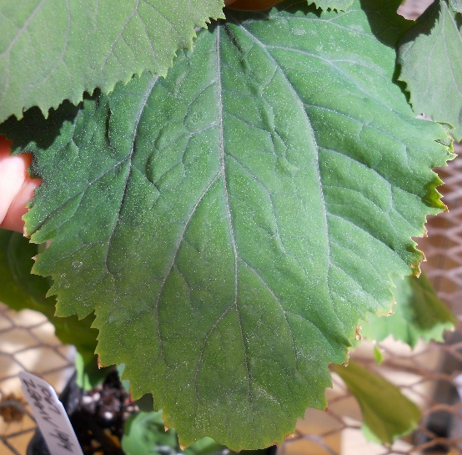
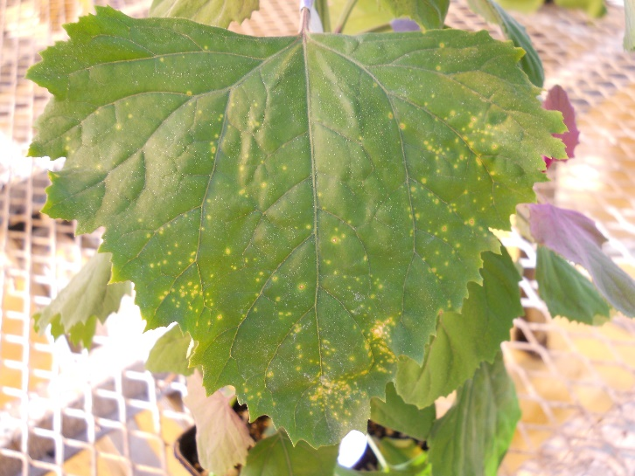
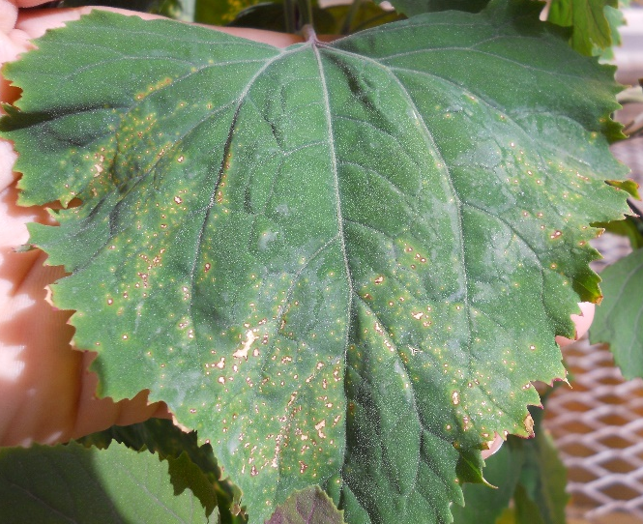
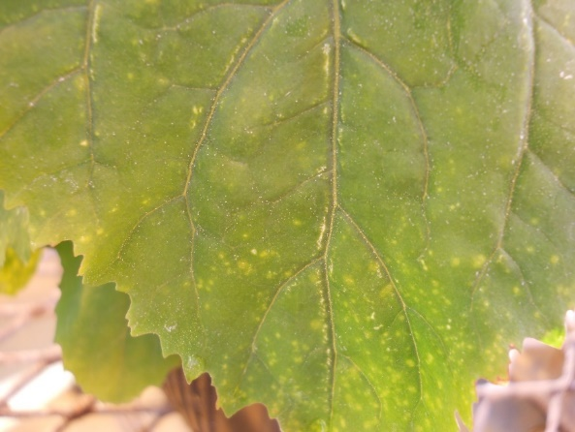
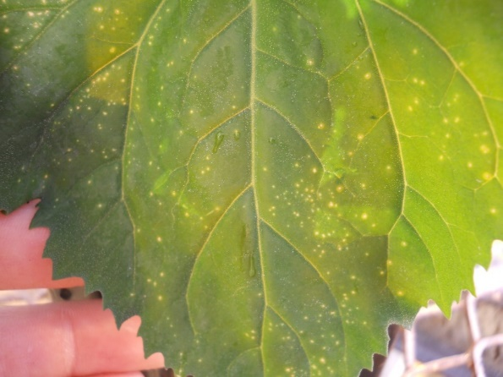
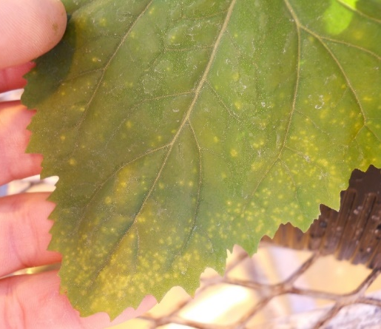
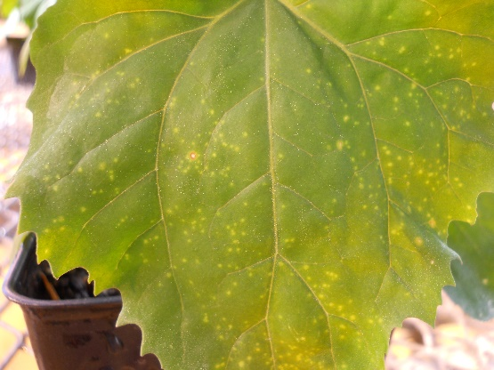
ATCC1067 ZGMMV no local lesions
Fresno local lesions
ATCC391 (Japan) local lesions
SJ local lesion
Israel local lesion
Kern local lesion
10 days post inoculation: all isolates have distinct local lesions
Yolo local lesion

Slide 10
Isolate Collection
California isolates: 3 unique isolates, 4 total
American Type Culture Collection: 1 CGMMV (Japan), 1 zucchini green mottle mosaic virus
Middle East: 1 isolate
Europe: 26 isolates
SE Asia: 4 isolates
37 total isolates

Slide 11
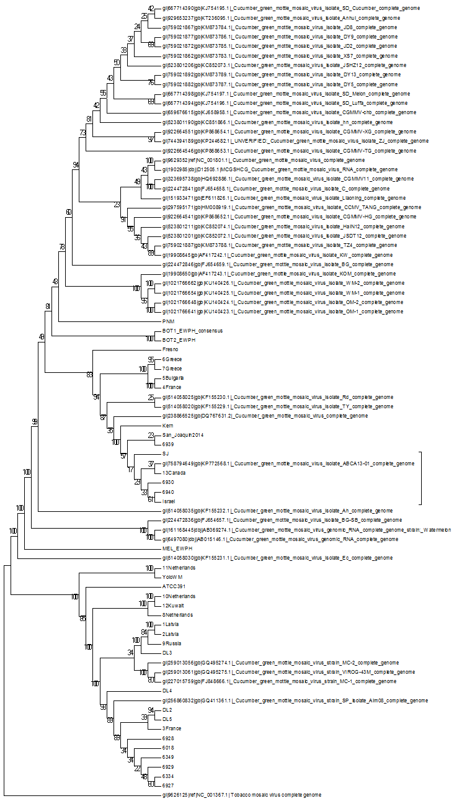
Phylogenetic analysis includes 46 full genome sequences from GenBank, and 36 sequences from international collaborators and California outbreaks.
The 36 additional sequences were generated from NGS sequencing of purified virion RNA. Analyses are ongoing.
China
Korea
Taiwan
Korea
Israel
India
Canada
Israel
Korea
Taiwan
Japan
Israel
Spain
Russia
Spain

Slide 12
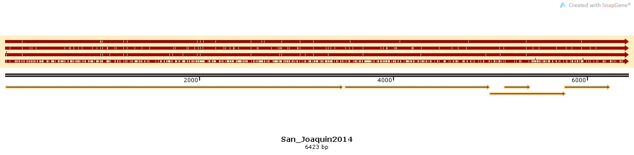
Full genome sequence alignment, North American isolates
1
2
3
4
5
Canada 2013 isolate
Fresno 2014 isolate
Kern 2014 isolate
Yolo 2013 isolate
San Joaquin 2014 isolate

Slide 13
Continued funding/future work
Finish CGMMV recovery plan, currently under review with collaborators
We received Farm Bill funding, grant #3.0323.00 “Enhancing the sensitivity, efficiency and accuracy for detecting Cucumber green mottle mosaic virus in cucurbit seeds.” Beginning in August
Go forward with qRT-PCR work
Complete sequence analyses
Optimize seed RNA purification or other molecular testing method

Slide 14
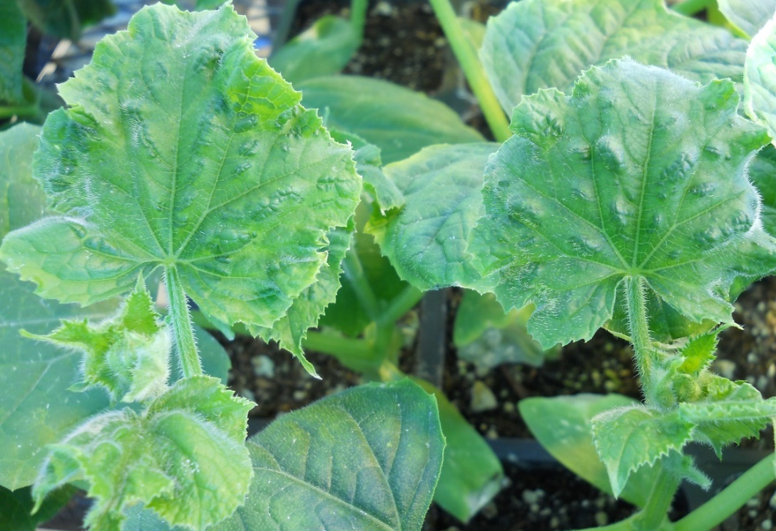
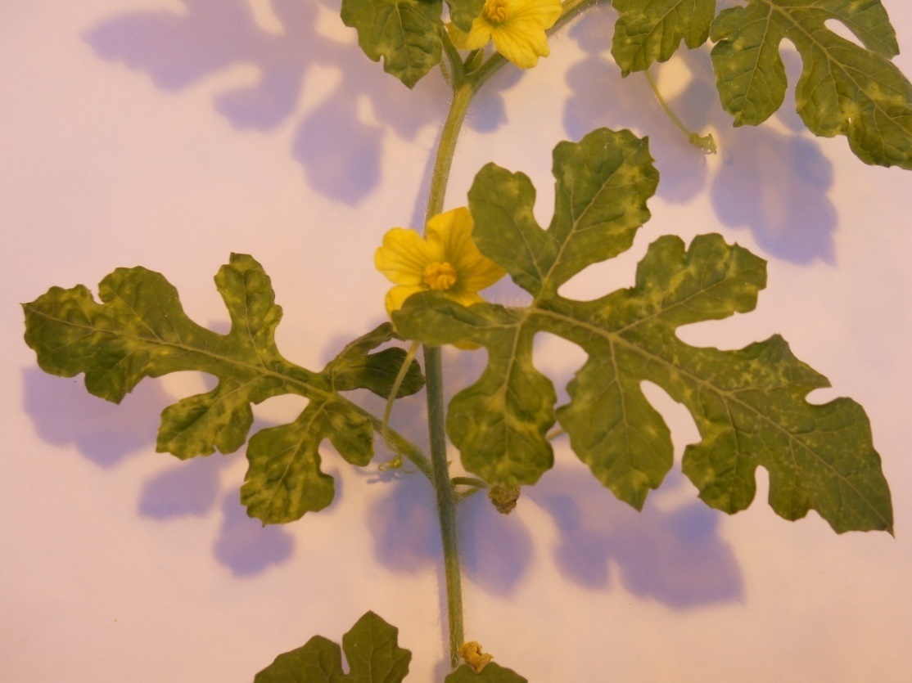
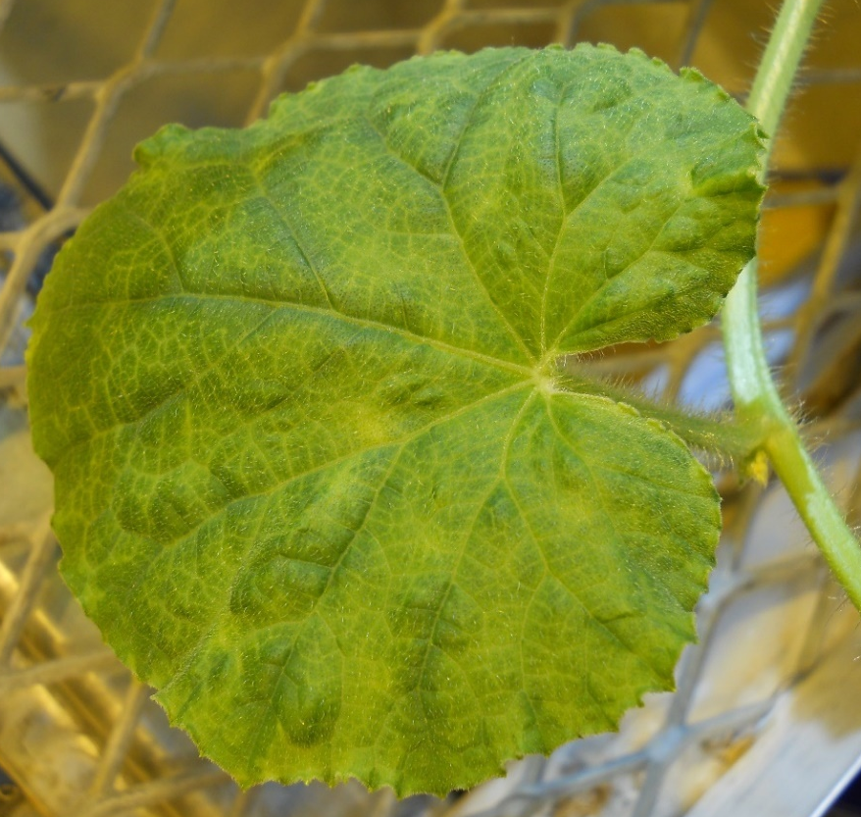
Questions?
Watermelon
Cucumber
Cantaloupe

