Slide 1

Using this Slide Deck
This slide deck is like a workbook. Add in and take out what’s needed.
Use the template slides that work for your presentation. Right-click>Duplicate Slide as needed. Delete the others.
Update an image – Right- click > Change Picture.
The notes panel for some slides contains suggested script. Update this script as needed.
Add your thoughts about the topic into the Notes Panel. Print notes prior - File>Export>Create Handouts>Notes below slides OR use multiple monitors so the notes panel can be visible.
Contact your SciSoc program manager for support as needed.

Slide 2
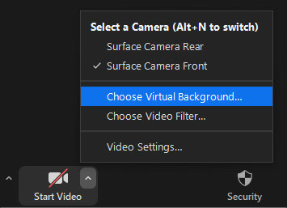


Prepare Event Systems
Check audio input/output
Mic’d setup works best for quality volume and clarity
Set your background
Actual or virtual background
Confirm proper lighting
Natural or artificial lighting from the front of your view
Contact your SciSoc program manager for support as needed.

Slide 3
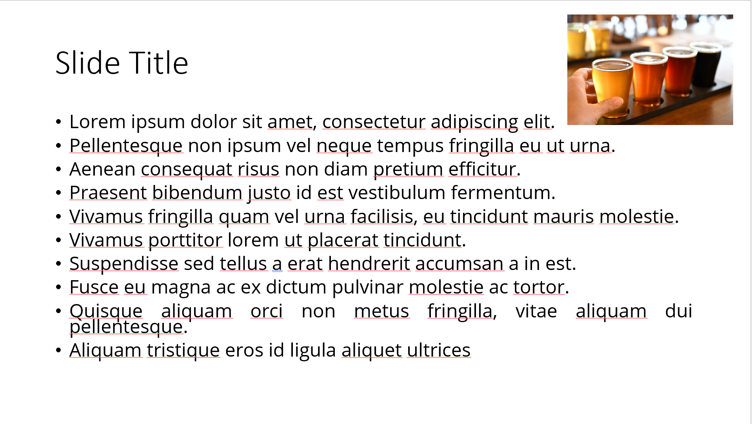
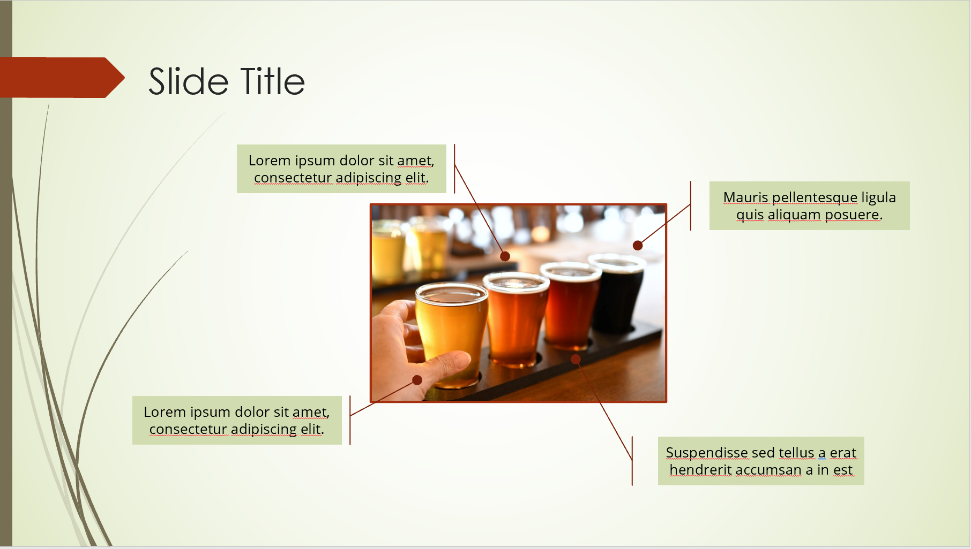
Ensure Slide Clarity
Contact your SciSoc program manager for support as needed.
Notes:
The clarity of your slide and what you put on it should enhance your message.
Ensure the following:
Ample white space. Don’t crowd the slide.
Ideally 1-2 ideas discussed per slide.
Avoid dense bullet point slides and a content dump. Put those details in your notes instead.
Aim for foreground/background color contrast.
Use purposeful images or illustrations that you can talk to from your presenter notes.

Slide 4
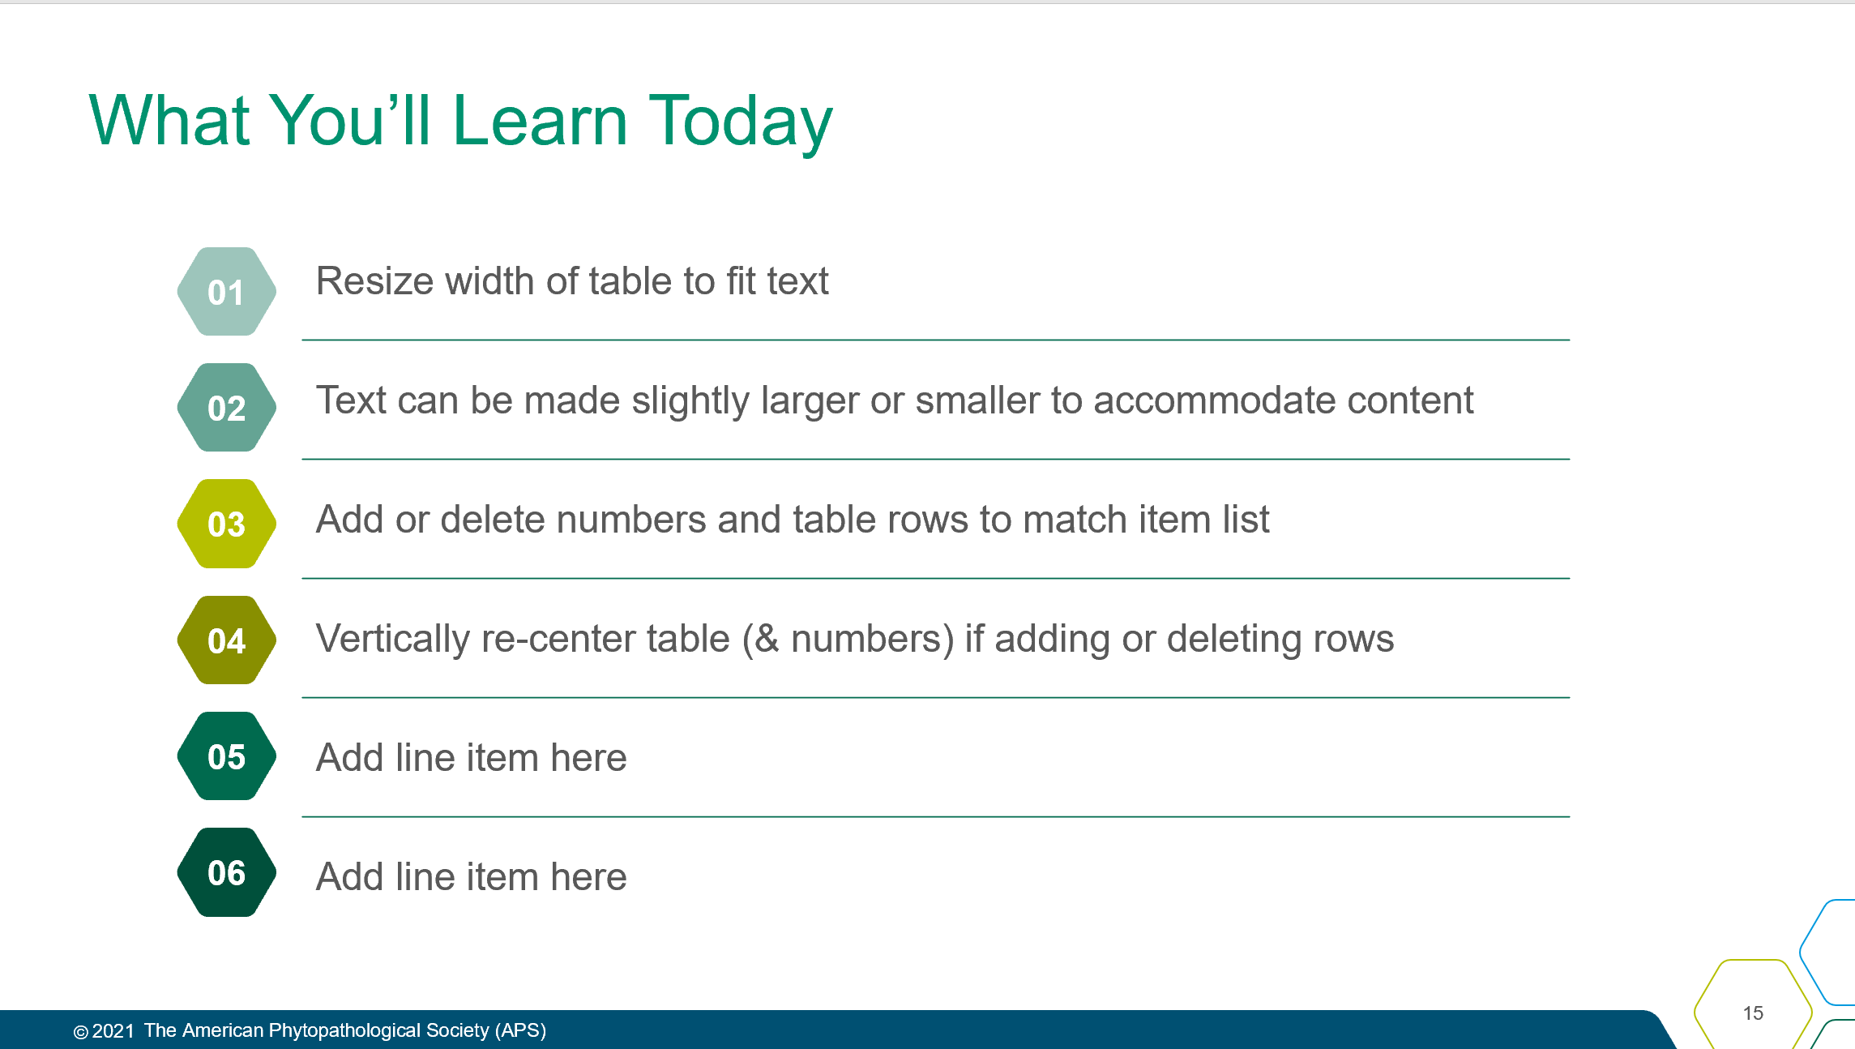
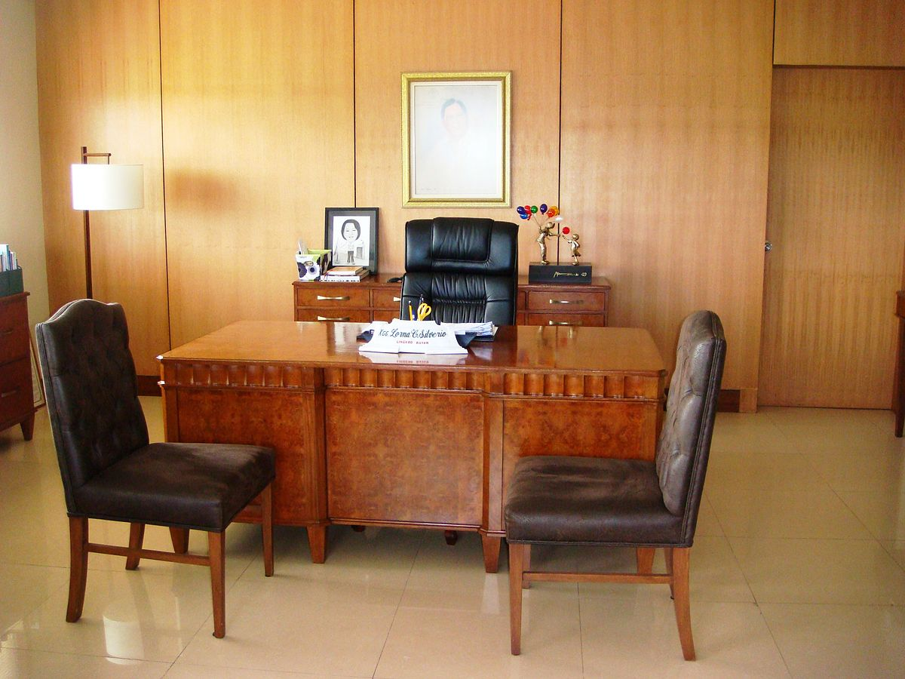
Engage the Attendees
Take a look at the topics we’ll cover today. Type into Chat which one interests you the most.
Let’s kick off today's session with a poll! Tell me which of todays topics most interests you?
If we get a strong result in one direction it can help guide the timing of our topics.
OR
POLL
topic 1
topic 2
topic 3
Contact your SciSoc program manager for support as needed.
Notes:
An engaged attendee is one that does minimal multi-tasking during your session. They should be energized and enlightened by the experience, confident applying what they’ve learned or a better understanding of the topic and be an association advocate with nonmembers to help grow our member knowledge to continue sharing and networking.
Presentation goals:
Connect the presentation outcomes to their work world. What are challenges spurred them to register? At presentation end, what content nugget can they apply immediately back at work?
Interact with attendees: Polls, commenting in chat, breakout rooms, etc.
Advance the slide every 1 minute with 1-2 topics per slide.
Capture attention with compelling graphics, video, and charts. Avoid dense bullet point slides.
Address attendees by name when possible.
Encourage attendees to share ideas and information using various virtual modalities. Ideally respond to Questions as they come in and not wait until the end of the presentation. This would require the moderator to review the Q&A panel for timely questions.
Share additional resources to extend the learning outside the presentation (websites, social media, linked documents, etc.).

Slide 5

Get Copyright Permission
Contact your SciSoc program manager for support as needed.
Notes:
As a reminder, you must own or have permission to use all media (images, illustration, video) or documentation used in this presentation.
This is an issue that can have financial repercussion to your association and one we are careful to adhere to.

Slide 6


Title Here
Click on photo to replace

Slide 7

[insert presenter name]
REQUIRED (UNLESS SHARE LIVE)
Background/Education:
Current job/role:
Areas of interest:
My unique:
Notes:
DO:
Introduce yourself.
Put highlights on slides, but detail in what you say.
Use bullets as needed but keep them concise. Share: Background/Education, Current job/role, focus in this session, and something fun or memorable to share. Remember this is also networking so what would be helpful for others to know to make a connection, e.g. email, Twitter handle, phone #, etc..

Slide 8
What You’ll Learn Today
Resize width of table to fit text
Text can be made slightly larger or smaller to accommodate content
Add or delete numbers and table rows to match item list
Vertically re-center table (& numbers) if adding or deleting rows
Add line item here
Add line item here
01
02
03
04
05
06
Notes:
SAY:
By the end of this presentation, you will/be able to:
{insert topic or objective]
DO:
Keep these succinct. Actionable ideally. Try to use a similar beginning to each line to ease reading. For example, avoid starting one line with a question “how to …” and another with a verb. You can add a line prior so its easier to start the list, such as “By the end of the presentation, attendees will be able to:”

Slide 9
Title and Content Layout
First list level is unbulleted text
  Increase list level for bullet one
    Bullet two
      Bullet three
        Bullet four

Slide 10
Two Content Layout
First list level is unbulleted (bold if needed)
  Bulleted text
    Bullet two
      Bullet three
        Bullet four
First list level is unbulleted (bold if needed)
  Bulleted text
    Bullet two
      Bullet three
        Bullet four

Slide 11
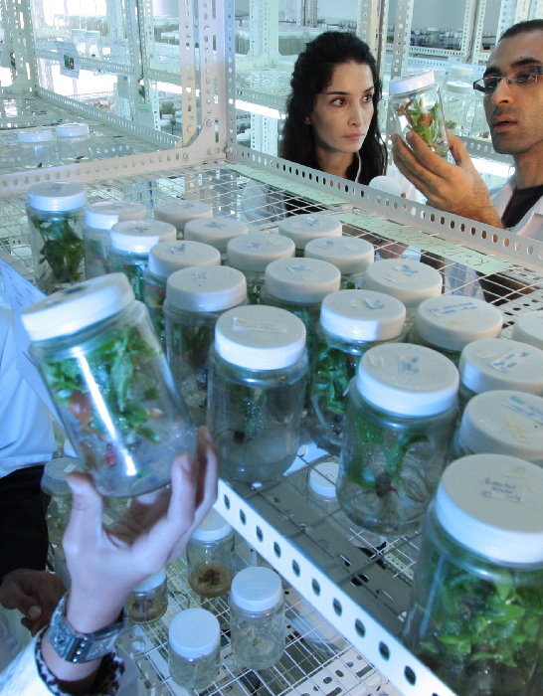
Title, Content & Photo
Click on photo to replace

Slide 12
Chart or Graph
Use simple gray box for callouts

Slide 13
Icons
Icons can be recolored using shape fill. Icons can be used with yellow hex shape (center vertically & horizontally with shape then group). To resize icon and/or shape, use the shift key to keep the original proportions.

Slide 14
Video title

Slide 15

Section Header Layout
Photo can be replaced by clicking on image, deleting and clicking on icon to insert new photo

Slide 16

Breakout Room Discussion
Notes:
NOTE: If you will be using a breakout room, please information your Program Manager ahead of time.

Slide 17

Poll Question
Add poll question
Delete this
shape if no callout is needed
Notes:
NOTE: If you will be using a poll, please information your Program Manager ahead of time.

Slide 18

Activity Instructions
  Add instructions
Delete this
shape if no callout is needed

Slide 19
Notes:
SAY:
It’s time to answer some of the questions you’ve been asking from the Q&A box.
DO:
Make sure to use their name and show appreciation for the comment.

Slide 20

One Thing
that you’ll apply
Notes:
SAY:
Alright, so you’ve heard many great ideas, methods, strategies and similar during my presentation, but which ONE thing you heard today stands out?
What will you either apply back at work right away or that you want to look at further when you leave the session?
Take a moment to consider your ideas or look at your notes and etc. then type it into the chat panel. If you see someone’s idea that you find interesting - feel free to comment back to them. To do this typically you put an @ and then their name and type your thoughts.
I’ll be quiet and give you a few moments to share your thoughts NOW in the Chat panel.
DO:
Watch the chat panel and comment on some of the ideas coming in. Use their name and reiterate the point. “Yes, Jim Smith that was a pretty interesting stat [name] shared on the [fact]” and so on. Use this as an opportunity to ask further questions directly from attendees.

Slide 21

Resources
  Add list of events/publications/etc.
Delete this
shape if no callout is needed
Notes:
SAY:
If you found today’s topic particularly interesting, find ways to continue the learning. We’ve provided a few additional resources to extend the topic outside of this talk. Write them down. Use your phone to take a picture of this screen.
DO:
Locate any additional resources to share with members that extend beyond this presentation – pubs, websites, name people and share email address or other.

