Slide 1

Using this Slide Deck
This slide deck is like a workbook. Add in and take out what’s needed.
Use the template slides that work for your presentation. Right-click>Duplicate Slide as needed. Delete the others.
Update an image – Right- click > Change Picture.
The notes panel for some slides contains suggested script. Update this script as needed.
Add your thoughts about the topic into the Notes Panel. Print notes prior - File>Export>Create Handouts>Notes below slides OR use multiple monitors so the notes panel can be visible.
Contact your SciSoc program manager for support as needed.

Slide 2
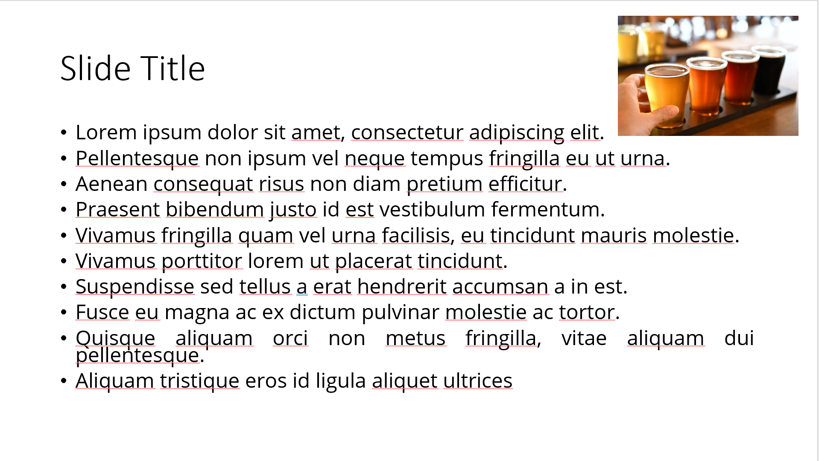
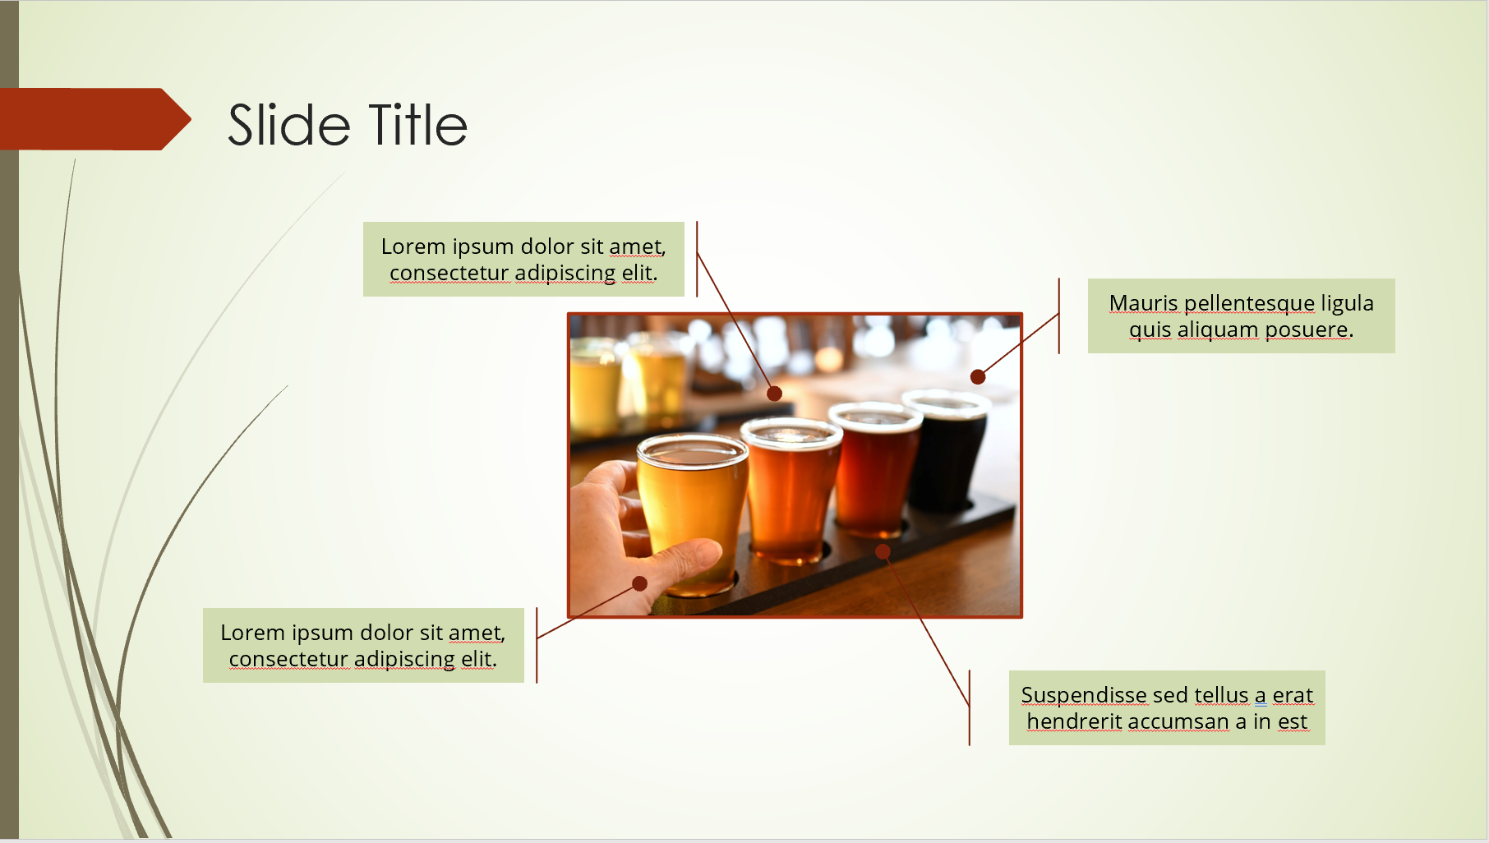
Ensure Slide Clarity
Contact your SciSoc program manager for support as needed.
Notes:
The clarity of your slide and what you put on it should enhance your message.
Ensure the following:
Ample white space. Don’t crowd the slide.
Ideally 1-2 ideas discussed per slide.
Avoid dense bullet point slides and a content dump. Put those details in your notes instead.
Aim for foreground/background color contrast.
Use purposeful images or illustrations that you can talk to from your presenter notes.

Slide 3

Get Copyright Permission
Contact your SciSoc program manager for support as needed.
Notes:
As a reminder, you must own or have permission to use all media (images, illustration, video) or documentation used in this presentation.
This is an issue that can have financial repercussion to your association and one we are careful to adhere to.

Slide 4


Title Here
Click on photo to replace

Slide 5

[insert presenter name]
Background/Education:
Current job/role:
Areas of interest:
My unique:
Notes:
DO:
Introduce yourself.
Put highlights on slides, but detail in what you say.
Use bullets as needed but keep them concise. Share: Background/Education, Current job/role, focus in this session, and something fun or memorable to share. Remember this is also networking so what would be helpful for others to know to make a connection, e.g. email, Twitter handle, phone #, etc..

Slide 6
What You’ll Learn Today
Resize width of table to fit text
Text can be made slightly larger or smaller to accommodate content
Add or delete numbers and table rows to match item list
Vertically re-center table (& numbers) if adding or deleting rows
Add line item here
Add line item here
01
02
03
04
05
06
Notes:
SAY:
By the end of this presentation, you will/be able to:
{insert topic or objective]
DO:
Keep these succinct. Actionable ideally. Try to use a similar beginning to each line to ease reading. For example, avoid starting one line with a question “how to …” and another with a verb. You can add a line prior so its easier to start the list, such as “By the end of the presentation, attendees will be able to:”

Slide 7
Title and Content Layout
First list level is unbulleted text
  Increase list level for bullet one
    Bullet two
      Bullet three
        Bullet four

Slide 8
Two Content Layout
First list level is unbulleted (bold if needed)
  Bulleted text
    Bullet two
      Bullet three
        Bullet four
First list level is unbulleted (bold if needed)
  Bulleted text
    Bullet two
      Bullet three
        Bullet four

Slide 9
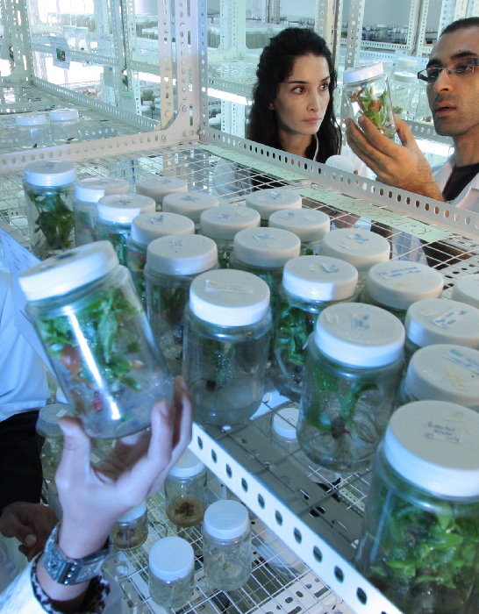
Title, Content & Photo
Click on photo to replace

Slide 10
Chart or Graph
Use simple gray box for callouts

Slide 11
Icons
Icons can be recolored using shape fill. Icons can be used with yellow hex shape (center vertically & horizontally with shape then group). To resize icon and/or shape, use the shift key to keep the original proportions.

Slide 12
Video title
Notes:
If you have video in your presentation, please inform your APS Program Manager so that AV is prepared.

Slide 13

Section Header Layout
Photo can be replaced by clicking on image, deleting and clicking on icon to insert new photo

Slide 15

Resources
  Add list of events/publications/etc.
Delete this
shape if no callout is needed

