Slide 1
Micologia en Ruedas

Slide 2
Outline
Fungi
Fungal structure
Fungal reproduction
Nutrition
Fungi vs. Plants
Ecological roles and uses

Slide 3
Fungi
Eukaryotic organisms
Belong to the Fungi Kingdom
Cosmopolitans
Play important roles
Created in BioRender

Slide 4
Diversity of fungi
18% of all species on Earth
1.5 millon of species
Only 25,000 to 80,000 have been identified
Have diverse morphologies and structures
SPECIES
ON
EARTH
Created in BioRender
Notes:
8.7 millones de espcies en el mundo

Slide 5
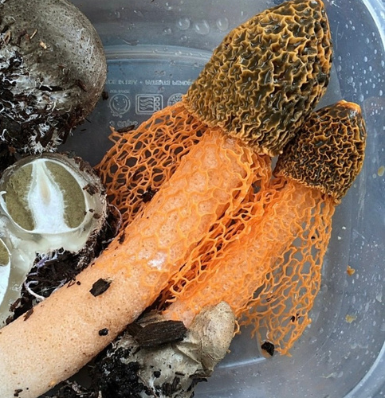
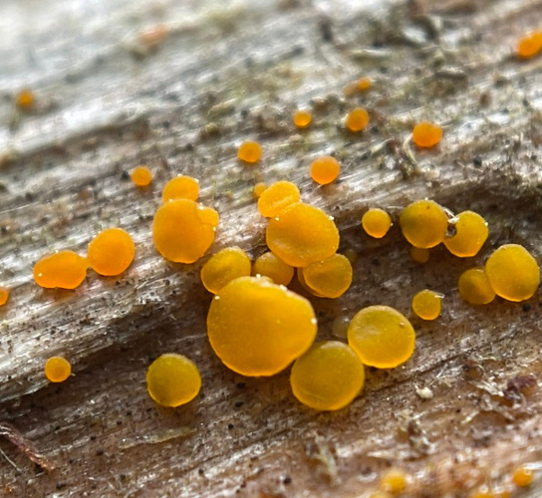
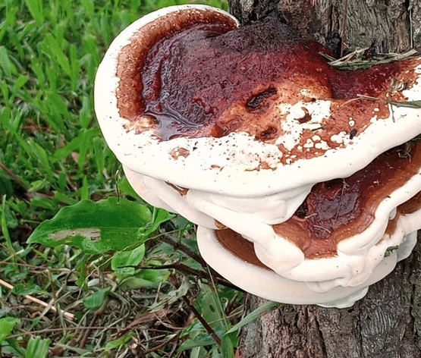
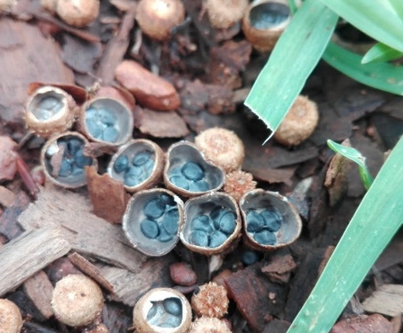
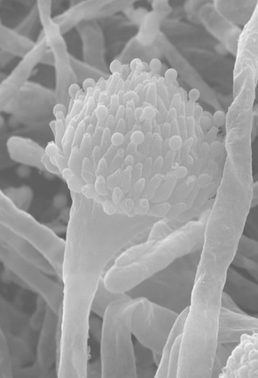
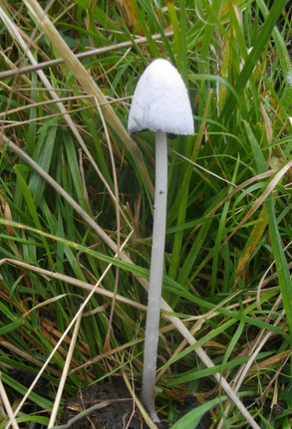
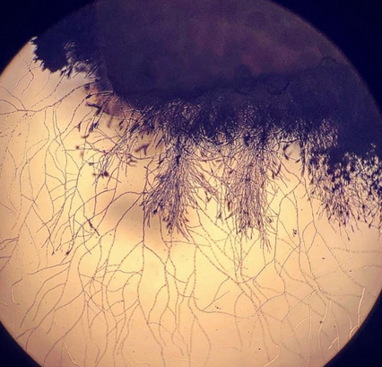
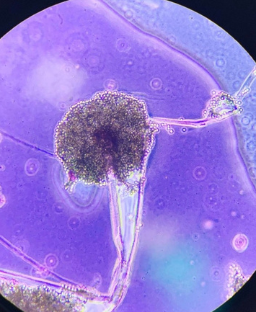
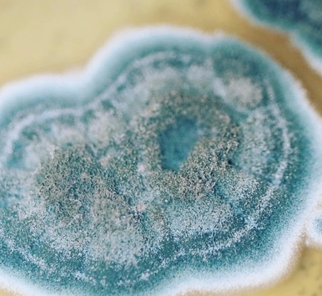
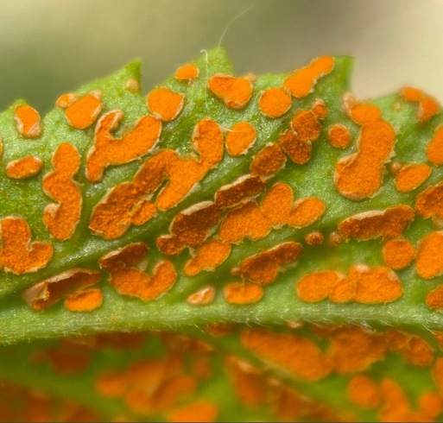
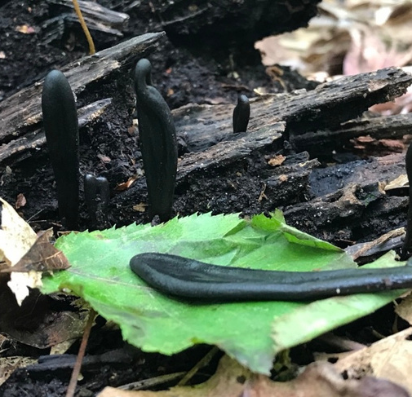
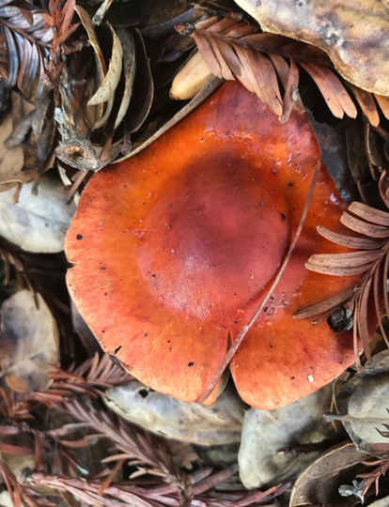
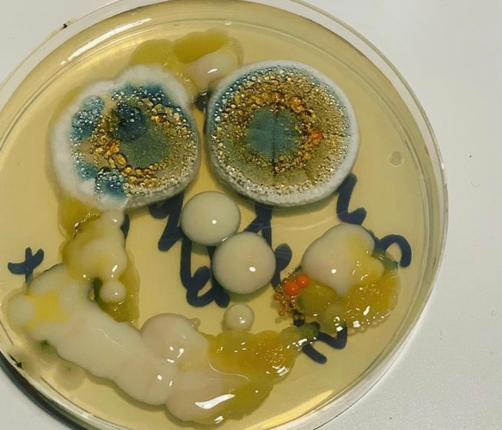
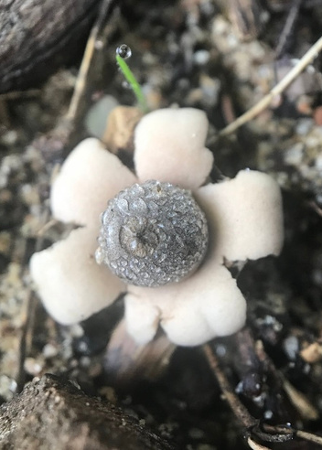

Slide 6
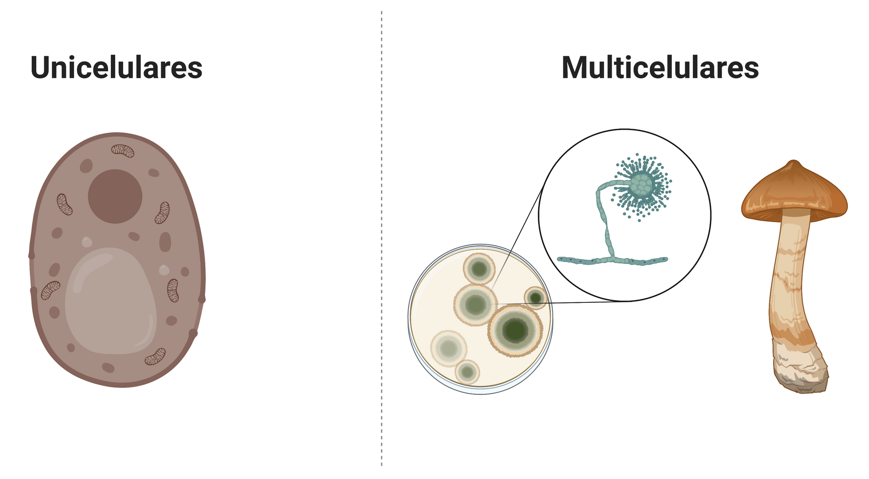
Type of Fungi
UNICELLULAR
MULTICELLULAR
Created in BioRender

Slide 7
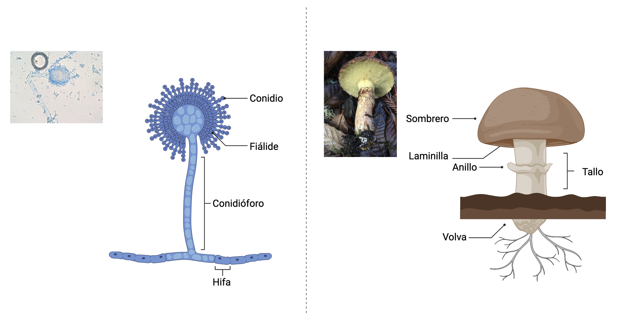
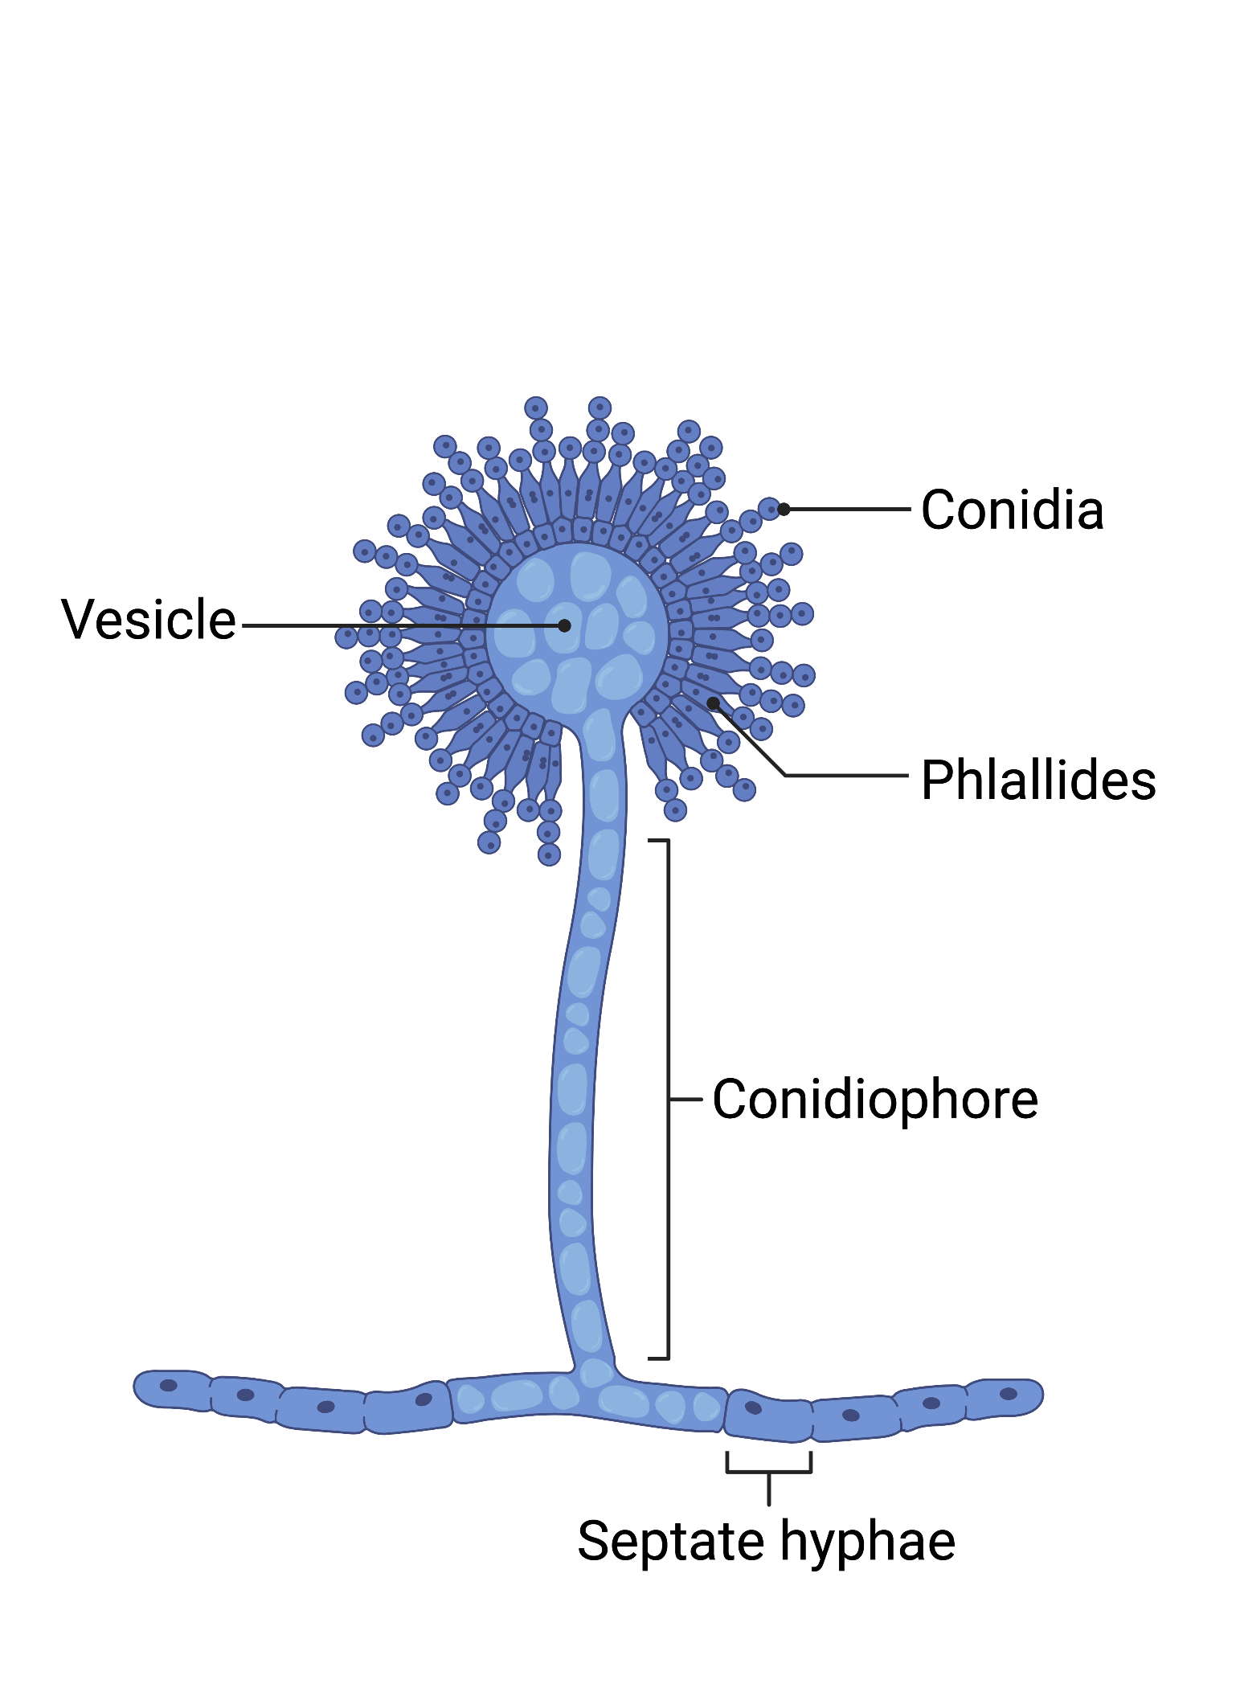
Structure
Created in BioRender
Pictures: Nicole Colón and MycoTwitter

Slide 8
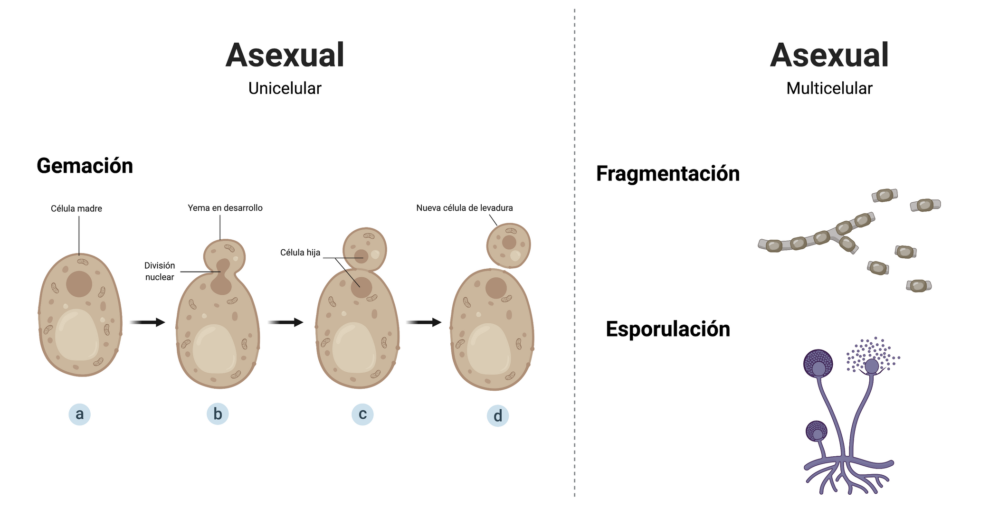
Reproduction
Mot
Mother cell
Bud
Daughter
cell
FRAGMENTATION
Nuclear
division
Daughter
cell
SPORULATION
Created in BioRender

Slide 9
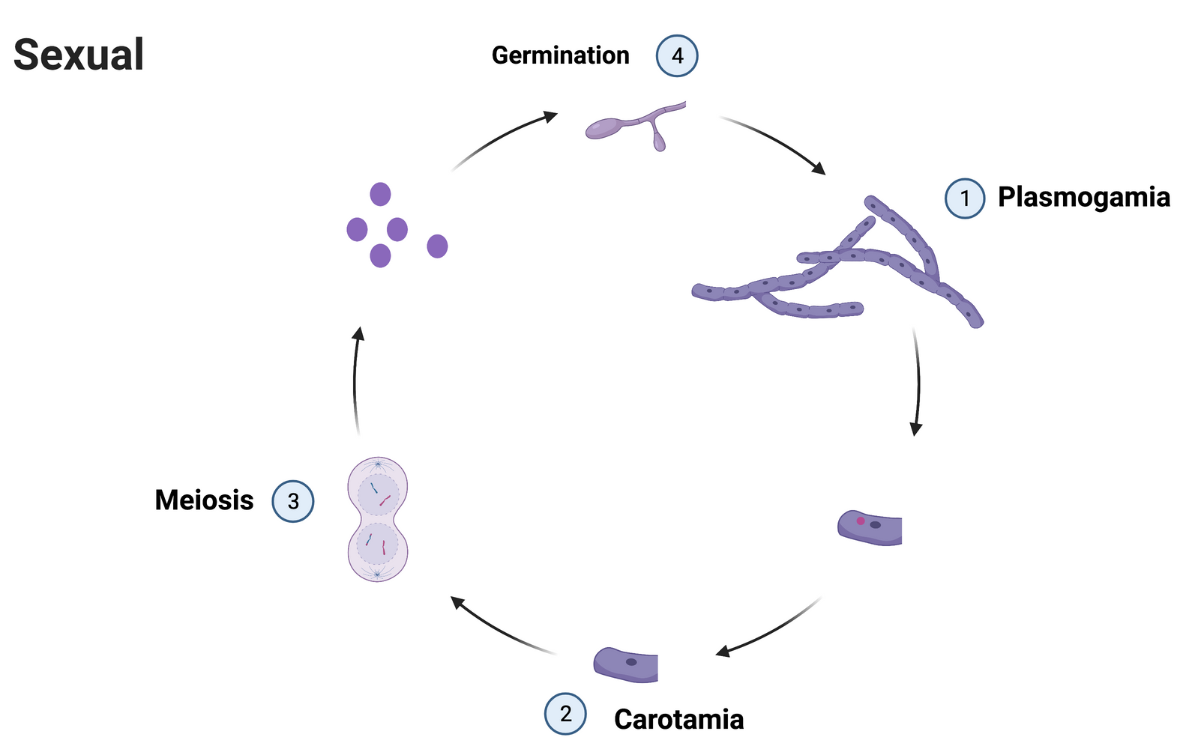
Reproduction
v
v
1- Plasmogamy
2- Karyogamy
3- Meiosis
4- Germination
v
v
Created in BioRender

Slide 10
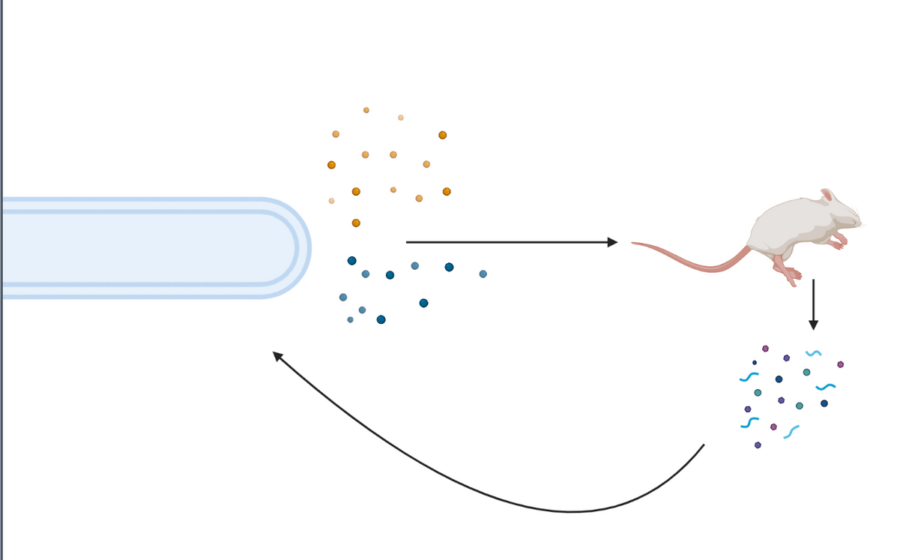
Nutrition
Heterotrophs
Mycelium
Fungal enzymes
Dead tissue degradation
Absorption of broken-down particles
Created in BioRender

Slide 11
Reproduction
Nutrition
P = Seeds and Pollen
F = Spores
P = Autotrophs
F = Heterotrhops
Fungi vs. Plants
Structure
P = Leaf, Stem, Roots
F = Hypha and Mycelium
P = Plant
F= Fungi

Slide 12
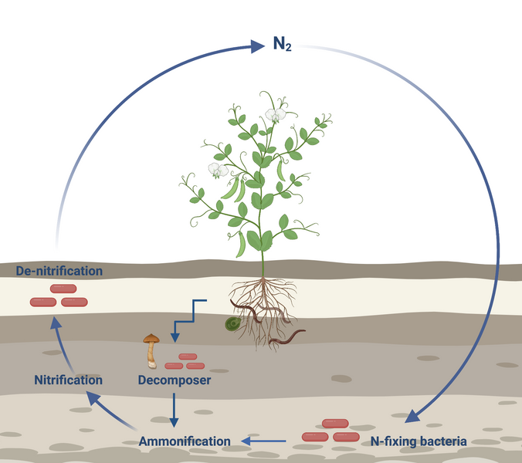
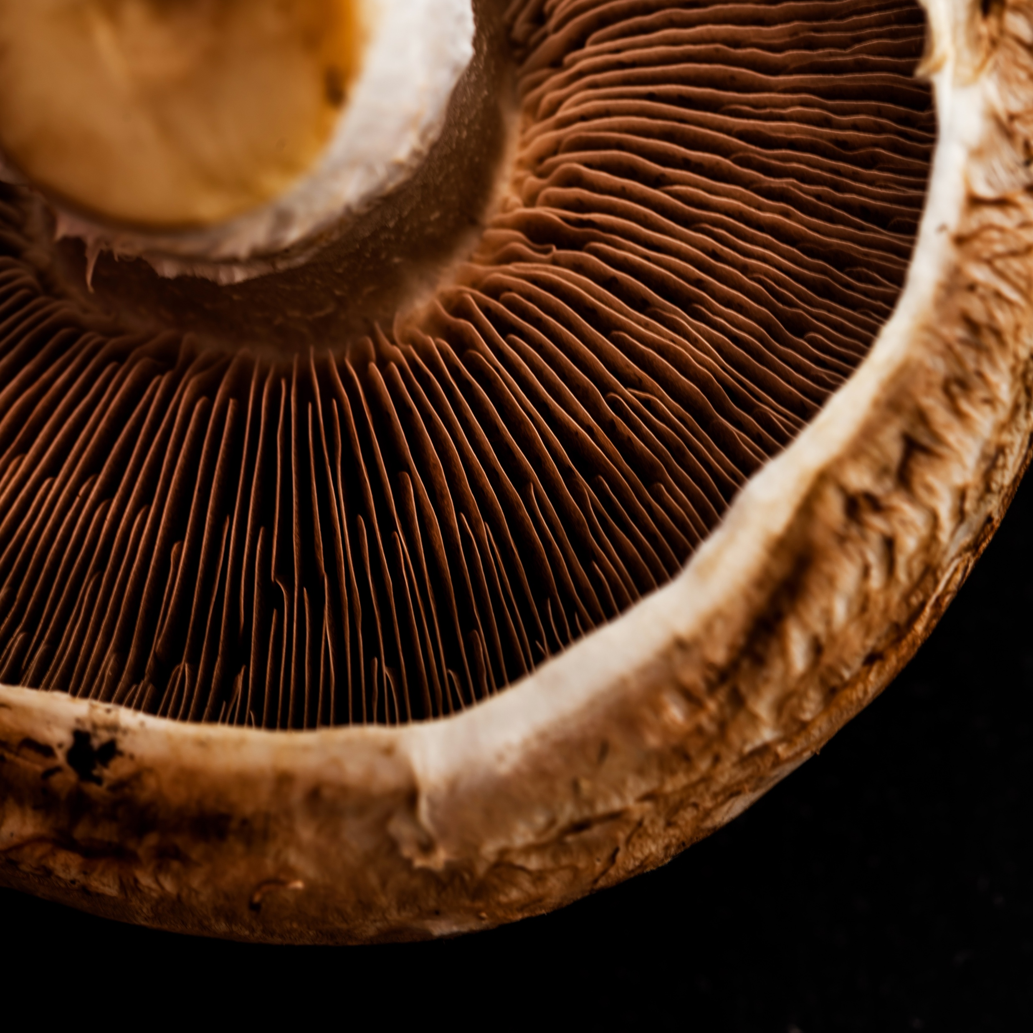
Role of Fungi
Decomposers
Nutrient cycle
Antibiotics
Food source
Created in BioRender.com
Created in BioRender.com
Notes:
Penicillium chrysogenum

Slide 13
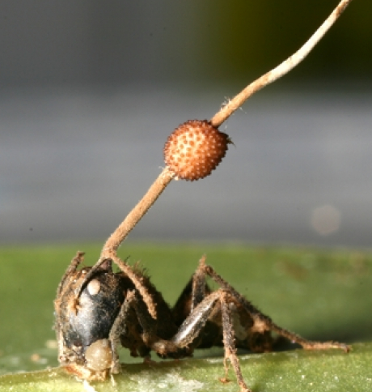
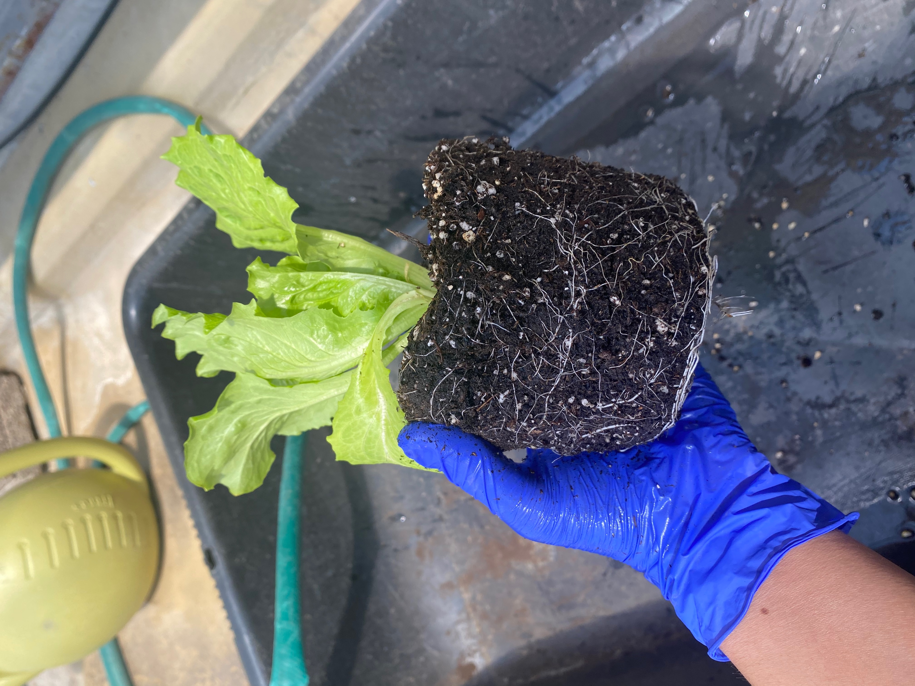
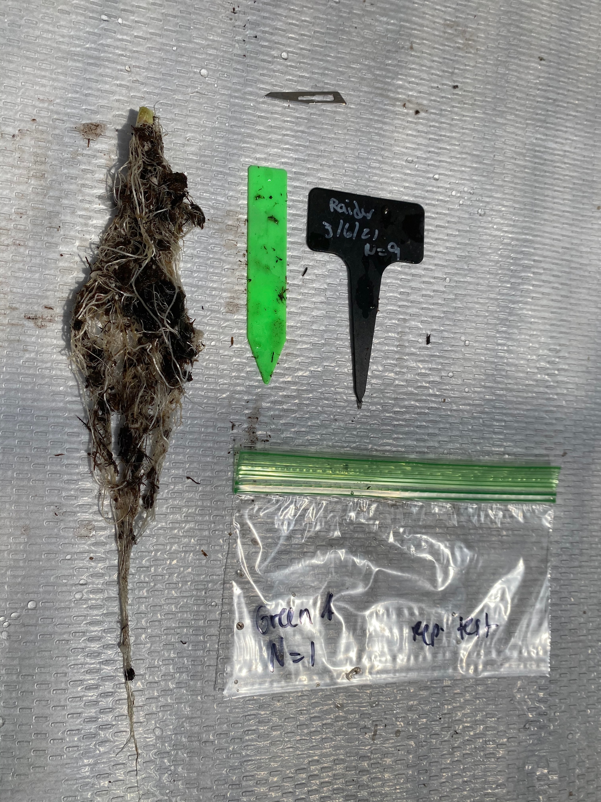
Role of Fungi
Food Production
Insecticides
Agriculture
Diseases
Epidemics.psu.edu

Slide 14
Day 1 of workshop
Wipe down the counter with 70% EtOH to ensure a clean working surface.
Label the plate or pan with your group number, date, and initials.
Remove the cotton swab from the packet.
Select an area of the classroom to swab.
Write the area in the plate.
Remember to write the area in your notes.
Once selected, swab the area with the cotton swab.
Gently streak the surface of the agar with the cotton swab.
Parafilm the plate or put the lid back on the pan.
Leave it in the designated area for 7 days.
Foto por: Nicole Colon-Carrion

Slide 15
Micologia en Ruedas
Created by: Nicole Colon-Carrion
MSA Ambassador

Slide 16
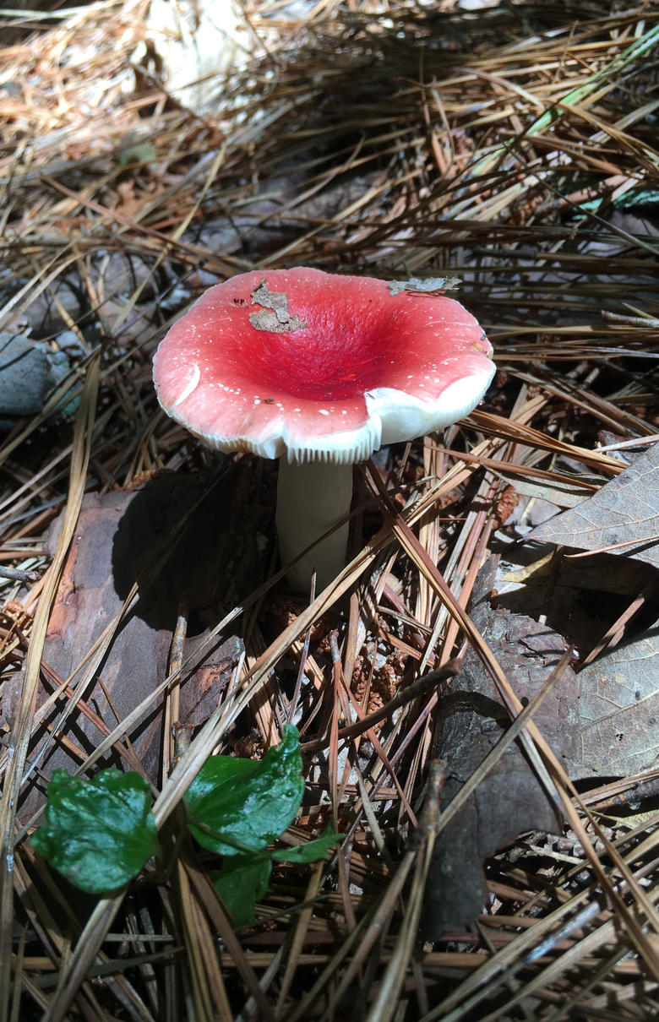
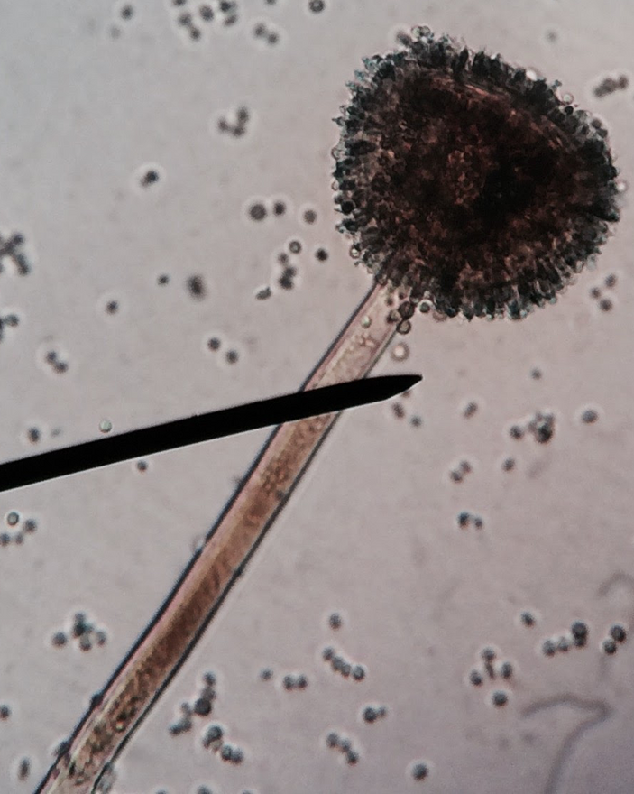
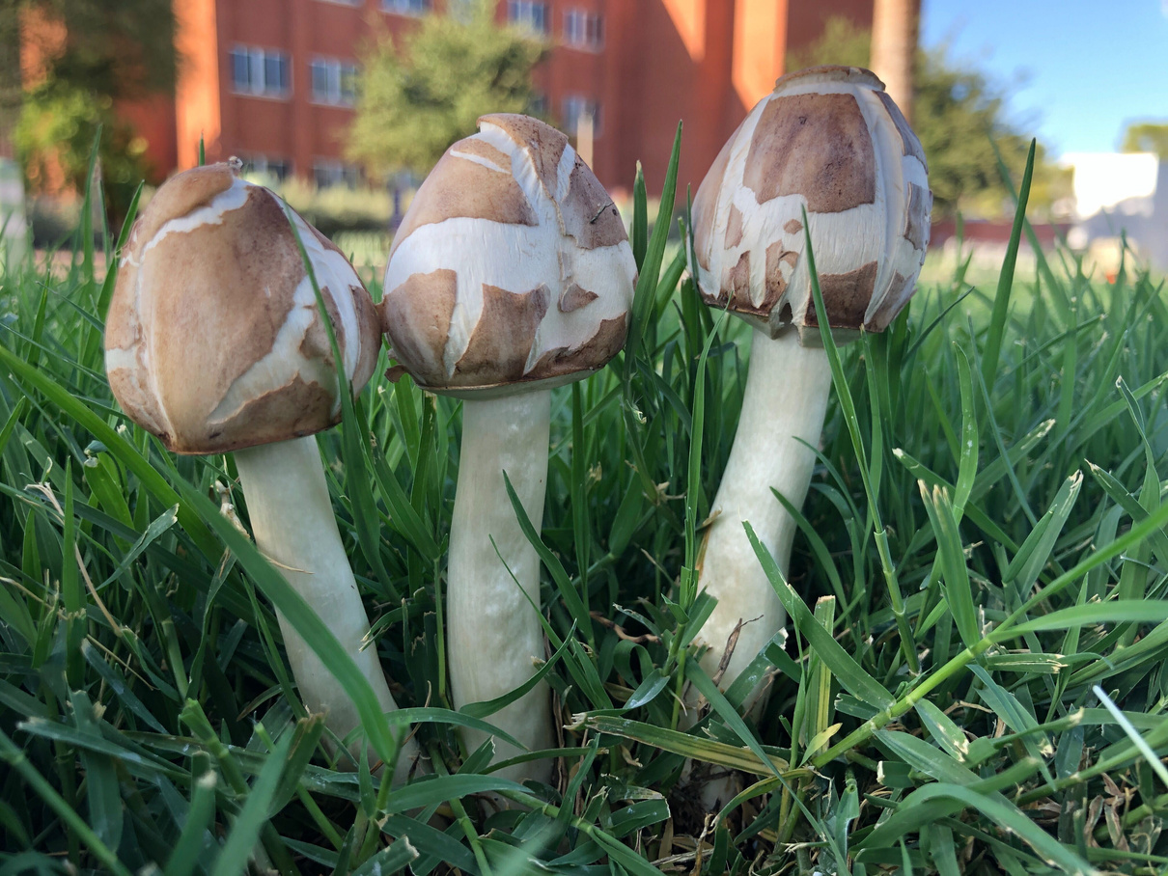
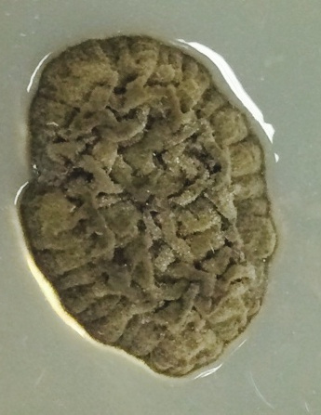
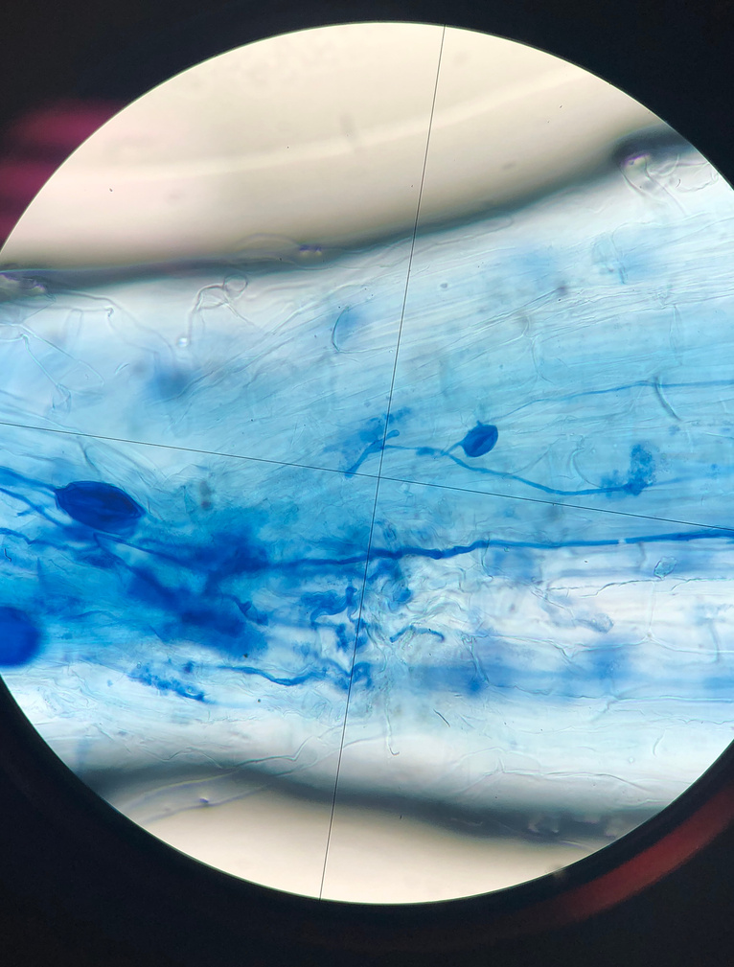
It's a FUNgi World
Pictures by: Nicole Colon-Carrion; Brooke Sykes; Dr. Hamzazai

Slide 17
Day 2 of workshop
Wipe down the counter with 70% EtOH to ensure a working surface.
Collect your plate from the designated area.
Take the time to observe your plate or pan and the microbes that have grown on it. Draw what you observe on the sheet provided and make notes.
Select one fungal colony that grew, and you wish to observe.
Wait for the instructor to call you to transfer the isolate into the microscope slide. After the instructor has finished with the slide, add clear nail polish to the border of the coverslip and let it dry to seal the slide.
Place the microscope slide on the microscope and adjust lenses.
Look away!
Picture by: Nicole Colon-Carrion

Slide 18
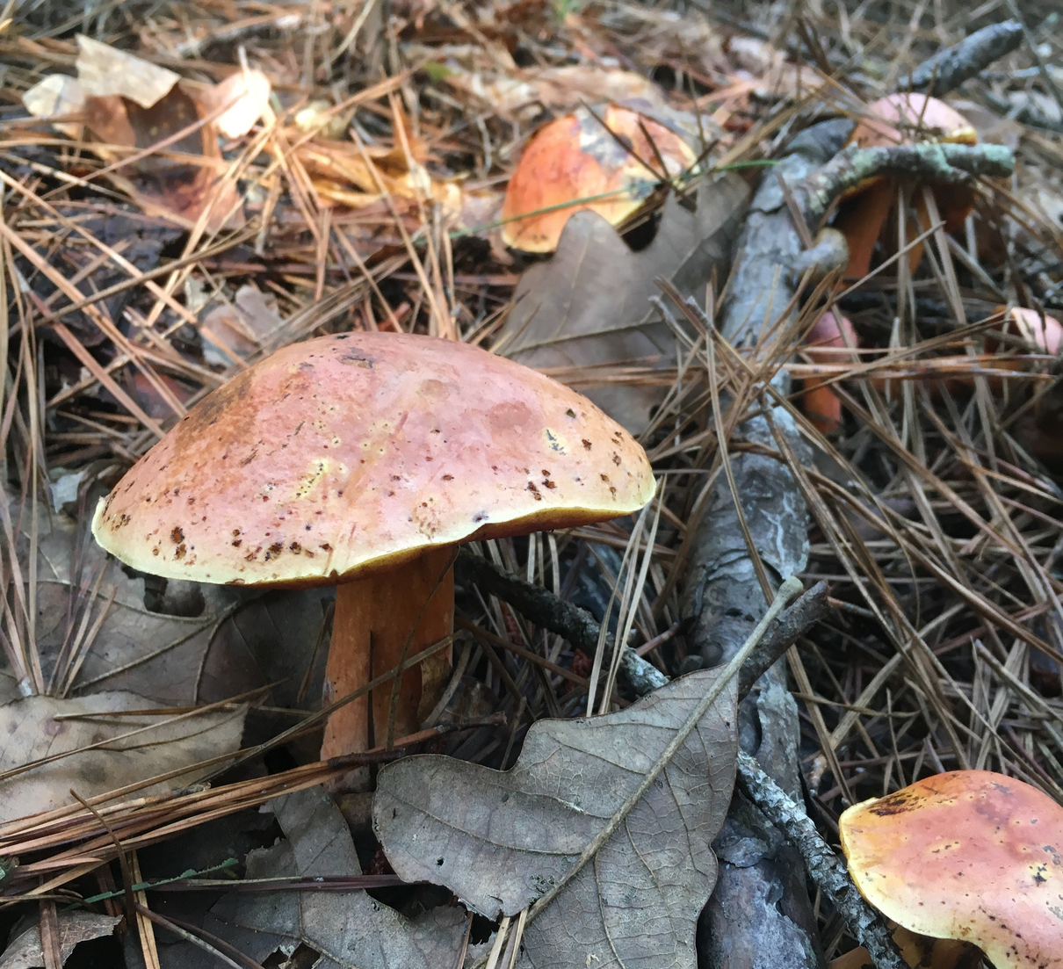
What is mycology?
The study of fungi
Foto por: Brooke Sykes

Slide 19
Branches of mycology
Food mycology
Medical mycology
Taxonomy
Environmental
mycology
¡
Plant Pathology
Industrial mycology
Marine mycology
Ethnomycology
& MORE

Slide 20
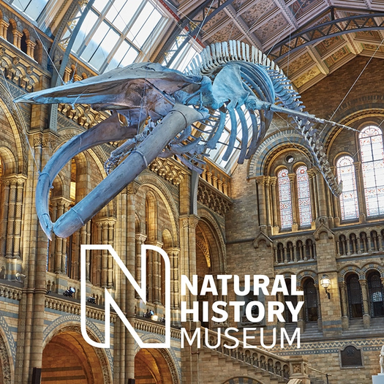
Where can I work?
Industry
Government
University
Museums
& MORE

Slide 21
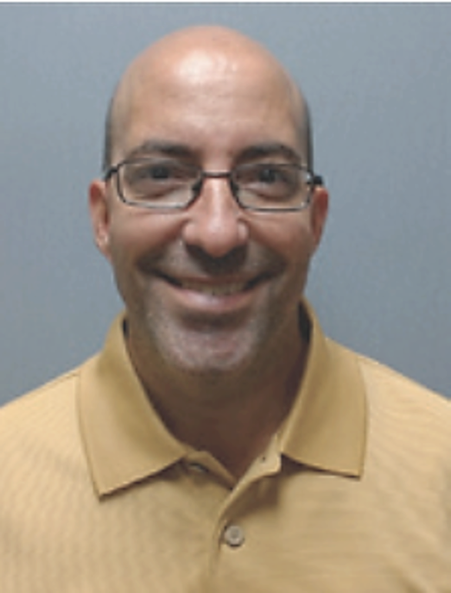
Puerto Rican Mycologist
Dr. Chad Lozada-Troche
Born in Cabo Rojo, Puerto Rico. He studied a B.S. in Pre-medical (1994), M.S. with a concentration in Biology, (Mycology- 1997) and a Ph.D. in Biological Oceanography with a concentration in Marine Botany (2009) at UPRM. He has 26 years of experience as a teacher at the University Level. Scientific contributions include the description of new genera and species of macroalgae from the Caribbean and the Atlantic Ocean, providing research experiences to undergraduate students in the areas of phycology (systematics of macroalgae), mycology (environmental contaminants, fungi in food, aquatic fungi, mangrove endophytic fungi and sea grasses). He has participated in local, national and international conferences throughout his Academic Career. He is currently an Associate Professor at the University of Puerto Rico at Cayey where he teaches courses in Genetics, Medical Mycology, Economic Mycology, Introduction to Marine Botany, Introduction to Molecular Systematics and Introduction to Biological Research.

Slide 22
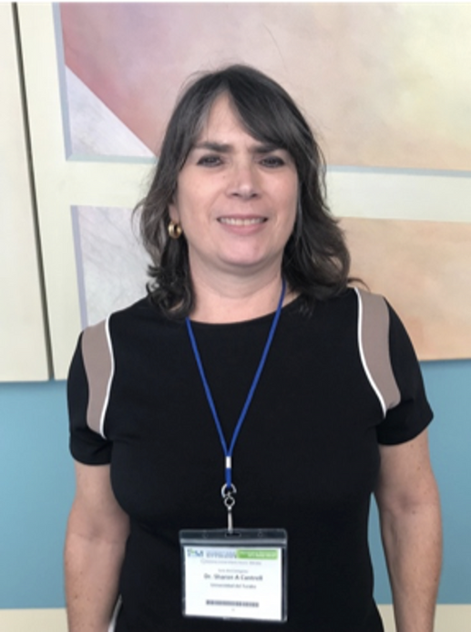
Puerto Rican Mycologist
Dr. Sharon Cantrell
She earned a B.S. and an M.S. at the University of Puerto Rico, Mayagüez, and a Ph.D. in Phytopathology at the University of Georgia, where she studied discomycete systematics. She is the first Puerto Rican to be president of the Mycological Society of America (MSA). She is a professor at the School of Natural Sciences and Technology at the Universidad del Turabo in Gurabo, Puerto Rico. Her research is focused on fungal ecology, climate change, extreme environments, taxonomy and systematics.

Slide 23
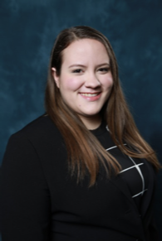
Puerto Rican Mycologist
Dr. Sofía Macchiaveli
Native of Mayaguez. She completed a bachelor's degree in Biology at the UPR-Mayagüez, where she did research with Dr. Dimuth Siritunga in the area of Plant Biotechnology. She then completed a PhD at the University of Wisconsin-Madison in Plant Pathology with Dr. Amanda Gevens, a potato and vegetable extension specialist. She currently works with the UPRM Agricultural Extension Service.

Slide 24
Puerto Rican Mycologist
Mareli Sanchez Julia
Originally from San Juan, Puerto Rico. She earned a BA in Environmental Studies and Biology from Wofford College. She is currently a doctoral candidate at Tulane University. Her research focuses on how soil properties and plant biometric traits influence the assembly and diversity of plant symbiotic fungi, both in species-rich tropical forests and species-poor coastal mangroves. .

Slide 25
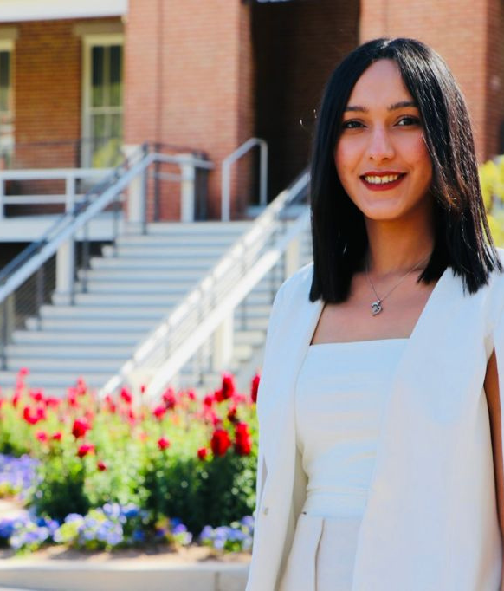
Puerto Rican Mycologist
Dr. Nicole Colón Carrión
Originally from Caguas, PR. I completed my bachelor's degree in Natural Sciences, with a concentration in Biology at the University of Puerto Rico at Cayey. I completed my Ph.D. in plant pathology with a university education certification at the University of Arizona. In my research I sought to understand how climate change affects the symbiotic relationships between endophytic fungi and plants, in tropical forests and agroecosystems. I currently work at Corteva AgriScience as a Plant Pathologist Research Investigator.

