Slide 1
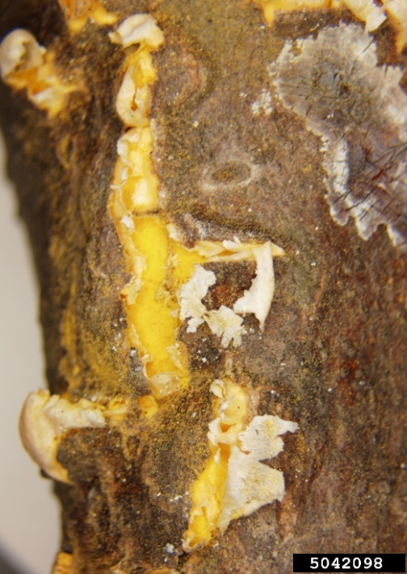
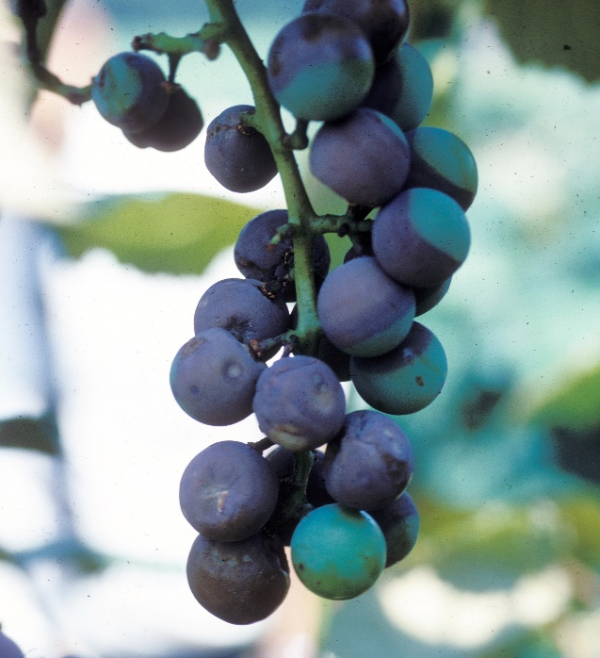
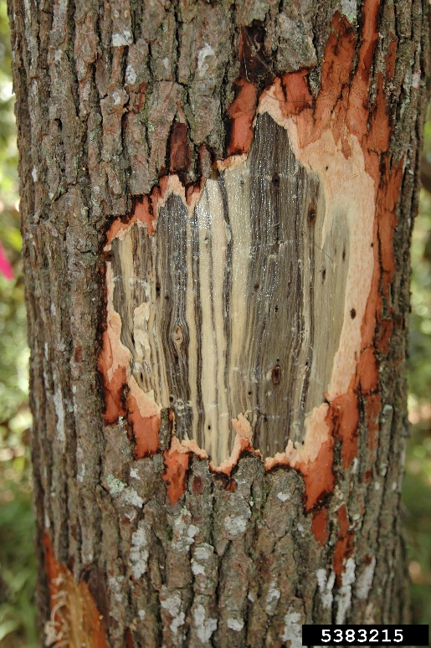
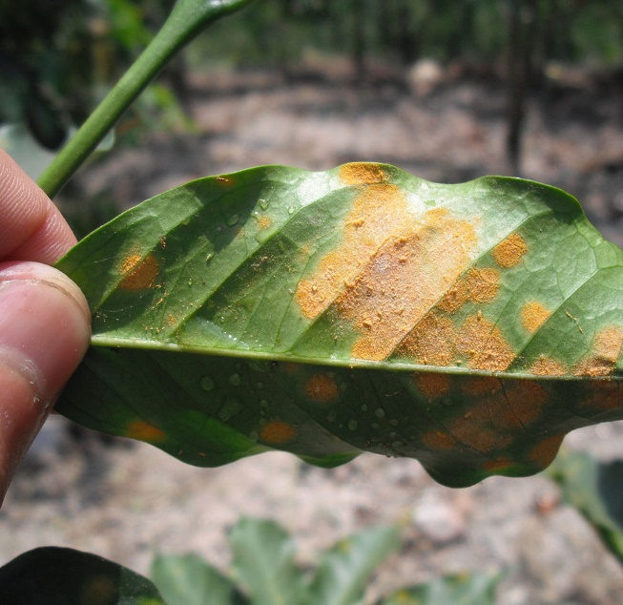
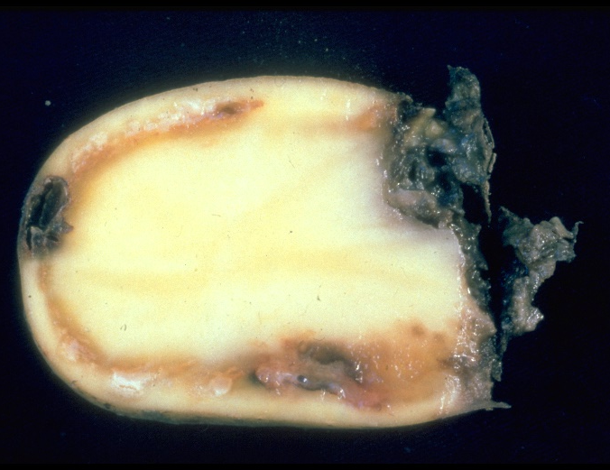
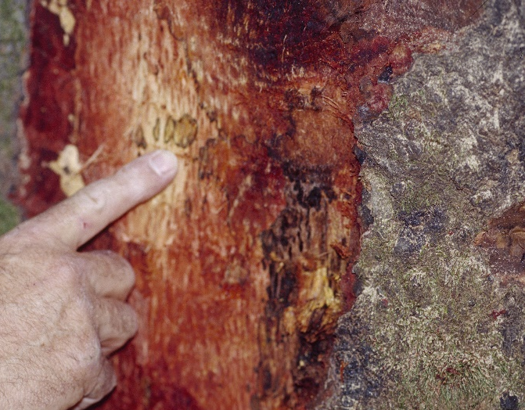
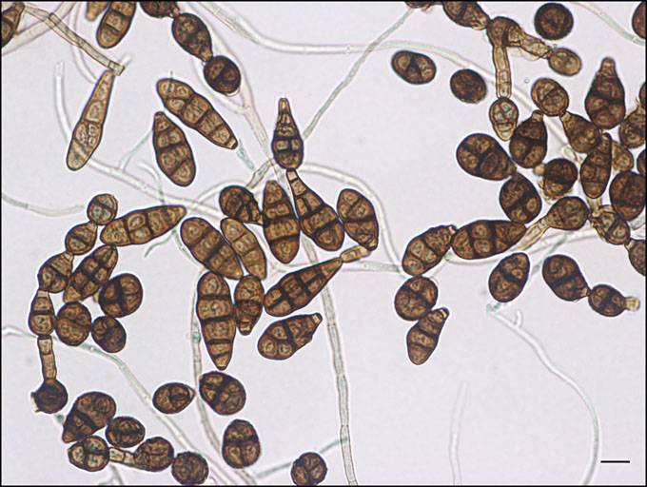
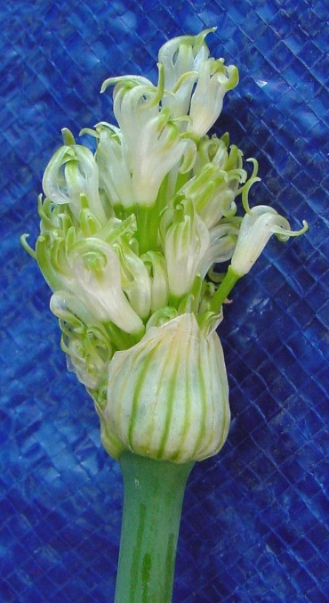
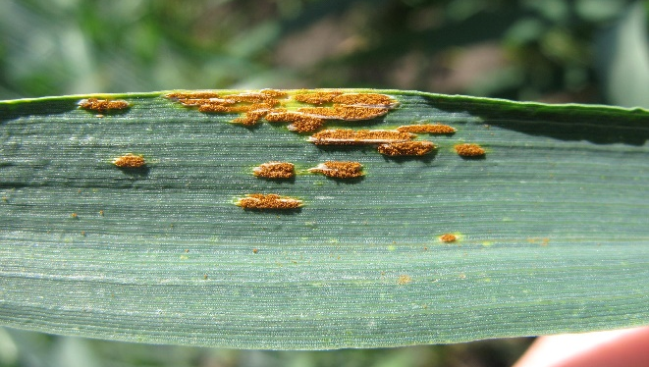
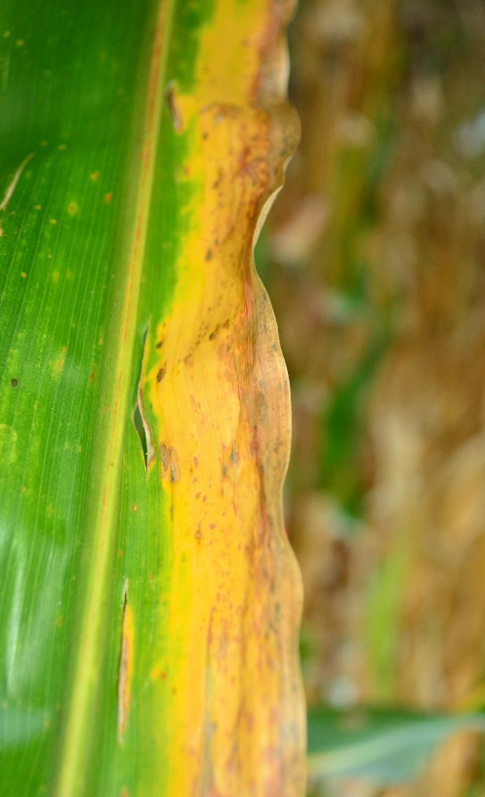
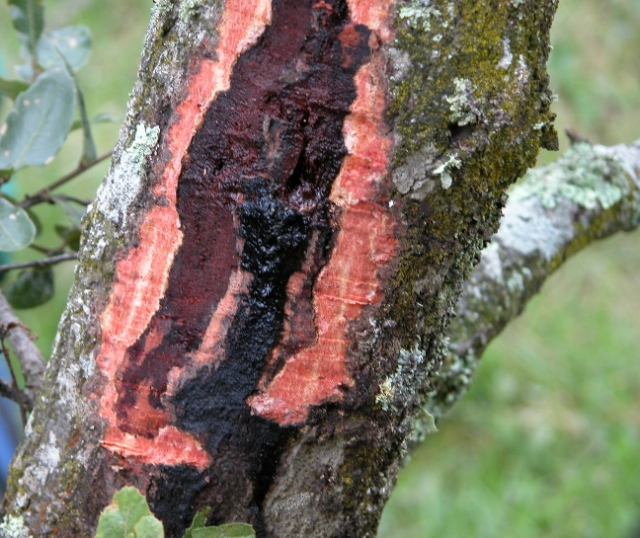
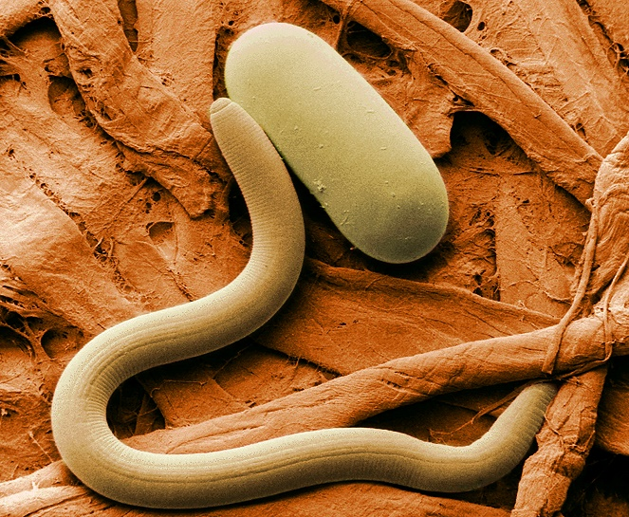
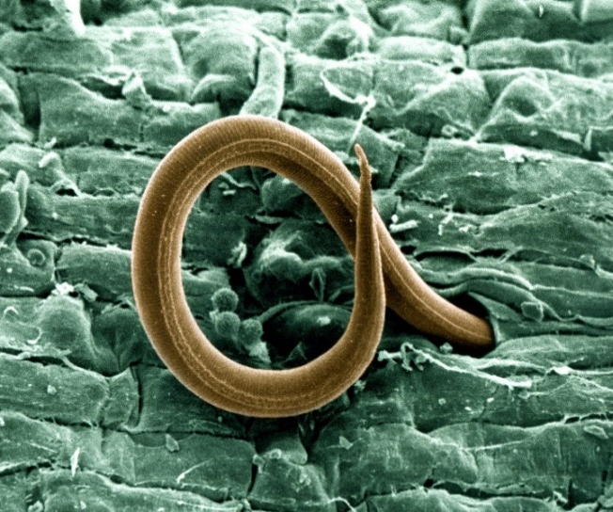
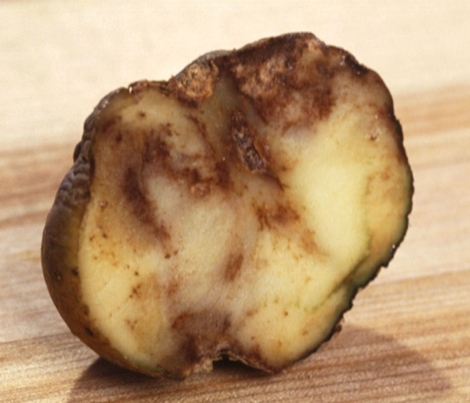
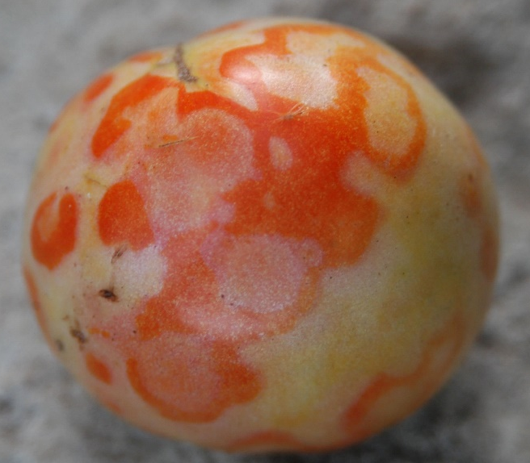
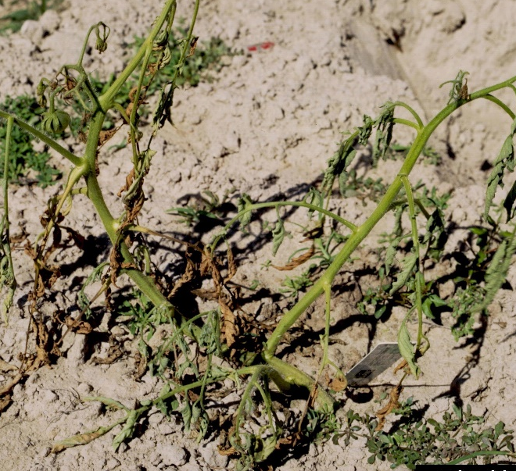
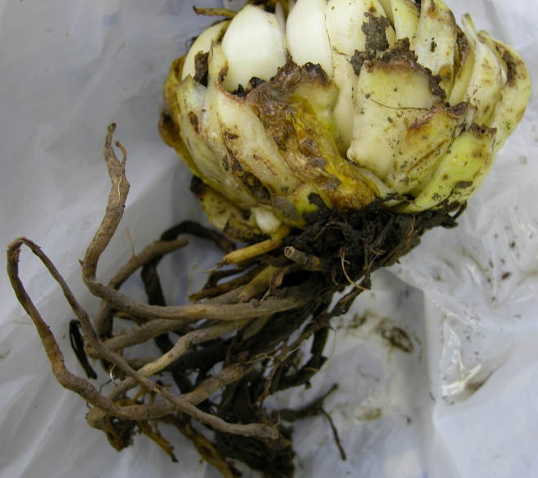
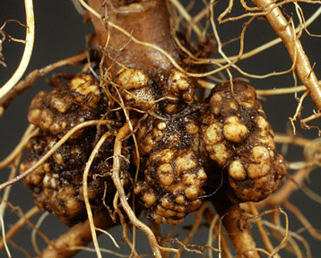
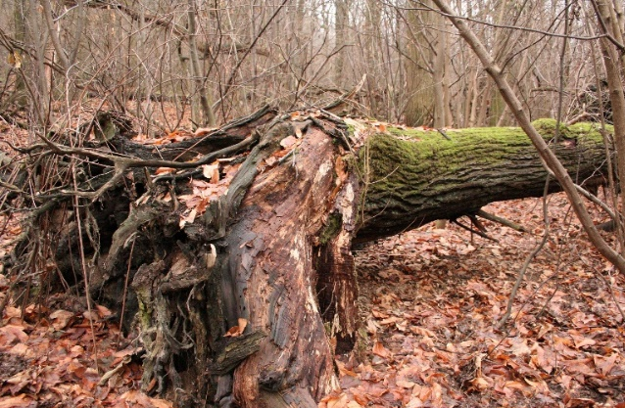
#1 White Pine Blister Rust
I am a fungal disease.
I cause serious damage to white pines (which is why I like hiking in the woods).
Windy, kite-flying weather
helps me spread my spores.
#2 Sudden Oak Death
- I am an oomycete (fungal like organism). I like “hiking” in the woods to find trees and shrubs.
- My spores are spread by wind and rain.
- I'm not a picky eater (host range includes > 100 species).
#5 Coffee rust
I am a fungal disease.
I am found in the tropics, or wherever coffee is grown.
You could say I'm a picky eater - I literally live on coffee.
#6 Brown rot of potato
I am a bacterial disease.
I can infect hundreds of plant species (I’m not picky) – potato tomato, banana, geraniums, peppers, eggplant and more!
#9 Black rot of grape
My name describes me well. I’m an important fungal disease of grapes, and there’s nothing like a wet, windy day to help me spread my spores.
#10 Alternaria alternata
Spots, rots and blights
I’m a fungus that can infect hundreds of plants, including citrus and papaya. I’m also associated with lung infections and mold allergies (I’m not picky!) My spores are spread by the wind.
#13 Maize lethal necrosis
I am a complex two viruses, and I like to hitch a ride on insects.
I infect mainly corn and I’m causing devastating farm losses in West Africa.
#14 Aster yellows
I am a phytoplasma (small microorganism) associated with hundreds of species, many in the Aster family but also crops such as wheat and barley (I’m not picky).
#17 Stem rust
I am a fungal disease of wheat and barley.
Throughout history, I have been a threat to the world supply of wheat.
My windborne spores like to travel the world.
#18 Laurel wilt
I am a fungus disease of the laurel family – redbay, sassafras etc., but avocados may be my most well-known host.
I am spread by the redbay ambrosia beetle.
Photo: Joseph O'Brien, USDA Forest Service, Bugwood.org
Photo: Joseph O'Brien, USDA Forest Service, Bugwood.org
National Plant Protection Organization, the Netherlands , Bugwood.org
Mary Burrows, Montana State University, Bugwood.org
National Plant Protection Organization, the Netherlands , Bugwood.org
Photo: University of Georgia Plant Pathology, Bugwood.org
Ronald F. Billings, Texas A&M Forest Service , Bugwood.org
National Plant Protection Organization, the Netherlands , Bugwood.org
National Plant Protection Organization, the Netherlands , Bugwood.org
#3 Chestnut blight
I’m a fungal disease.
American chestnut is my favorite tree (I’m kinda picky).
I’ve done a good job of wiping out chestnut trees in North America.
Rain and wind help to spread my spores.
#4 Phytophthora root rot (Phytophthora cinnamomi)
I can infect over 100 trees and shrubs: azalea, rhododendron, camellia, boxwood, avocado, pine, juniper, hemlock, spruce, fir, cedar, cypress and more (I’m not picky).
The rain creates the wet soils that I love.
#7 Cyst nematode (Heterodera)
I am a tiny, parasitic worm.
I tend to feed on and infect the roots of specific plants such as soybean and potato.
#8 Root knot nematode (Meloidogyne)
I am a tiny, parasitic worm.
I must admit I cause a lot of damage to agricultural crops worldwide. I've been known to feed on the roots nearly 2000 different plants (definitely not picky!)
#11 Late blight of potato
I am the potato disease associated with the Irish potato famine.
If you like digging in the dirt, you may find me infecting my favorite food, potato tubers (I’m kinda picky).
#12 Crown gall
I am a bacterial disease.
I can be found in the soil (digging in the dirt), where I infect the roots of grapes, many fruit and nut trees and dozens of other plant species (not picky!)
#15 Stewart’s wilt of corn
I am a bacterial disease, and I am spread by flea beetles. I’m kind of picky; I especially like sweet corn!
#16 Tomato spotted wilt virus
I infect over 1000 species, including many vegetables, peanut and tobacco (I’m not a picky eater).
Thrips (insects) help me spread from plant to plant.
#19 Fusarium wilt
I am found in soils worldwide, often part of a root rot complex and/or assoc. with nematodes (I’m a team player).
#20 Rhizoctonia damping-off, blight and rot
I am a soil-borne fungus found around the world.
I’m not a picky eater (I like potatoes, cereals, sugarbeet, cucumber, rice and even turfgrass)
Photo: Soybean cyst nematode, USDA ARS
Photo: William Wergin and Richard Sayre. Colorized by Stephen Ausmus. USDA
Photo: Soybean cyst nematode, USDA ARS
Photo: Andrej Kunca, National Forest Centre - Slovakia, Bugwood.org
Photo: Joseph O'Brien, USDA Forest Service, Bugwood.org
Photo: Soybean cyst nematode, USDA ARS
Photo: William Wergin and Richard Sayre. Colorized by Stephen Ausmus. USDA
Scott Bauer, USDA ARS, Bugwood.org
Felix Francis, University of Delaware, Bugwood.org
Ward Upham, Kansas State University, Bugwood.org
William M. Brown Jr., Bugwood.org
Penn State Dept of Plant Pathology & Environmental Microbiology Archives, Bugwood.org

