Slide 1
Recovery plan for
Monilinia polystroma
Kerik D. Cox¹ & Sara Villani²
¹Plant Pathology and Plant-Microbe Biology
Cornell University
²Department of Plant Pathology
North Carolina State University

Slide 2
Outline
Monilinia species causing brown rot
Monilinia polystroma
Differentiation
Distribution
Biology & disease
Management
Risk & Recovery

Slide 3
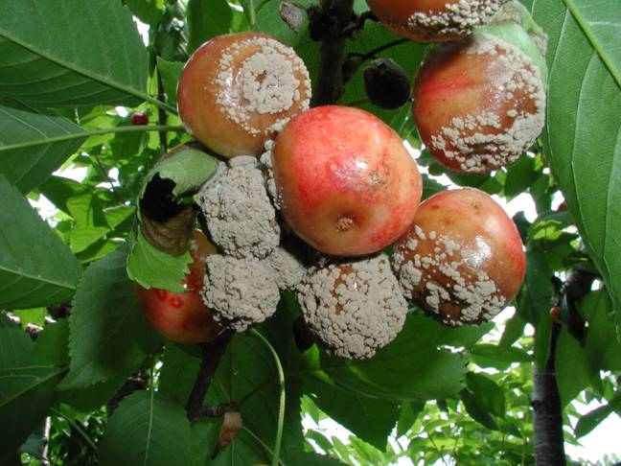
Monilinia species causing brown rot
Monilinia fructicola:
Species native to North America > invasive to Europe and Asia
Aggressive fruit rot pathogen
Notes:
Typical summer diseases can include:
Phomopsis fruit rot & Alternaria leaf spot, which I couldn’t find pictures of on peach
Anthracnose (characterized by sunken firm concentric ringed lesions filled with salmon colored spores & powdery mildew – see more easily on green fruit as powdery white leasions
Peach scab which appears as fuzzy slightly raised olive colored spots & Peach shot hole (Coryneum Blight) which on fruit produces a very dark sunken lesion

Slide 4
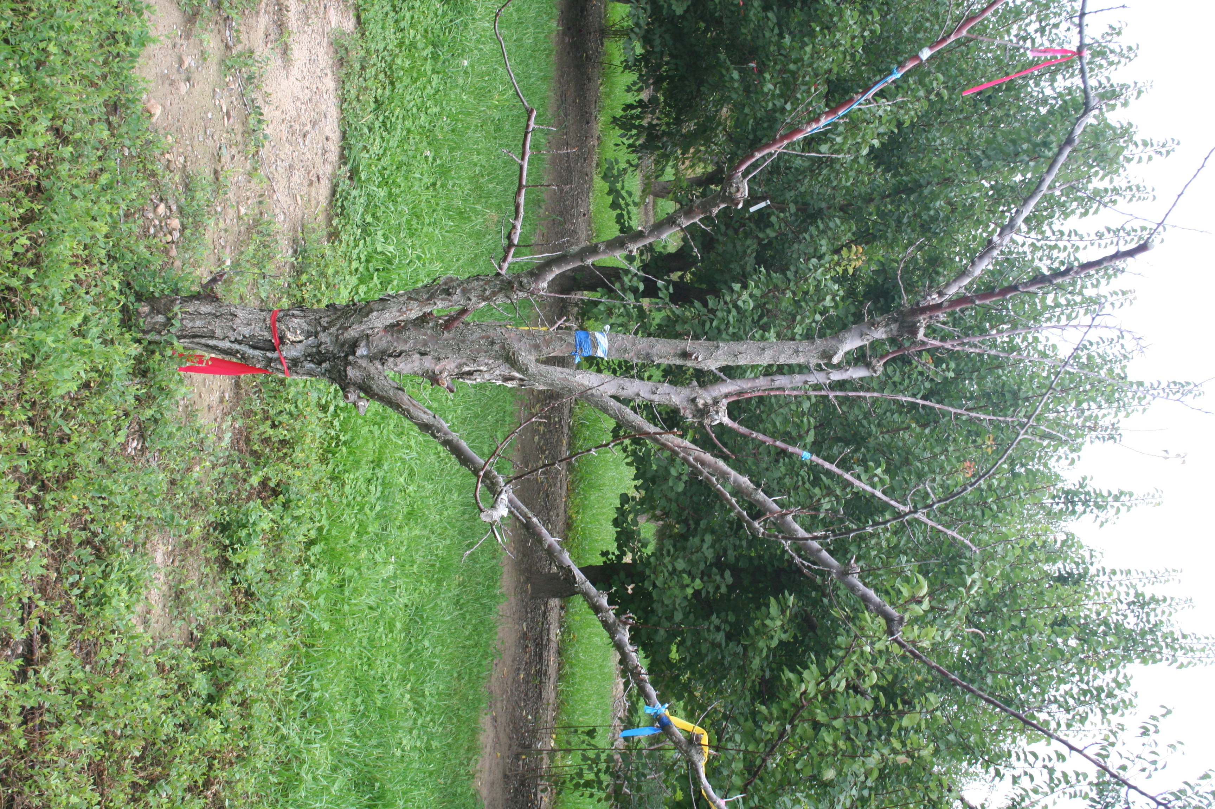
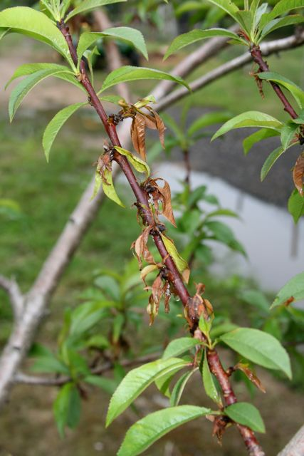
Monilinia species causing brown rot
Monilinia laxa:
Species native to Europe “European brown rot”
Prefers cool wet weather
Aggressive blossom & shoot blight pathogen
M. Laxa NY
Notes:
Typical summer diseases can include:
Phomopsis fruit rot & Alternaria leaf spot, which I couldn’t find pictures of on peach
Anthracnose (characterized by sunken firm concentric ringed lesions filled with salmon colored spores & powdery mildew – see more easily on green fruit as powdery white leasions
Peach scab which appears as fuzzy slightly raised olive colored spots & Peach shot hole (Coryneum Blight) which on fruit produces a very dark sunken lesion

Slide 5
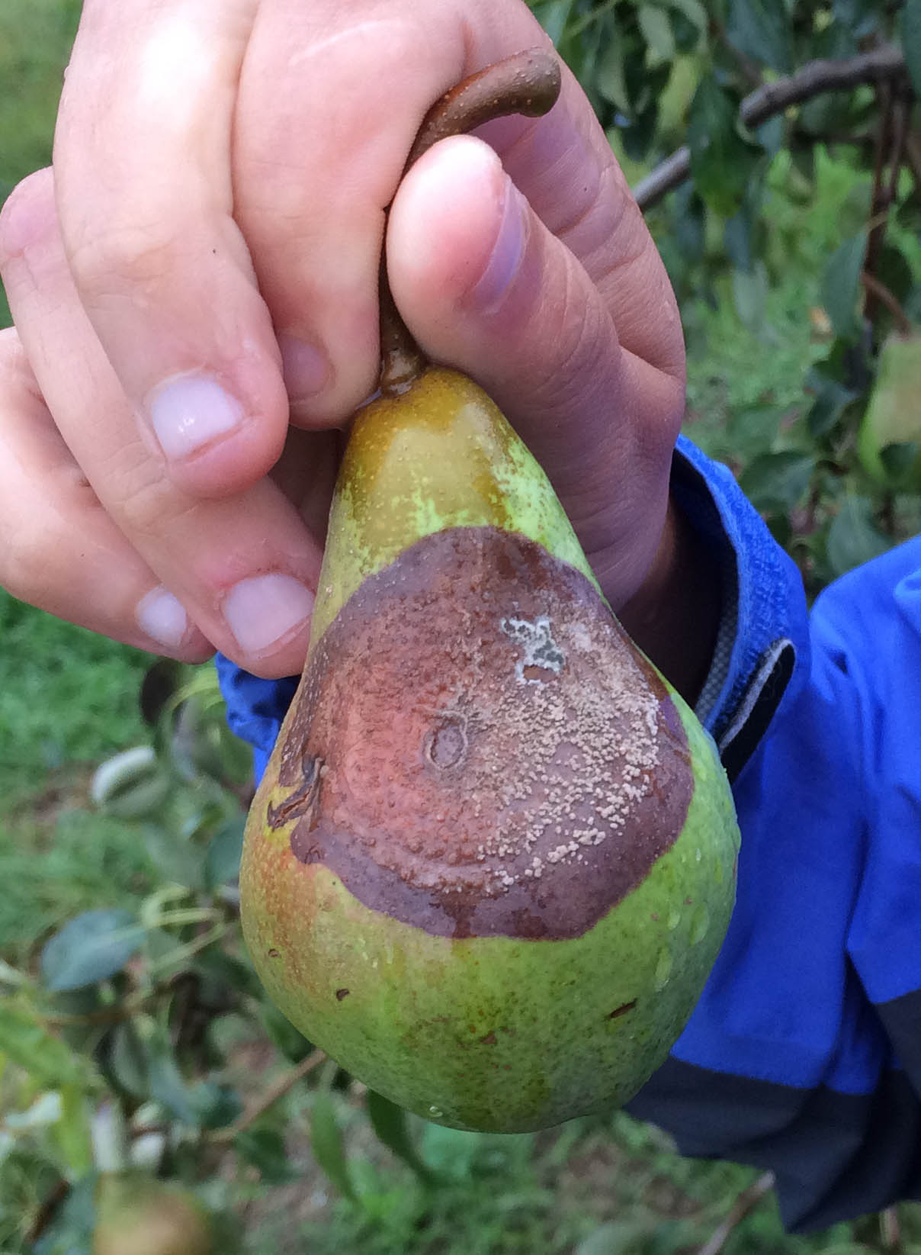
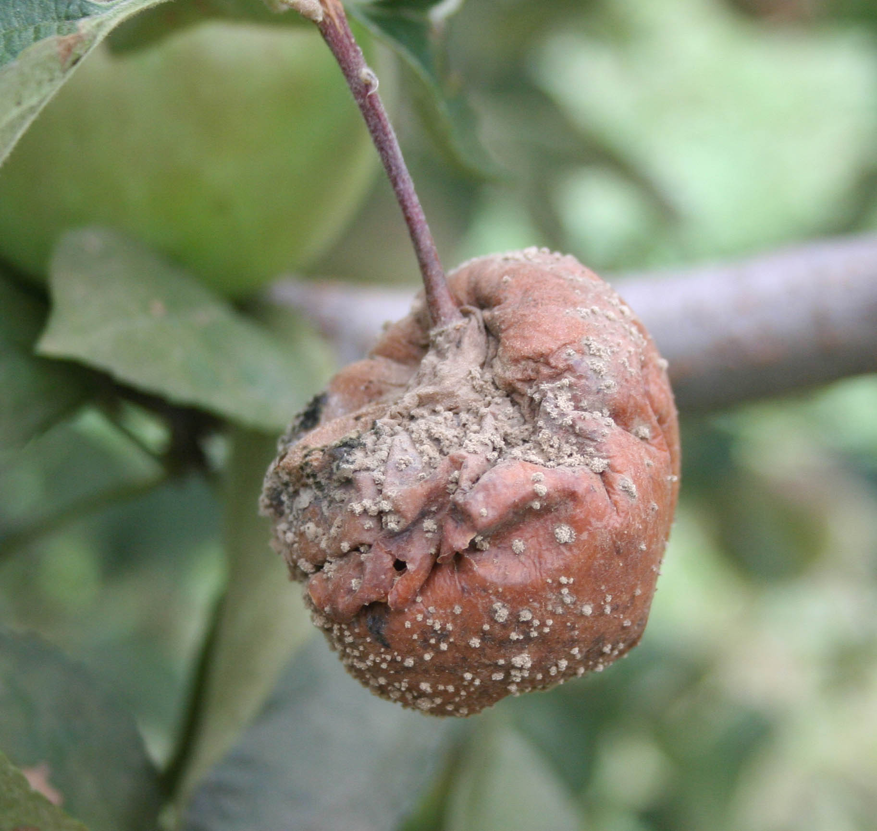
Monilinia species causing brown rot
Monilinia fructigena:
Species prevelant in Europe & Asia, causing brown rot of Malus, Pyrus, & Prunus spp.
Both actually M. fructicola – Long Island, NY
Notes:
Typical summer diseases can include:
Phomopsis fruit rot & Alternaria leaf spot, which I couldn’t find pictures of on peach
Anthracnose (characterized by sunken firm concentric ringed lesions filled with salmon colored spores & powdery mildew – see more easily on green fruit as powdery white leasions
Peach scab which appears as fuzzy slightly raised olive colored spots & Peach shot hole (Coryneum Blight) which on fruit produces a very dark sunken lesion

Slide 6
Outline
Monilinia species causing brown rot
Monilinia polystroma
Differentiation
Distribution
Biology & disease
Management
Risk & Recovery

Slide 7
Monilinia polystroma
Molecular / morphological species – differentiated from M. fructigena
Fulton (et al. 1999): Japanese M. fructigena differed from European on 4x1 bp substitutions in ITS1 and 1 bp sub. in ITS2
M. fructicola and M. Laxa: 5x1 bp subs.
M. frutigena and M. fructicola: 13 x1bp subs
van LEEUWEN et al. (2002): established morphological differences between M. fructigena & M. polystroma
Notes:
Typical summer diseases can include:
Phomopsis fruit rot & Alternaria leaf spot, which I couldn’t find pictures of on peach
Anthracnose (characterized by sunken firm concentric ringed lesions filled with salmon colored spores & powdery mildew – see more easily on green fruit as powdery white leasions
Peach scab which appears as fuzzy slightly raised olive colored spots & Peach shot hole (Coryneum Blight) which on fruit produces a very dark sunken lesion

Slide 8
Monilinia polystroma
Molecular / morphological species – differentiated from M. fructigena
Johnston et al., 2014: proposed Monilinia as genus – no naturally observed teleomorph
Poniatowska et al. (2016): diversity (ISSR, RAPD, PCR MP assay) & host specificity study
Distribution
M. polystroma originated in Japan (1999)
Spread into eastern Europe afterwards
Notes:
Typical summer diseases can include:
Phomopsis fruit rot & Alternaria leaf spot, which I couldn’t find pictures of on peach
Anthracnose (characterized by sunken firm concentric ringed lesions filled with salmon colored spores & powdery mildew – see more easily on green fruit as powdery white leasions
Peach scab which appears as fuzzy slightly raised olive colored spots & Peach shot hole (Coryneum Blight) which on fruit produces a very dark sunken lesion

Slide 9
Monilinia polystroma
Distribution (reported occurences)
2009: Hungary: apples
2010: China: apple, pear, & plum
2011: Czech Republic: apple & peach
2012: Switzerland: apricot
2013: Serbia: apple & Poland: apple, peach, plum, & cherry
2014: Italy: peach
2015: Croatia: apples
Notes:
Typical summer diseases can include:
Phomopsis fruit rot & Alternaria leaf spot, which I couldn’t find pictures of on peach
Anthracnose (characterized by sunken firm concentric ringed lesions filled with salmon colored spores & powdery mildew – see more easily on green fruit as powdery white leasions
Peach scab which appears as fuzzy slightly raised olive colored spots & Peach shot hole (Coryneum Blight) which on fruit produces a very dark sunken lesion

Slide 10
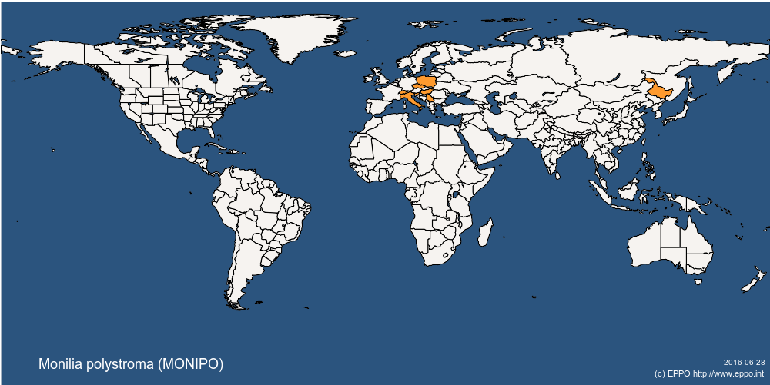
Monilinia polystroma Distribution
https://gd.eppo.int/taxon/MONIPO/distribution
Notes:
Typical summer diseases can include:
Phomopsis fruit rot & Alternaria leaf spot, which I couldn’t find pictures of on peach
Anthracnose (characterized by sunken firm concentric ringed lesions filled with salmon colored spores & powdery mildew – see more easily on green fruit as powdery white leasions
Peach scab which appears as fuzzy slightly raised olive colored spots & Peach shot hole (Coryneum Blight) which on fruit produces a very dark sunken lesion

Slide 11
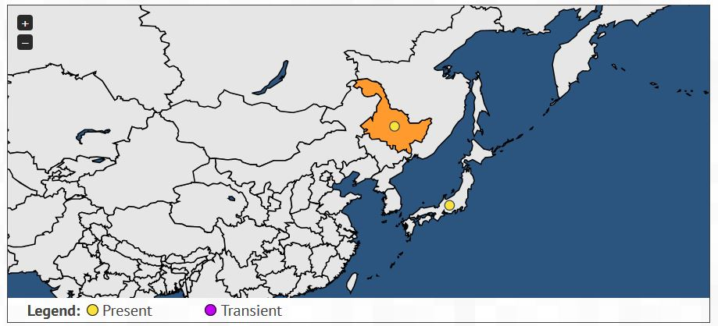
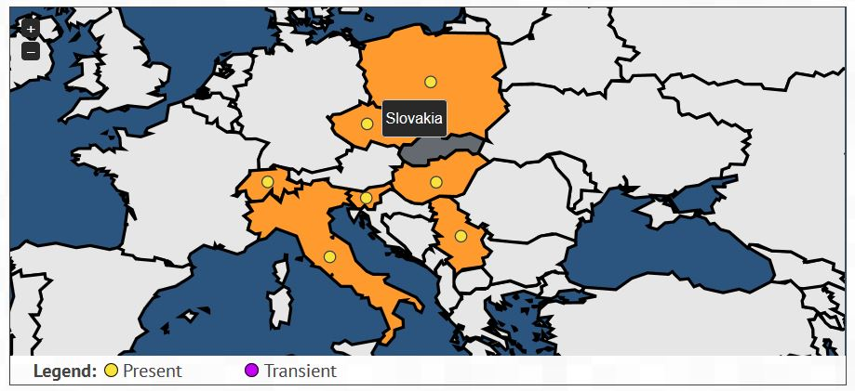
Monilinia polystroma Distribution
https://gd.eppo.int/taxon/MONIPO
China
Japan
Poland
Hungary
Italy
Notes:
Typical summer diseases can include:
Phomopsis fruit rot & Alternaria leaf spot, which I couldn’t find pictures of on peach
Anthracnose (characterized by sunken firm concentric ringed lesions filled with salmon colored spores & powdery mildew – see more easily on green fruit as powdery white leasions
Peach scab which appears as fuzzy slightly raised olive colored spots & Peach shot hole (Coryneum Blight) which on fruit produces a very dark sunken lesion

Slide 12
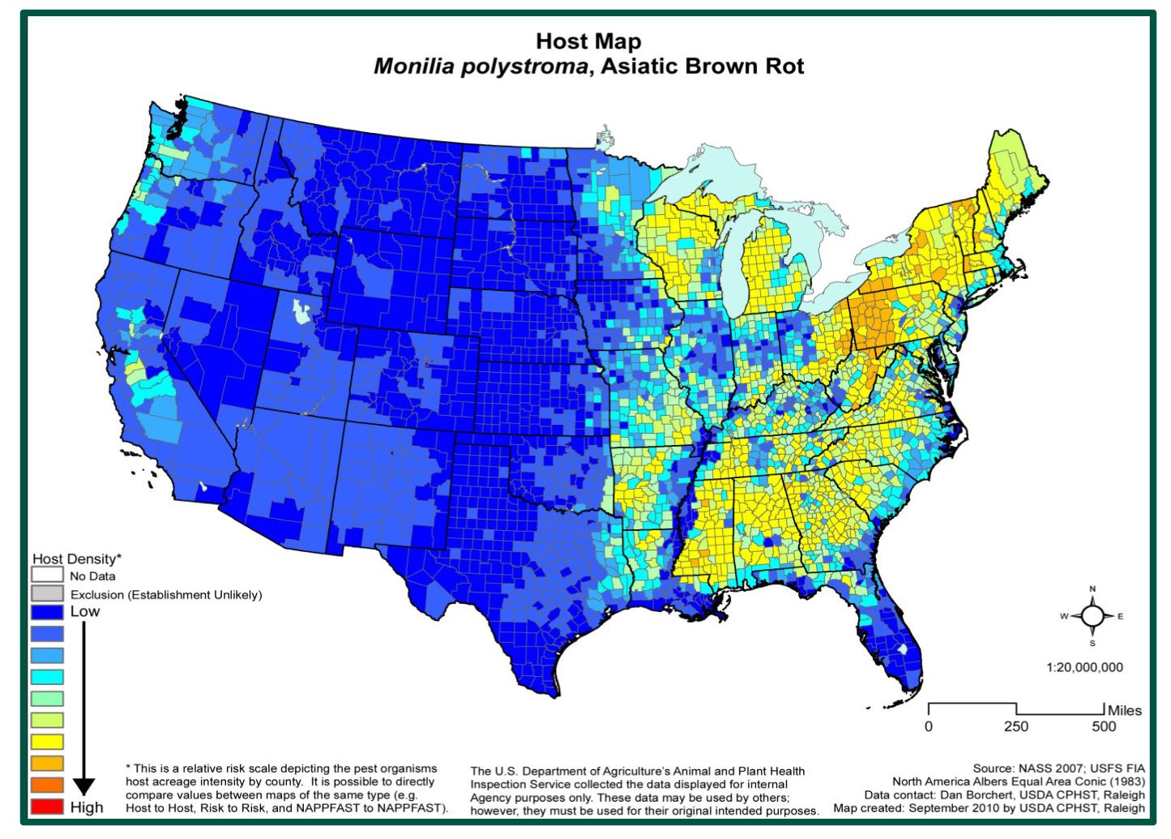
Monilinia polystroma United States Risk Map
Risk map development by NAPPFAST
More Malus × domestica
More Prunus
Notes:
Typical summer diseases can include:
Phomopsis fruit rot & Alternaria leaf spot, which I couldn’t find pictures of on peach
Anthracnose (characterized by sunken firm concentric ringed lesions filled with salmon colored spores & powdery mildew – see more easily on green fruit as powdery white leasions
Peach scab which appears as fuzzy slightly raised olive colored spots & Peach shot hole (Coryneum Blight) which on fruit produces a very dark sunken lesion

Slide 13
Monilinia polystroma United States Risk Map
Risk map development by NAPPFAST
Lost host domain (nappfast.org) > needs new hosting site
Based on host acreage intensity by county > mostly pome over stone fruit acreage
A new risk map could be generated in Google maps
Notes:
Typical summer diseases can include:
Phomopsis fruit rot & Alternaria leaf spot, which I couldn’t find pictures of on peach
Anthracnose (characterized by sunken firm concentric ringed lesions filled with salmon colored spores & powdery mildew – see more easily on green fruit as powdery white leasions
Peach scab which appears as fuzzy slightly raised olive colored spots & Peach shot hole (Coryneum Blight) which on fruit produces a very dark sunken lesion

Slide 14
Outline
Monilinia species causing brown rot
Monilinia polystroma
Differentiation
Distribution
Biology & disease
Management
Risk & Recovery

Slide 15
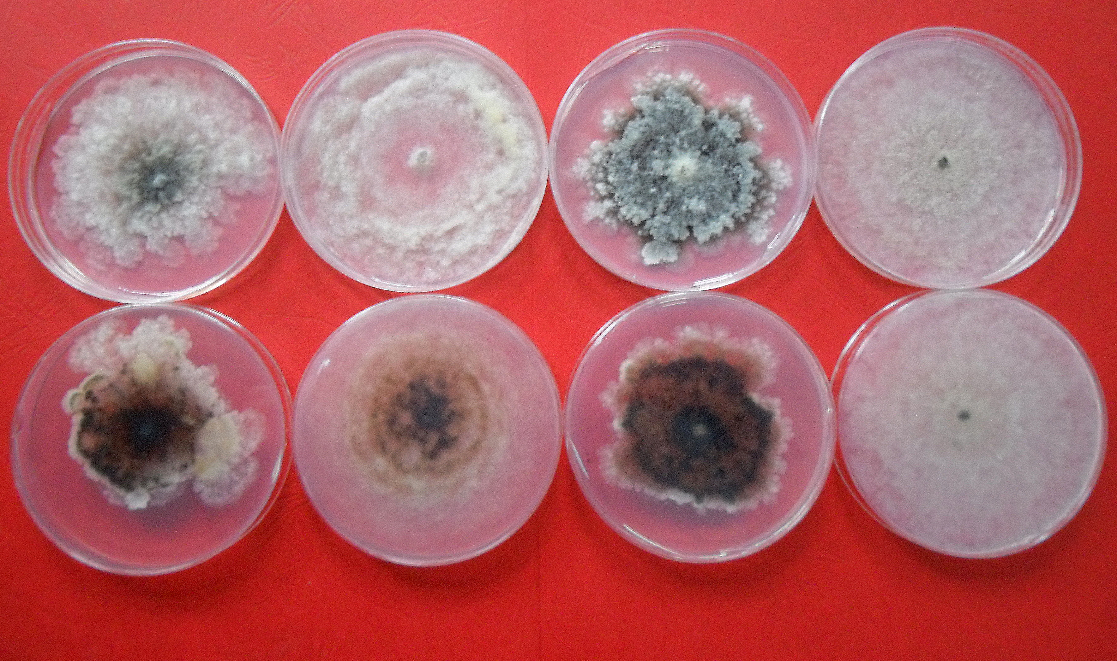
Monilinia polystroma Biology and Disease
M. polystroma similar M. fructigena in biology, but culture morphology different
Anna Poniatowska
M. laxa
M. fructigena
M. polystroma
M. fructicola
Notes:
Typical summer diseases can include:
Phomopsis fruit rot & Alternaria leaf spot, which I couldn’t find pictures of on peach
Anthracnose (characterized by sunken firm concentric ringed lesions filled with salmon colored spores & powdery mildew – see more easily on green fruit as powdery white leasions
Peach scab which appears as fuzzy slightly raised olive colored spots & Peach shot hole (Coryneum Blight) which on fruit produces a very dark sunken lesion

Slide 16
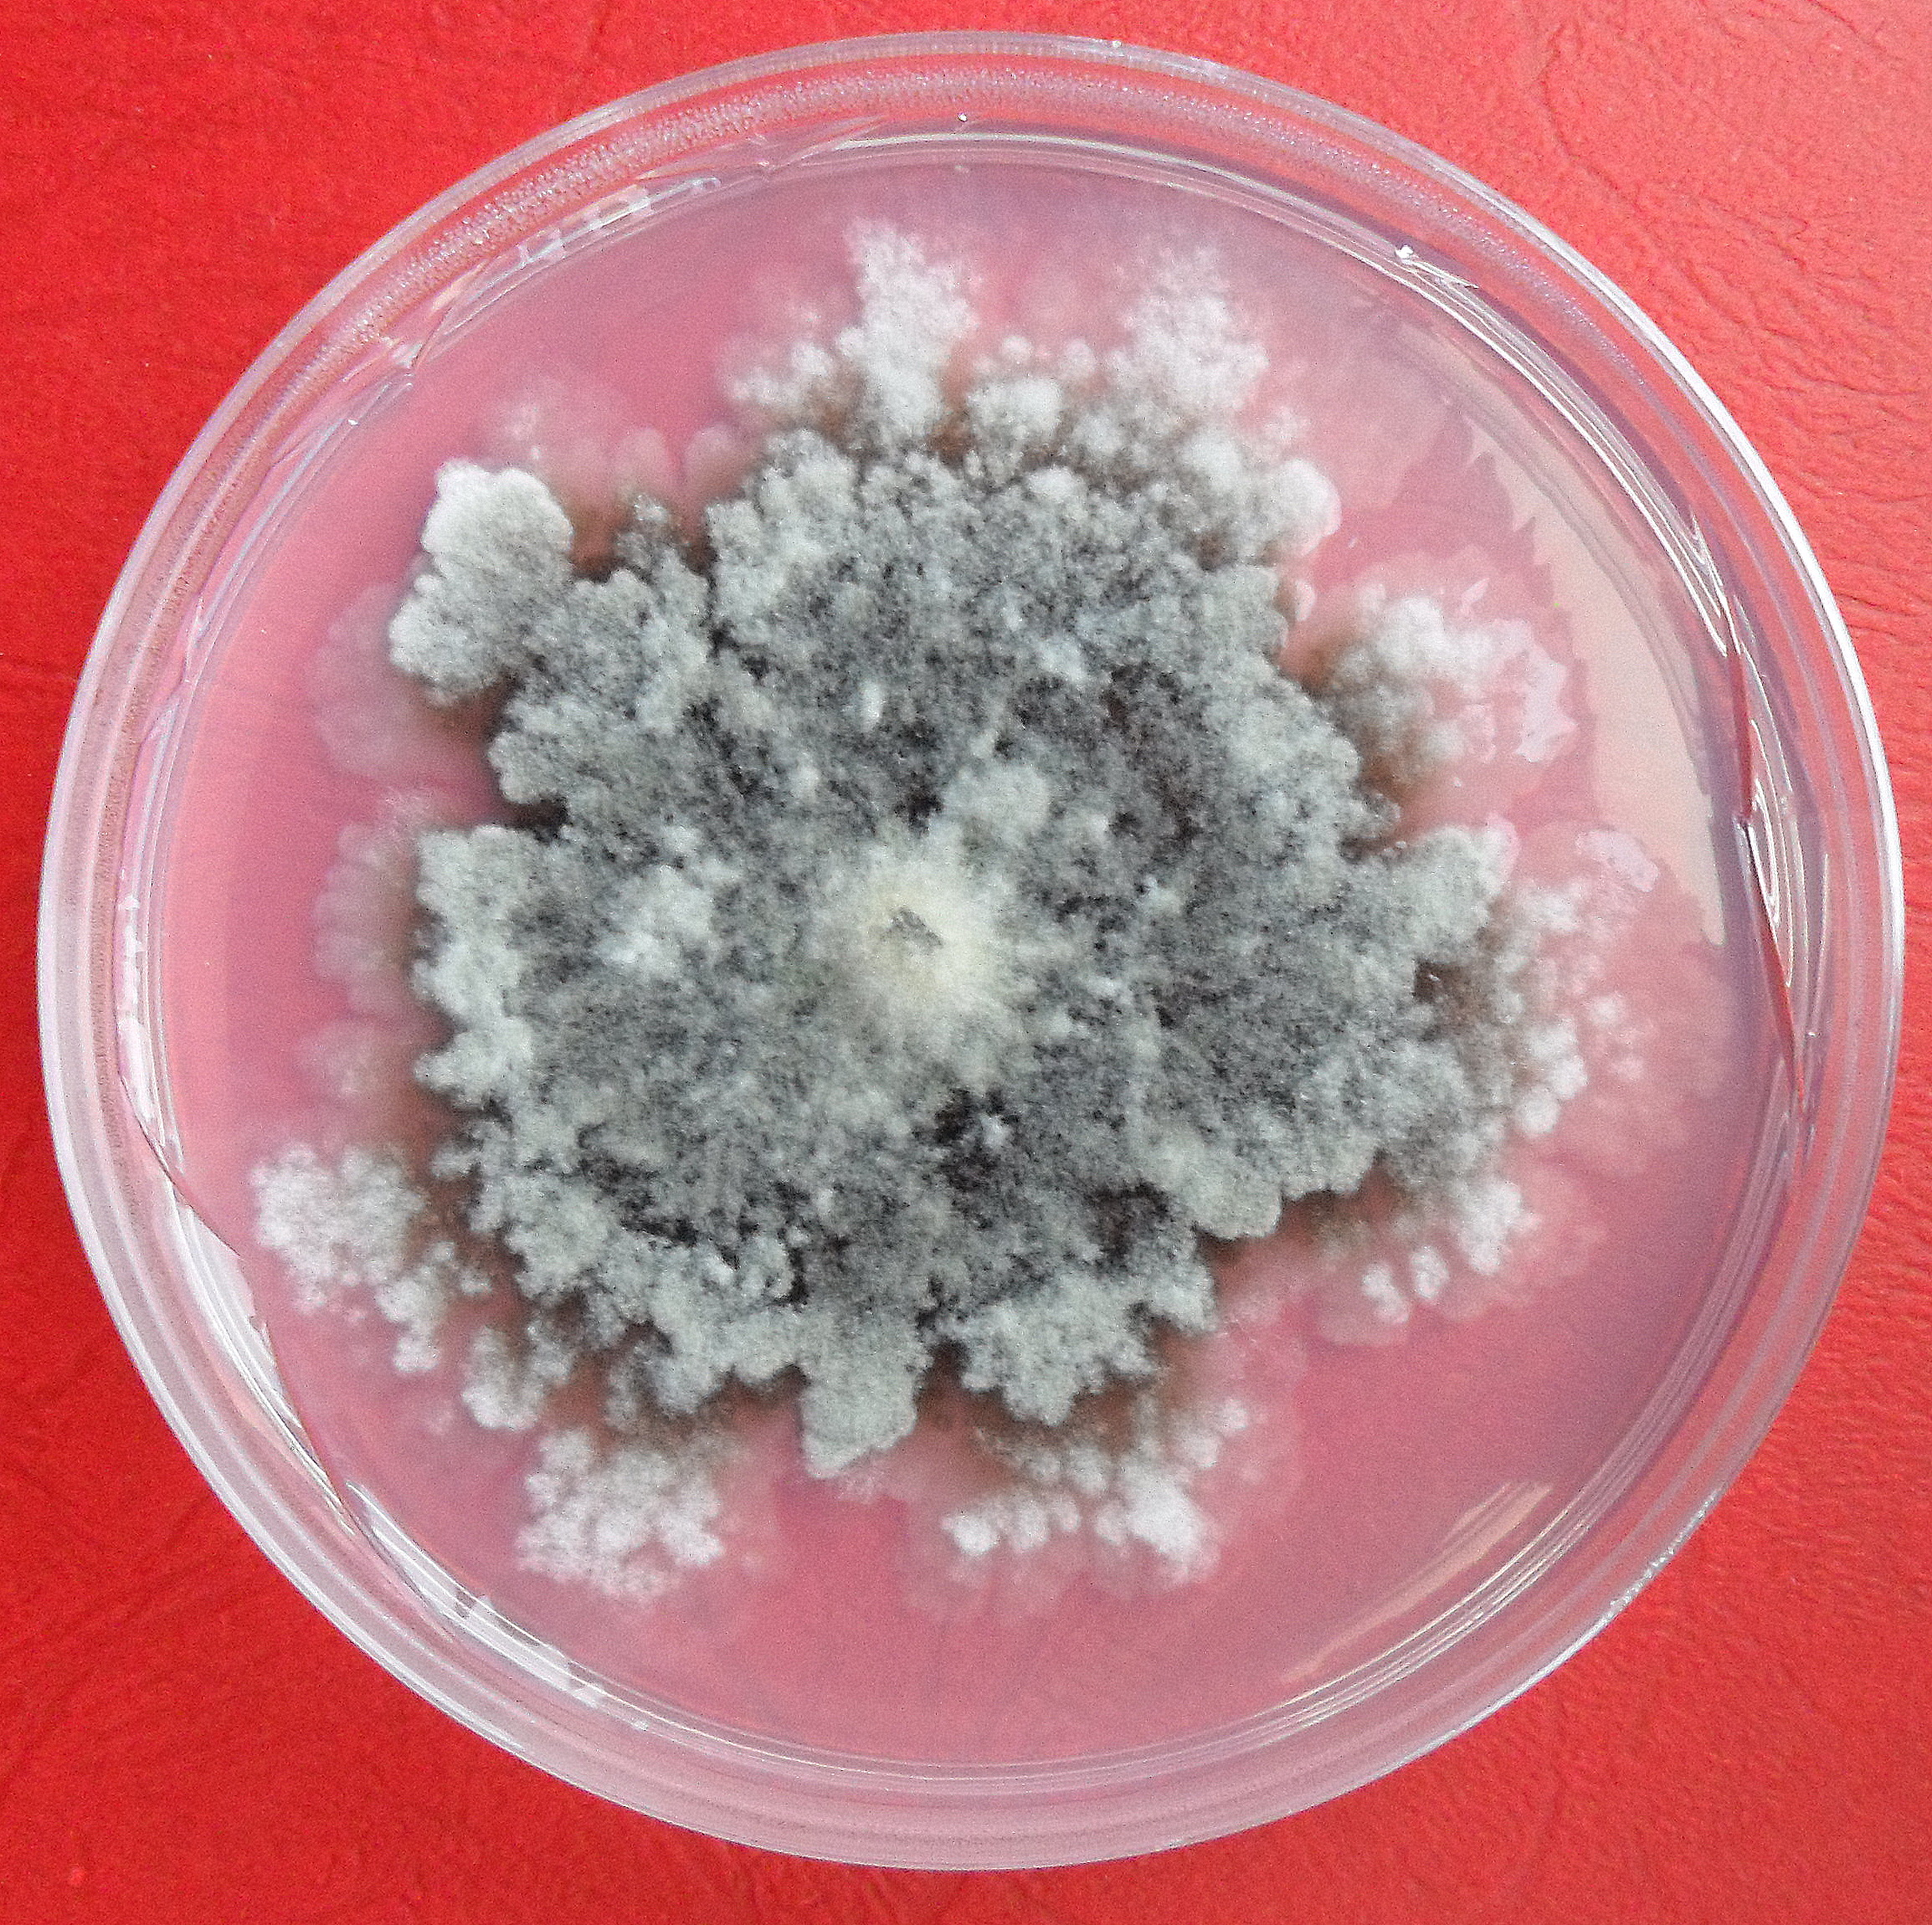
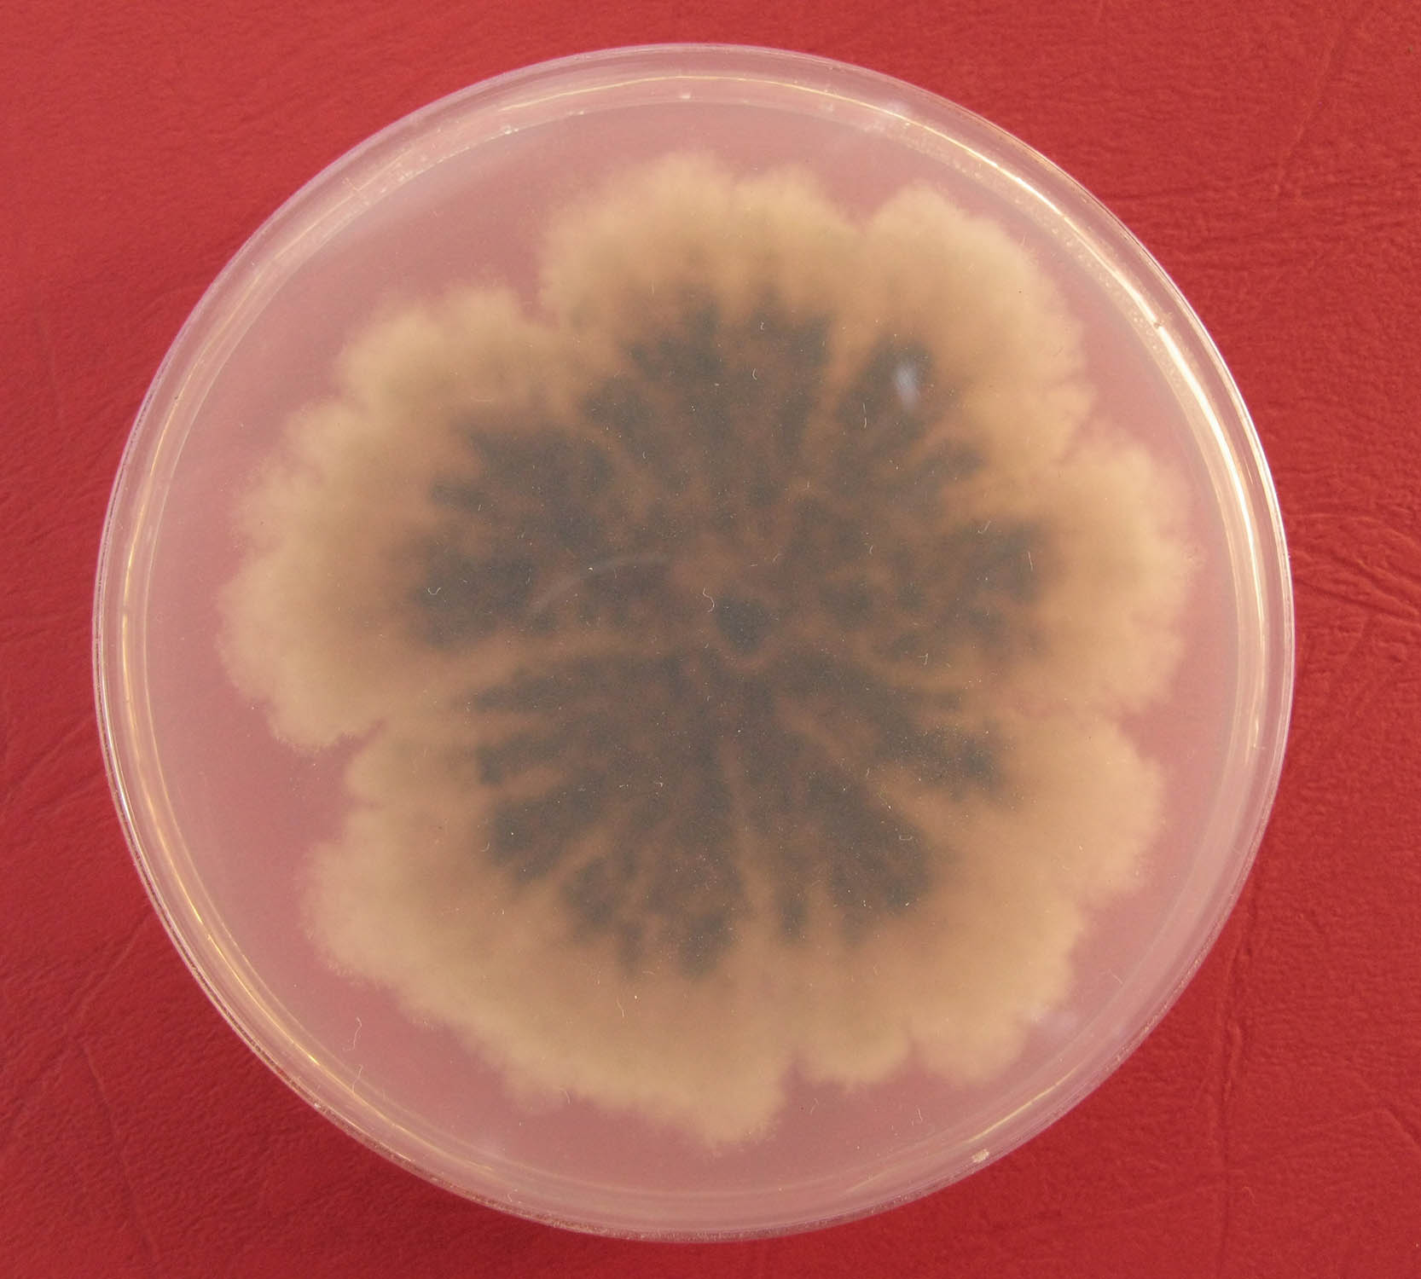
Monilinia polystroma Biology and Disease
Apothecia unimportant in life history– rare to never observed in nature
M. polystroma excessive stromatal plates in culture – enhance survival?
Anna Poniatowska
Anna Poniatowska
Notes:
Typical summer diseases can include:
Phomopsis fruit rot & Alternaria leaf spot, which I couldn’t find pictures of on peach
Anthracnose (characterized by sunken firm concentric ringed lesions filled with salmon colored spores & powdery mildew – see more easily on green fruit as powdery white leasions
Peach scab which appears as fuzzy slightly raised olive colored spots & Peach shot hole (Coryneum Blight) which on fruit produces a very dark sunken lesion

Slide 17
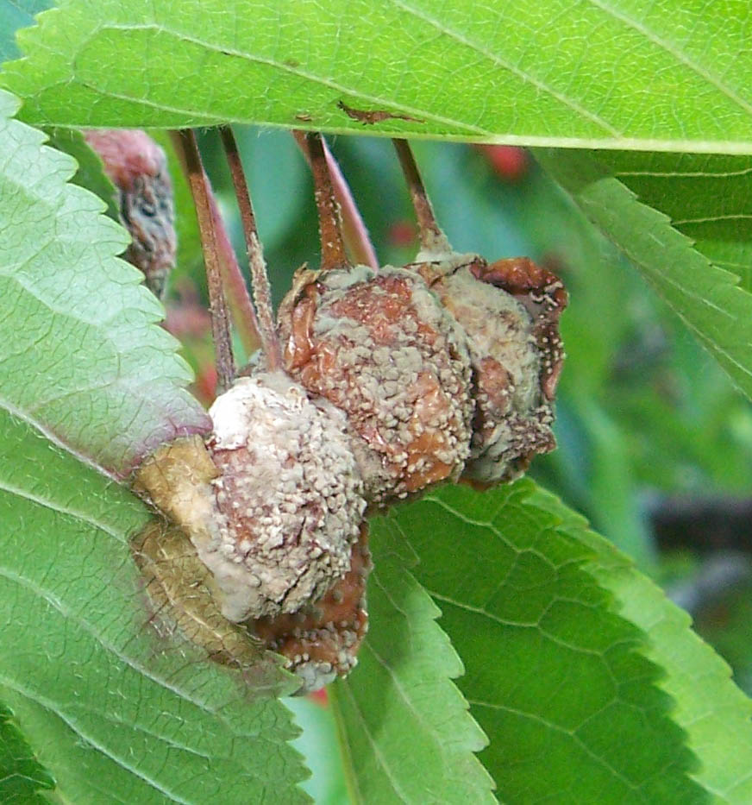
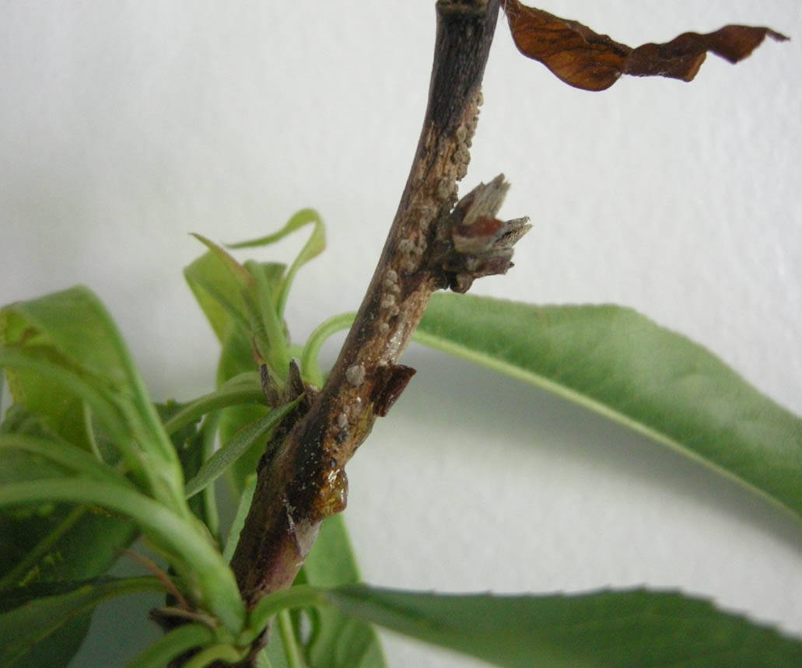
Monilinia polystroma Biology and Disease
M. polystroma make slightly larger conidia than M. fructigena
Survives on mummified fruit or in cankers
Notes:
Typical summer diseases can include:
Phomopsis fruit rot & Alternaria leaf spot, which I couldn’t find pictures of on peach
Anthracnose (characterized by sunken firm concentric ringed lesions filled with salmon colored spores & powdery mildew – see more easily on green fruit as powdery white leasions
Peach scab which appears as fuzzy slightly raised olive colored spots & Peach shot hole (Coryneum Blight) which on fruit produces a very dark sunken lesion

Slide 18
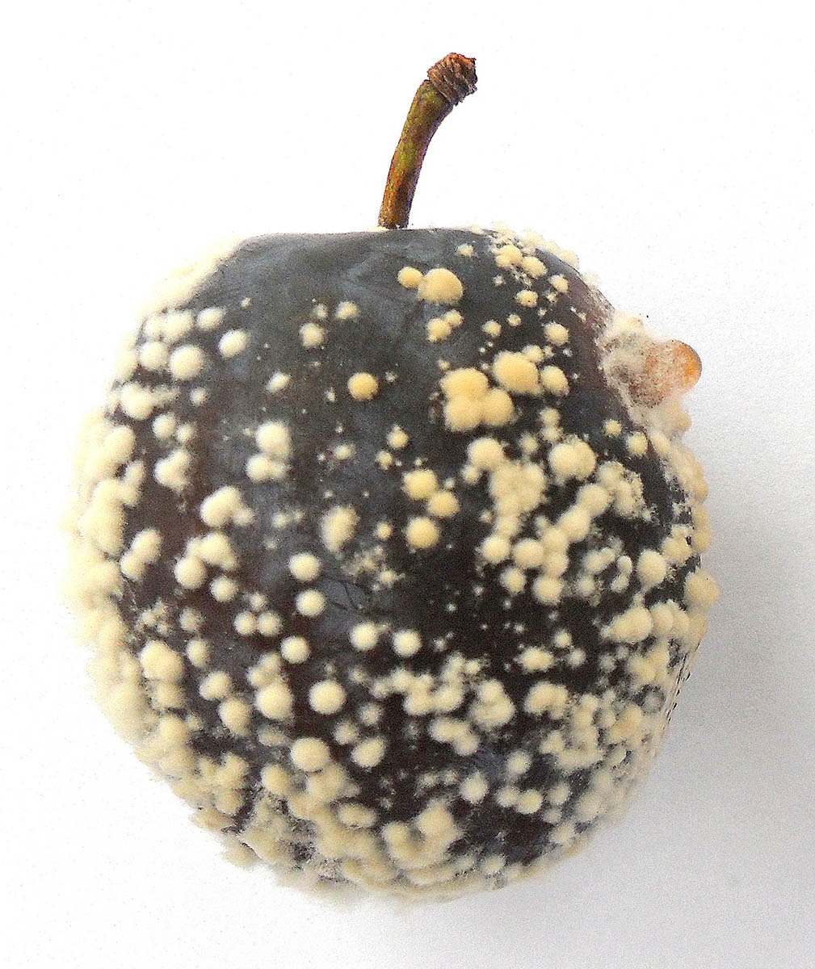
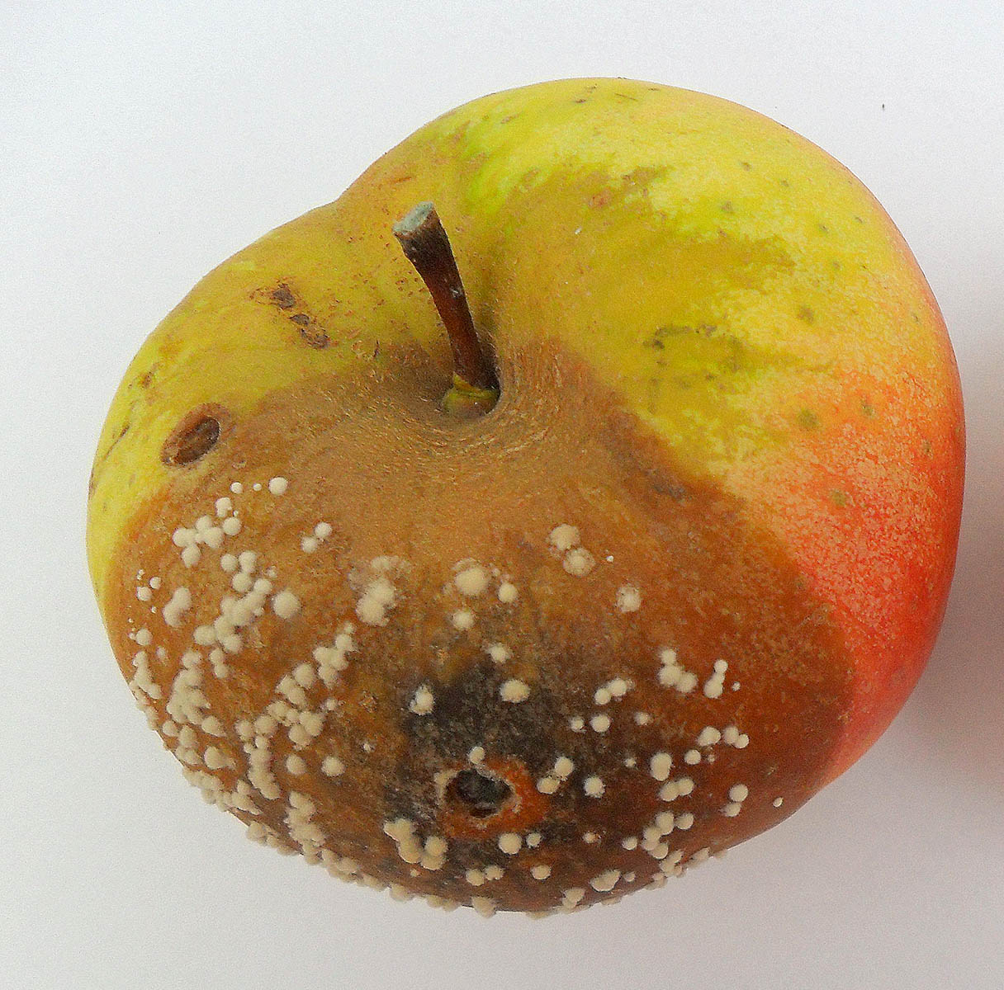
Monilinia polystroma Biology and Disease
M. polystroma is similar M. fructigena in terms of it’s ability to cause disease
Identical in latent period, lesion expansion, and sporulation
Both less aggressive than M. laxa and M. fructicola
Anna Poniatowska
Notes:
Typical summer diseases can include:
Phomopsis fruit rot & Alternaria leaf spot, which I couldn’t find pictures of on peach
Anthracnose (characterized by sunken firm concentric ringed lesions filled with salmon colored spores & powdery mildew – see more easily on green fruit as powdery white leasions
Peach scab which appears as fuzzy slightly raised olive colored spots & Peach shot hole (Coryneum Blight) which on fruit produces a very dark sunken lesion

Slide 19
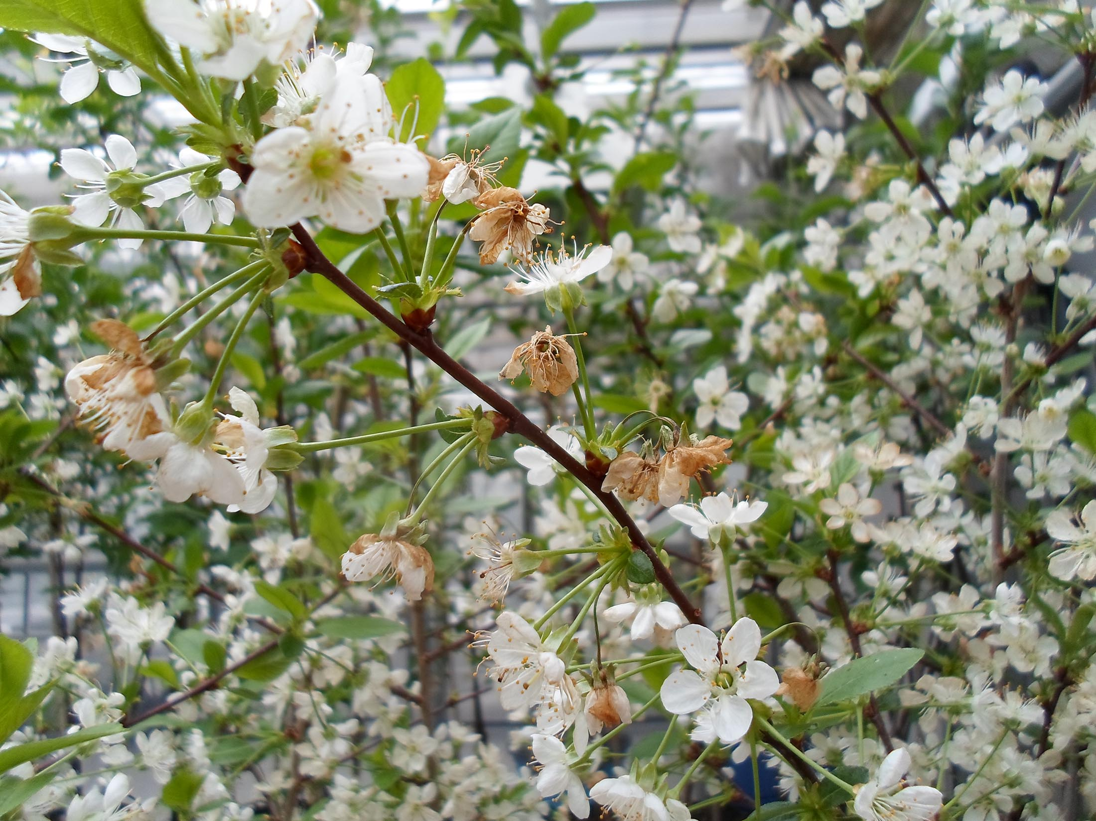
Monilinia polystroma Biology and Disease
Infection of stone fruit:
Warm weather & humidity causes sporulation of infested tissues in spring
Spores spread from cankers & mummies to blossoms and later fruit by wind/rain
Infections severe during warm wet weather near harvest when fruit accumulate sugar
M. Polystroma blossom blight & fruit rot Anna Poniatowska
Notes:
Typical summer diseases can include:
Phomopsis fruit rot & Alternaria leaf spot, which I couldn’t find pictures of on peach
Anthracnose (characterized by sunken firm concentric ringed lesions filled with salmon colored spores & powdery mildew – see more easily on green fruit as powdery white leasions
Peach scab which appears as fuzzy slightly raised olive colored spots & Peach shot hole (Coryneum Blight) which on fruit produces a very dark sunken lesion

Slide 20
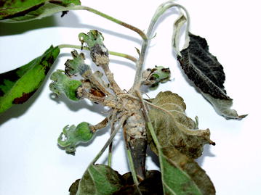
Monilinia polystroma Biology and Disease
Infection of apples:
Infections of susceptible apple cultivars primarily near harvest: starch > sugar
Infection occurs through wounds by rubbing, insects, or birds
Rare: infection of immature fruit clusters for certain apple cultivars > covered with thick yellowish stromata
M. Polystroma brown fruit rot
Anna Poniatowska
M. Polystroma infection of fruit clusters - T. Szabó
Notes:
Typical summer diseases can include:
Phomopsis fruit rot & Alternaria leaf spot, which I couldn’t find pictures of on peach
Anthracnose (characterized by sunken firm concentric ringed lesions filled with salmon colored spores & powdery mildew – see more easily on green fruit as powdery white leasions
Peach scab which appears as fuzzy slightly raised olive colored spots & Peach shot hole (Coryneum Blight) which on fruit produces a very dark sunken lesion

Slide 21
Monilinia polystroma Biology and Disease
Apples & Stone fruit:
Infections of apple & stone fruit most prevalent in organic or reduced fungicide operations in Europe
Europe becoming more restrictive on fungicide conventional fungicide use > increased issues pathogens like M. polystroma
Monilinia infections of apples rare in US except in plantings with reduced cover applications of conventional single-site fungicides (e.g. DMIs, QoIs, SDHIs)
Notes:
Typical summer diseases can include:
Phomopsis fruit rot & Alternaria leaf spot, which I couldn’t find pictures of on peach
Anthracnose (characterized by sunken firm concentric ringed lesions filled with salmon colored spores & powdery mildew – see more easily on green fruit as powdery white leasions
Peach scab which appears as fuzzy slightly raised olive colored spots & Peach shot hole (Coryneum Blight) which on fruit produces a very dark sunken lesion

Slide 22
Outline
Brown rot of stone fruit
Monilinia species causing brown rot
Monilinia polystroma
Differentiation
Distribution
Biology & disease
Management
Risk & Recovery

Slide 23
Monilinia polystroma Management
M. polystroma can be managed similarly to M. fructicola
Apples: use single-site fungicides (QoI, DMI, SDHI, APs) at petal fall and late summer covers to manage endemic apple diseases (i.e. apple scab, FSSB, bitter & black rot) 3 applications minimum
Organic apples: organic sulfur & copper cover application at petal fall and before pre-harvest rains
Notes:
Typical summer diseases can include:
Phomopsis fruit rot & Alternaria leaf spot, which I couldn’t find pictures of on peach
Anthracnose (characterized by sunken firm concentric ringed lesions filled with salmon colored spores & powdery mildew – see more easily on green fruit as powdery white leasions
Peach scab which appears as fuzzy slightly raised olive colored spots & Peach shot hole (Coryneum Blight) which on fruit produces a very dark sunken lesion

Slide 24
Monilinia polystroma Management
Stone fruit:
Bloom: > 60 ºF (16 ºC) + rain at bloom
Iprodione: up 48hrs kick back, 2 sprays/season
Chlorothalanil: up to ‘shuck split’ (petal/sepal split)
1 app. (QoI) Trifloxystrobin or (DMI) fenbuconazole or difenoconazole
Post Bloom: apply fungicide to green fruit prior to pit hardening depending on host & rainfall
Pre-harvest: Rotate DMI, QoI, AP, & SDHI fungicides until harvest on a 10-14 day interval
Notes:
Typical summer diseases can include:
Phomopsis fruit rot & Alternaria leaf spot, which I couldn’t find pictures of on peach
Anthracnose (characterized by sunken firm concentric ringed lesions filled with salmon colored spores & powdery mildew – see more easily on green fruit as powdery white leasions
Peach scab which appears as fuzzy slightly raised olive colored spots & Peach shot hole (Coryneum Blight) which on fruit produces a very dark sunken lesion

Slide 25
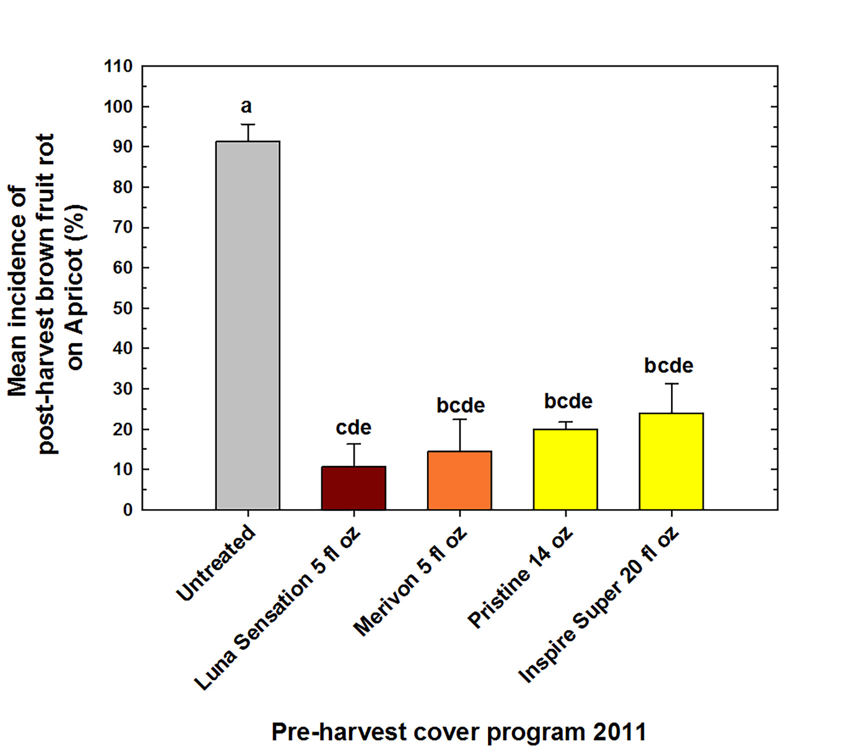
Monilinia polystroma Management
Newer QoI, DMI, SDHI fungicides effective against brown fruit rot
Notes:
Typical summer diseases can include:
Phomopsis fruit rot & Alternaria leaf spot, which I couldn’t find pictures of on peach
Anthracnose (characterized by sunken firm concentric ringed lesions filled with salmon colored spores & powdery mildew – see more easily on green fruit as powdery white leasions
Peach scab which appears as fuzzy slightly raised olive colored spots & Peach shot hole (Coryneum Blight) which on fruit produces a very dark sunken lesion

Slide 26
Outline
Brown rot of stone fruit
Monilinia species causing brown rot
Monilinia polystroma
Differentiation
Distribution
Biology & disease
Management
Risk & Recovery

Slide 27
Risk & Recovery
Risk of M. polystroma establishment
Risk map based on pome acreage & suitable temperate climate
Apple growers in high risk areas:
Rarely have apple brown rot (even on diversified farms)
Have summer cover programs with single-site fungicides > effective against Monilinia
Little interest in varieties eastern of European breeding programs
Notes:
Typical summer diseases can include:
Phomopsis fruit rot & Alternaria leaf spot, which I couldn’t find pictures of on peach
Anthracnose (characterized by sunken firm concentric ringed lesions filled with salmon colored spores & powdery mildew – see more easily on green fruit as powdery white leasions
Peach scab which appears as fuzzy slightly raised olive colored spots & Peach shot hole (Coryneum Blight) which on fruit produces a very dark sunken lesion

Slide 28
Risk & Recovery
Risk of M. polystroma establishment
M. fructicola likely to outcompete M. polystroma
M. fructicola populations established in high risk areas & often more aggressive
M. fructicola populations in high risk areas often have resistance to multiple fungicide classes
M. polystroma from EU organic apples > likely to have not been exposed to many fungicides
Proactive surveying for invasive Monilinia spp. by NYS-IPM & regional extension specialists (> 5 years)
Notes:
Typical summer diseases can include:
Phomopsis fruit rot & Alternaria leaf spot, which I couldn’t find pictures of on peach
Anthracnose (characterized by sunken firm concentric ringed lesions filled with salmon colored spores & powdery mildew – see more easily on green fruit as powdery white leasions
Peach scab which appears as fuzzy slightly raised olive colored spots & Peach shot hole (Coryneum Blight) which on fruit produces a very dark sunken lesion

Slide 29
Risk & Recovery
Recovery recommendations
Inspection and rejection of imported bud wood with shoot cankers & fruit mummies
>1 season of field certification of imported bud wood from countries with M. polystroma
Single-site fungicide program: Bloom application in stone fruit or Petal fall application in apples with 2-3 applications during pre-harvest covers with fungicide class rotation
Removal of any fruit mummies & molecular testing for species
Notes:
Typical summer diseases can include:
Phomopsis fruit rot & Alternaria leaf spot, which I couldn’t find pictures of on peach
Anthracnose (characterized by sunken firm concentric ringed lesions filled with salmon colored spores & powdery mildew – see more easily on green fruit as powdery white leasions
Peach scab which appears as fuzzy slightly raised olive colored spots & Peach shot hole (Coryneum Blight) which on fruit produces a very dark sunken lesion

Slide 30
Acknowledgements
Recovery plan co-authors & contributors from
Sara Villani, North Carolina State University
Guido Schnabel, Clemson University
Anna Poniatowska, Research Institute of Horticulture, Skierniewice, Poland
Imre Holb, University of Debrecen, Debrecen, Hungary

Slide 31
Questions

